Slide 1
Reassessment Report
A How to Guide

Slide 2
Reassessment Report
Select Reports from the toolbar in SAMS
Once the report screen is populated you will left click Report Types on the top right of the screen
From the drop down menu, check the box next to Assessments, by left clicking on the box, then left click on Apply

Slide 3
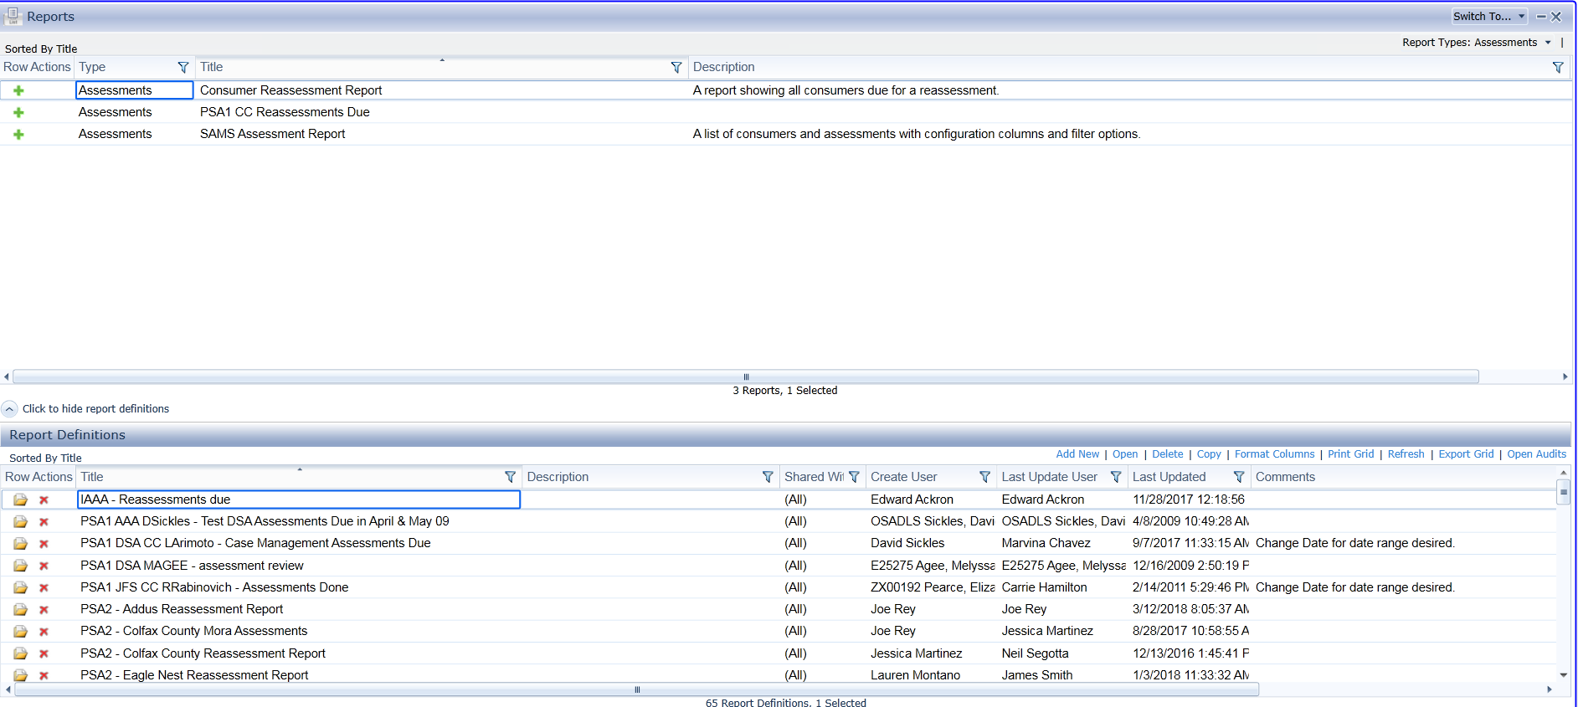
Reassessment Report
Your screen will automatically repopulate and should look like this

Slide 4
Reassessment Reports
If your screen looks different, there may be a filter still set that will need to be cleared
Usually the Filter Icon will be darkened if there is a filter in place.
You can always click on the filter Icon on any column, box similar to this one will appear and click on clear filter, if you see an option to clear all filters this indicates that there is more than one filter, so you would select clear all filters to clear all the filters.

Slide 5
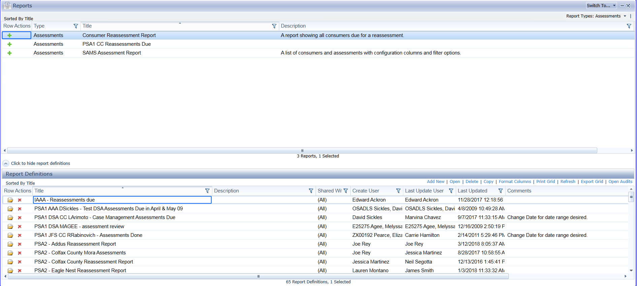
Reassessment Reports
Once all filters have been cleared, you will need to choose the report Named Consumer Reassessment Report by left clicking once so it highlights blue, now the bottom half of the screen will populate with those report definitions.

Slide 6
Reassessment Report
Under report definitions scroll down until you find the correct PSA for your organization, then continue to scroll until you see your organization name.
You could also click on the Filter Icon for the Title column and type in your PSA and organizations name.
Example: PSA3 – Hobbs

Slide 7
Reassessment Report
Once you have the correct report you will need to either double click on the name to open or left click on the folder to the left of the name to open it.
once you open the report you will see a screen like this, please click on the blue link that says Open

Slide 8
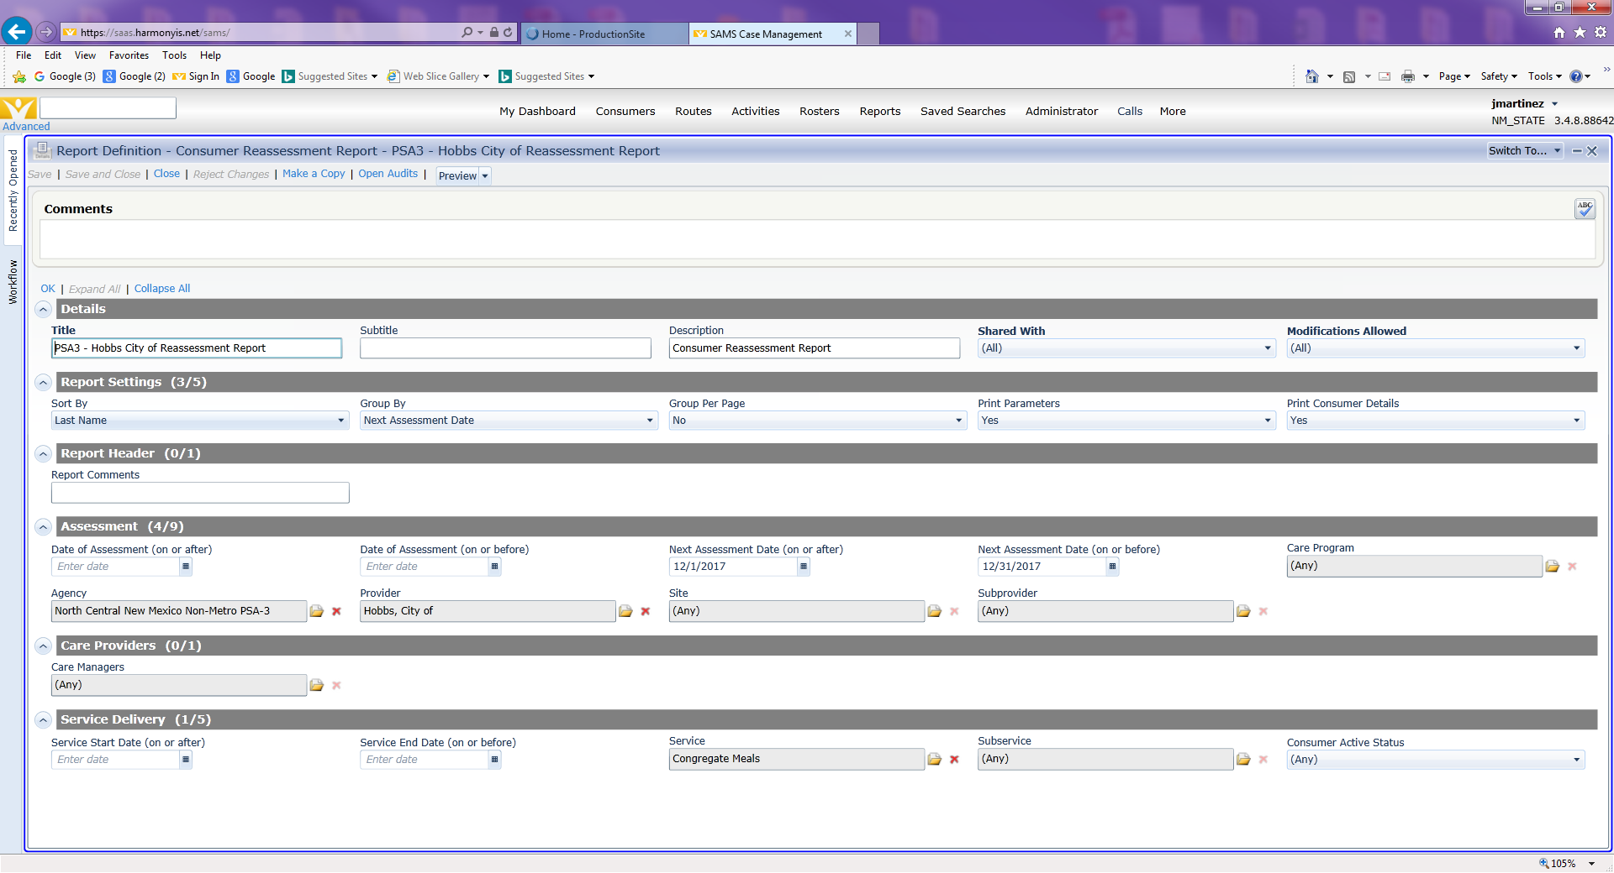
Reassessment Report
Once opened you will see a screen similar to this. Please note if any of the arrows to the left of the parameters is pointing up please click it so that it expands the fields.

Slide 9
Reassessment Report
Now that the fields have been expanded, locate the one that is titled Assessment (4/9)
change the dates in the following fields to the dates you are wanting. They are the fields labeled
Next assessment date (on or after)
Next assessment date (on or before) as shown below.

Slide 10
Reassessment Report
Once you have selected the dates you can preview and print your reports by
Left clicking on the down arrow next to the word preview and selecting adobe PDF or one of the others that you wish to use.
Once selected a window should pop up stating it is generating your reports.
Once the report is generated you can preview and print it.

Slide 11
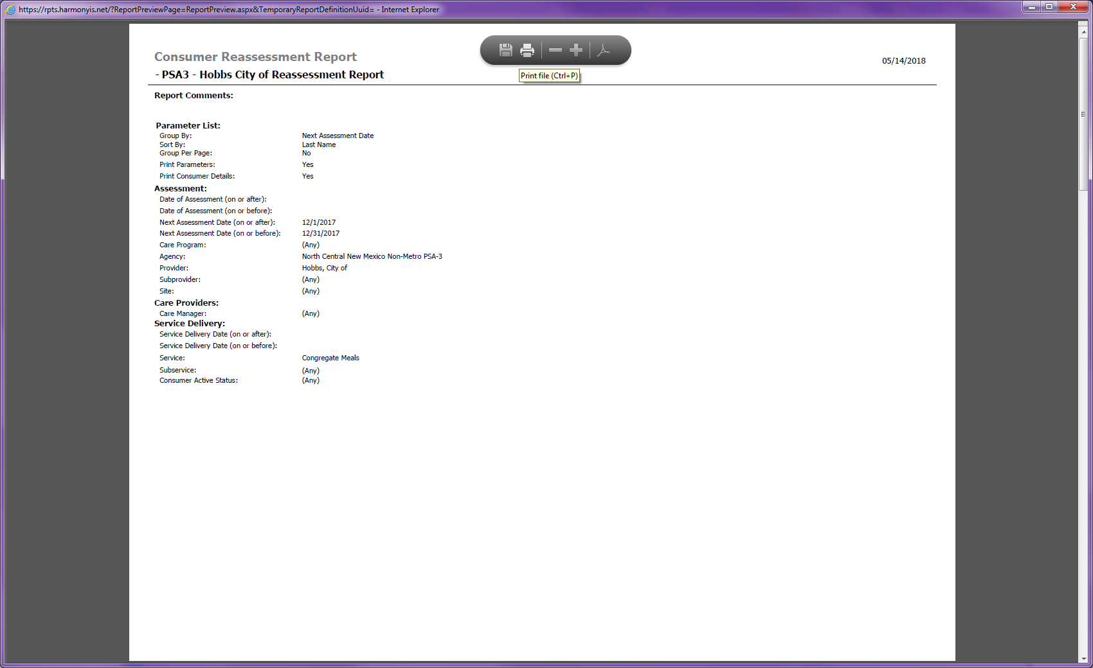
Reassessment Report
Once the report is generated, you can print it
After you print the report you can close out of the preview by using the X in the top right corner and return to the report screen at which time you can close, save and close or reject changes.
You are now finished printing your assessment report. Please note that this report will show everyone that needs to be reassessed within the dates you select for the services such as ADC, Congregate, HD Meals, and Transportation.

