Slide 1

NM-AAA Training #5
Wellness Check: Stress, Mental Health, Self-Care, and Sleep Hygiene
Constance Rudnicki, MS, RDN, LD
Registered Dietitian/Nutritionist
Non-Metro Agency Area on Aging

Slide 2
Objectives
The student will learn what stress is.
The student will learn about stress management
The student will learn about mental health
The student will learn about self-care

Slide 3
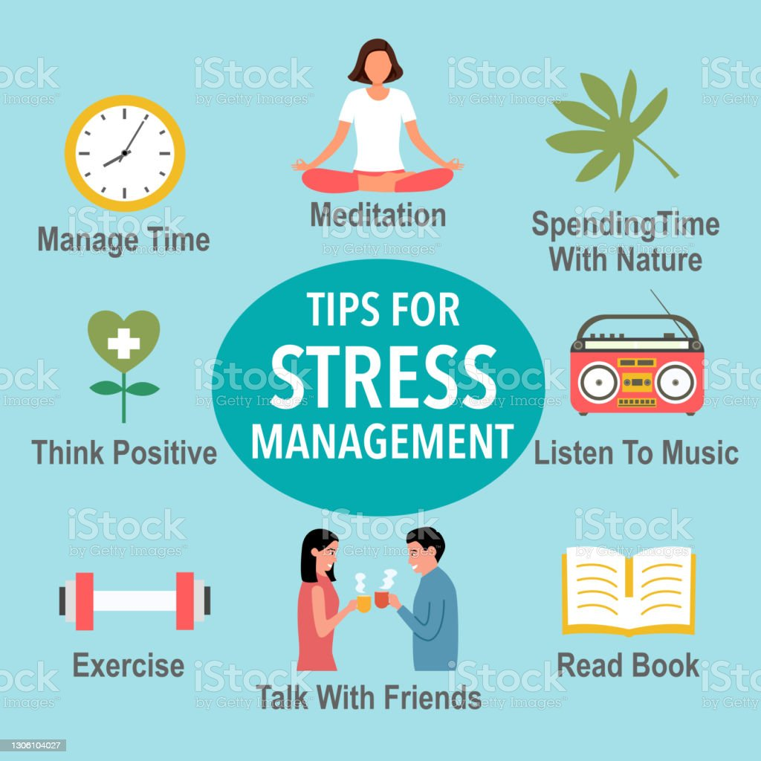
Part 1: Managing Stress and Stress Management

Slide 4
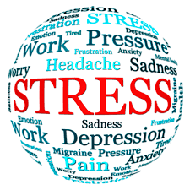
Now more than ever, stress can feel like an ever-present part of life.
Whether you work in an office or factor, or manage a home and watch the children with a lot of energy, each week can bring a number of stressful situations. Particular stressors can affect some groups disproportionately. And that's not to mention the ongoing pandemic. COVID-19, its economic impact, and the social isolation of lockdowns affected the mental health of many Americans.

Slide 5
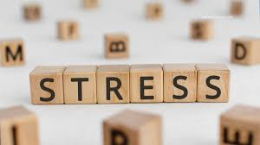
What is stress?
Stress is an automatic physical, mental, and emotional response to a challenging event.
It's a normal part of everyone's life. When used positively, stress can lead to growth, action, and change.
But long-term negative stress can decrease your quality of life.

Slide 6
Is stress really a problem?
In a word, yes. Especially if your feeling of "stress" remains constant or chronic. Chronic stress can affect your physical and mental health.
It can weaken your immune system and cause uncomfortable physical symptoms as well.

Slide 7
Is stress really a Problem Cont?
Talking about stress and its impact on our lives is still taboo.
That's especially true for some groups:
Among Black and Latino communities,
for example, recognizing stress can be seen as inconsistent with a strong work ethic.
Many in the Black and Latino communities may not feel they have the luxury of worrying about stress management.

Slide 8
Common Causes of Stress:
When Americans are asked to cite what is causing them stress.
money
work
health problems, and
family responsibilities (caregiving can be particularly stressful).
These responses span generations and groups and have remained unchanged for years.

Slide 9
you're most vulnerable to stress When:
  Not getting enough sleep
  Not having a support network
  Experiencing a major life change,
  such as moving,
  the death of a loved one,
  starting a new job,
  having a child
  Getting married
  Experiencing poor physical health
  Not eating well

Slide 10
How does stress affect the body??
Stress can have lasting effects on your health and well-being.
"These health effects affect some groups disproportionately: women, for example, are more than twice as likely to be diagnosed with depression compared to men."

Slide 11
How stress affects you continued
When you experience long-term stress, your brain is exposed to higher levels of a hormone called cortisol.
This exposure weakens your immune system, which makes it easier for you to get sick.
Knowing what situations cause it is the first step in coping with this very common experience.
Notes:
Stress can contribute to worsening the symptoms of your mental illness.
For example, in schizophrenia, it can encourage hallucinations and delusions, while in bipolar disorder, it can trigger episodes of mania and depression.

Slide 12
How stress affects you:
,
Stress affects:
Your whole body
Mentally
Physically
Signs include:
Headaches
Difficulty sleeping
Jaw pain
Changes in appetite
Frequent mood swings
Difficulty concentrating
Feeling overwhelmed

Slide 13
How stress affects you continued
digestive problems
anxiety
depression
trouble sleeping
weight gain
memory problems
high blood pressure
heart disease and stroke

Slide 14
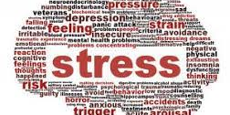
Stress Management: What Can You Do About It?
Stress is a fact of life. A 2017 American Psychological Association survey found that a whopping 71% of respondents reported experiencing at least one symptom of stress over the past month. And the stressors of the COVID-19 pandemic only made things worse..

Slide 15
Why should we try to manage stress?
Chronic stress is bad for you. Period. Point.
Therefore, it stands to reason that reducing your stress will reduce your risk of the damaging effects of stress on physical and mental health.
A constant state of stress can undermine your creativity, productivity, and motivation.
You want to manage stress so you can live your best life.

Slide 16
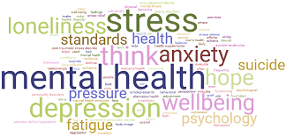
What is stress management?
“set of techniques and programs aimed at helping people deal more effectively with stress in their lives by analyzing specific stressors and taking positive steps to minimize their effects."
(Gale Encyclopaedia of Medicine, 2008).

Slide 17
Stress management
So what can we do about stress?
Small changes that combat stress are easy to try.
Check out this list for stress relief:
Find a friend
Move more
Go to sleep
Being with the breath

Slide 18
ADDITIONAL Ways to reduce stress
Accept
accepts your needs.
Manage
Manage your time.
Practice
Practice relaxation.
Exercise
Exercise daily. Exercise
Reserve
Set aside time for yourself.
Eat
Eat well.
Get
Get enough sleep.
Avoid
Avoid alcohol and drugs.
Talk
Talk to someone.
Notes:
accepts your needs. Recognize what your triggers are. What situations make you feel physically and mentally agitated? Once you know this, you can avoid them when it's reasonable and cope when you can't.
Manage your time. Prioritizing your activities can help you use your time well. Making a daily schedule helps ensure you don't feel overwhelmed by everyday tasks and deadlines.
Practice relaxation. Deep breathing, meditation, and progressive muscle relaxation are good ways to calm down. Taking a break to refocus can have benefits beyond the immediate moment.
Exercise every day. Schedule time to walk outside, bike, or join a dance class. Whatever you do, make sure it's fun. Daily exercise naturally produces hormones to relieve stress in your body and improves your overall physical health.
Set aside time for yourself. Schedule something that makes you feel good. It can be reading a book, going to the movies, getting a massage or taking your dog for a walk.
Eat well. Eating unprocessed foods, such as whole grains, fresh vegetables, and fruits is the foundation for a healthy body and mind. Eating well can also help stabilize your mood.
Get enough sleep. Symptoms of some mental health conditions, such as mania in bipolar disorder, can be triggered by too little sleep.
Avoid alcohol and drugs. They don't actually reduce stress: in fact, they often make it worse. If you are struggling with substance abuse, educate yourself and get help.
Talk to someone. Whether it's with friends, family, a counselor, or a support group, venting and talking can help. Consider attending an NAMI Connection Recovery Support Group.

Slide 19
13 different stress management techniques and strategies
The techniques are classified into three groups:
Action-oriented approaches: used to take action to change a stressful situation
Emotion-oriented approaches: used to change the way we perceive a stressful situation
Acceptance-oriented approaches: used to deal with stressful situations you can't control

Slide 20
Action-Orientated Approaches
Be Assertive
Reduce the noise
Manage your time
Creating boundaries
Get out of your head

Slide 21
Emotion-oriented approaches
Affirmations and images
Cognitive restructuring
ABC Technique
A=Adversity
B=Beliefs
C=Consequences

Slide 22

Example of ABC technique

Slide 23
Acceptance-oriented approaches
Diet and exercise
Mediation and physical relaxation
Building resilience
Sleep

Slide 24

Guided Visualization: Dealing with Stress

Slide 25
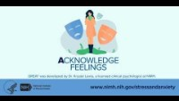
Quick and helpful practices for managing stress and anxiety

Slide 26
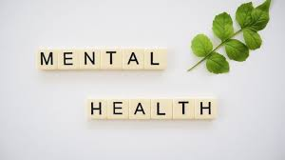
Part 2: Mental Health

Slide 27
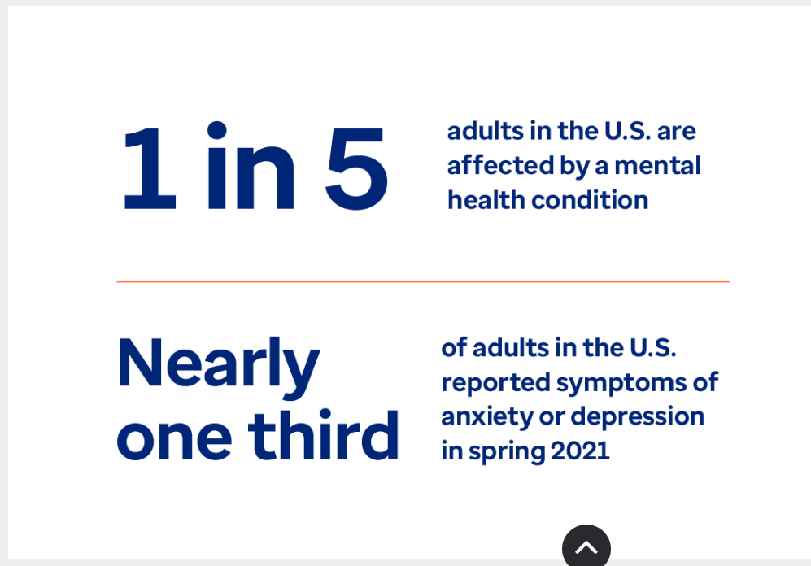

Slide 28
What is mental health?
It includes emotional, psychological and social well-being.
Affect the way we think, feel, act, make decisions, and relate to others
Mental health is more than the absence of mental illness
Essential to your overall health and quality of life.
Self-care can play a role in maintaining your mental health
help support your treatment and recovery if you have a mental illness.

Slide 29
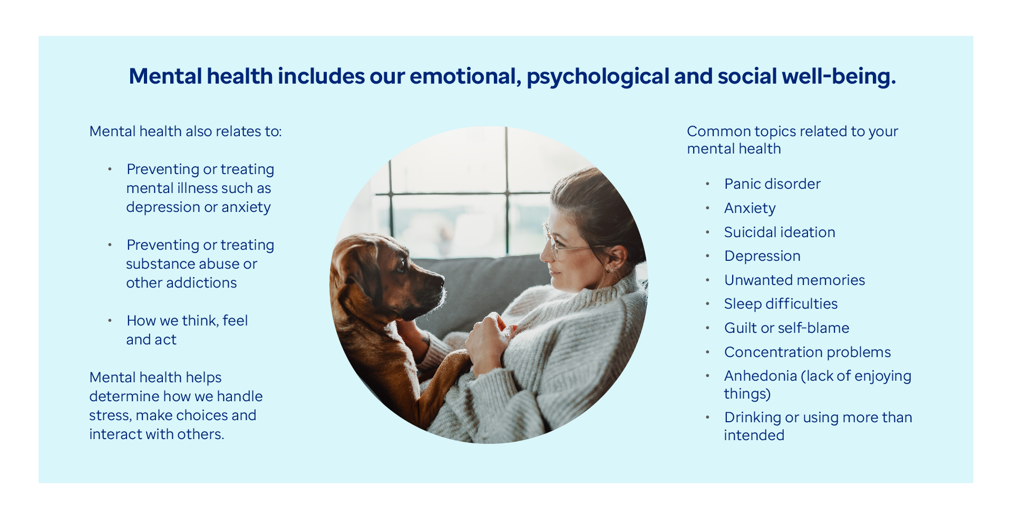

Slide 30
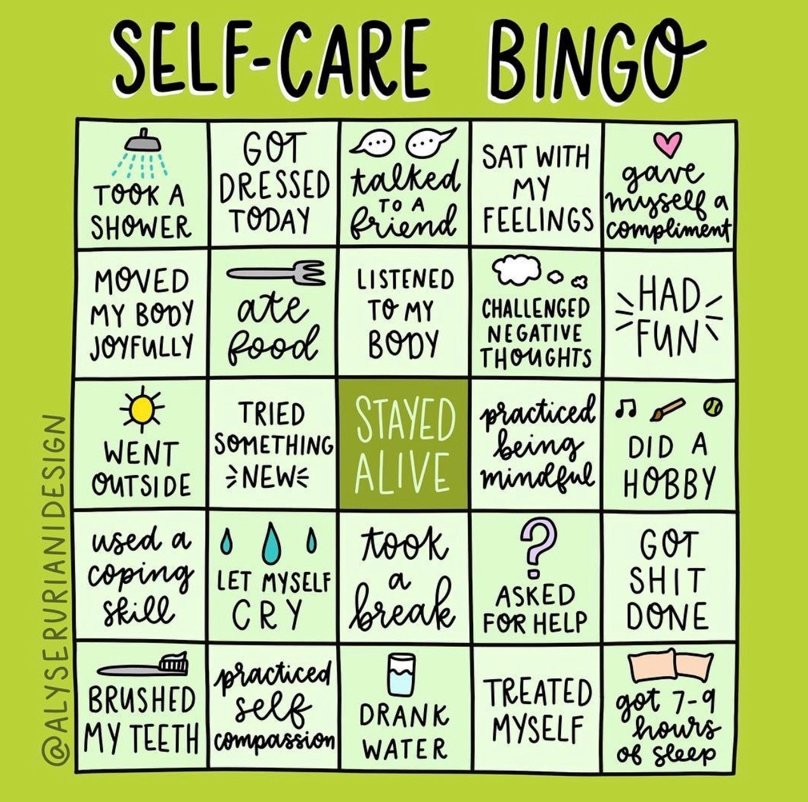
Part 3:Self Care
"What soap is to the body, laughter is to the soul." ~ Yiddish Proverb

Slide 31
What is self-care?
Take the time to do things that help you live well and improve both your physical health and mental health.
When it comes to your mental health, self-care can help you manage stress, reduce your risk of illness, and boost your energy.
Even small acts of self-care in your daily life can have a big impact.

Slide 32
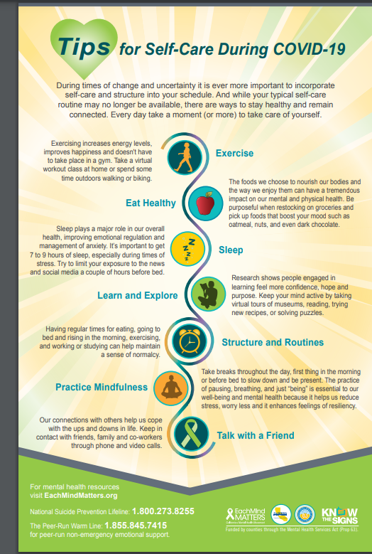
Self Care Tips

Slide 33
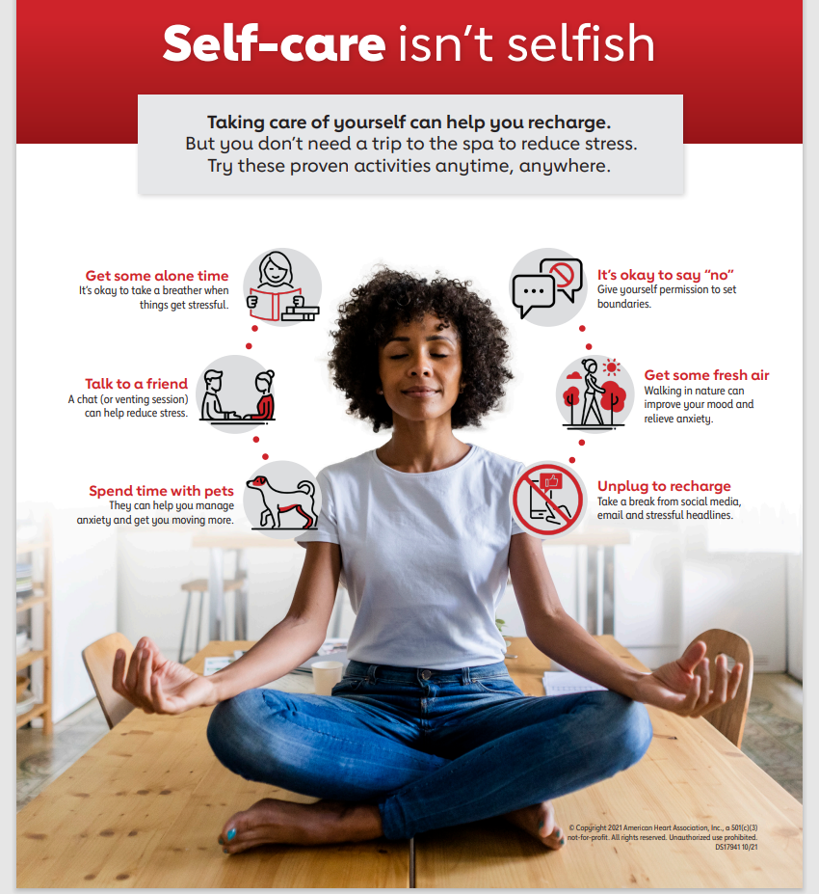

Slide 34


Slide 35
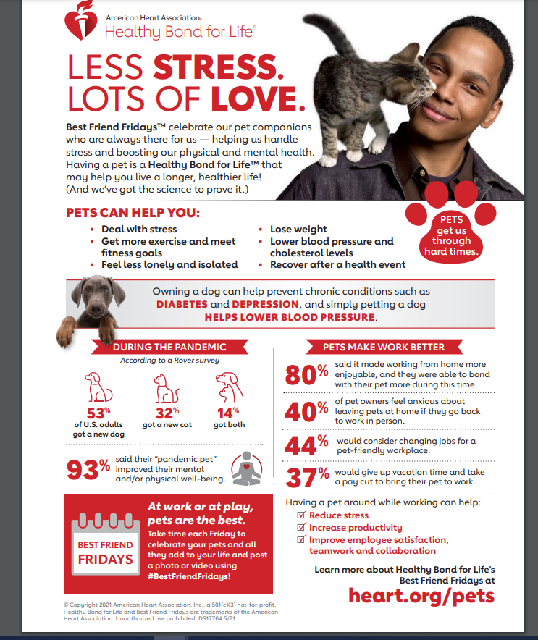

Slide 36
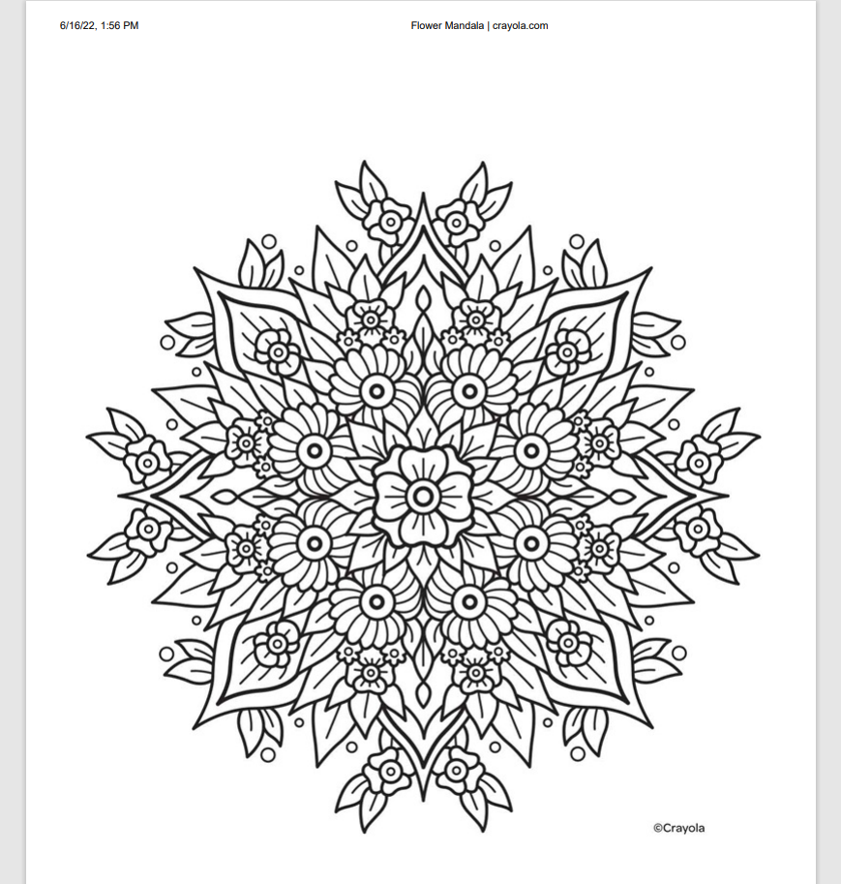

Slide 37


Slide 38
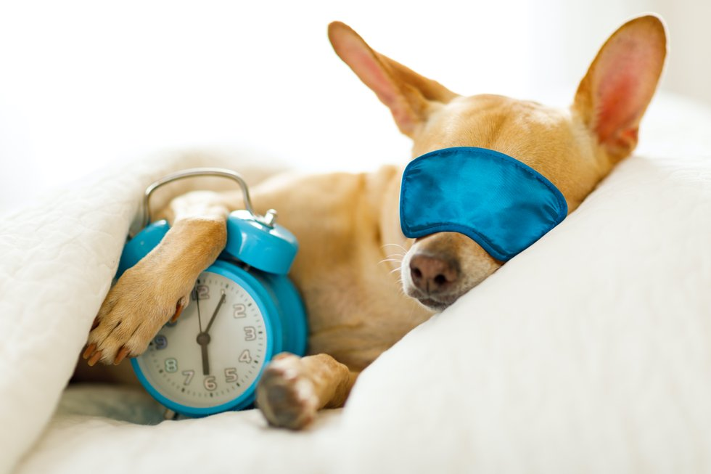
Part 4: Sleep Hygiene

Slide 39
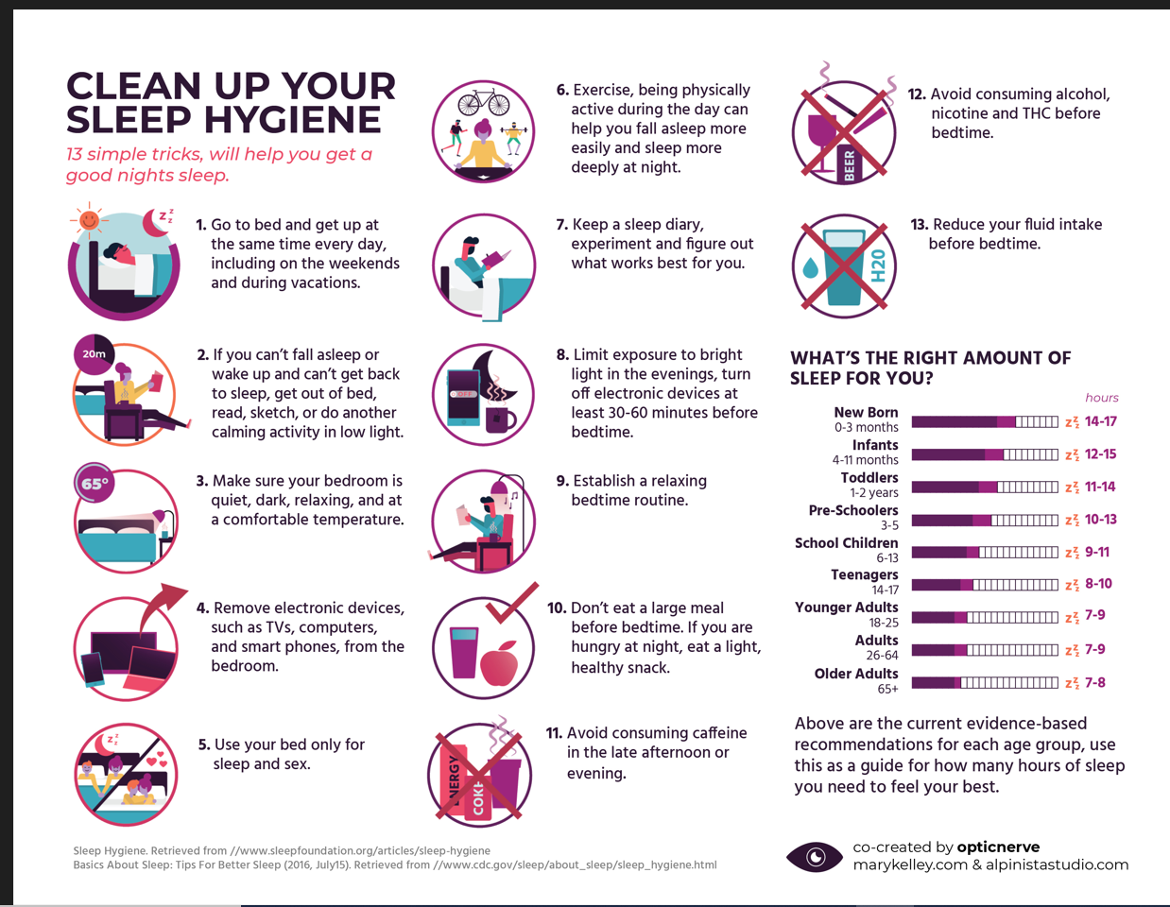

Slide 40
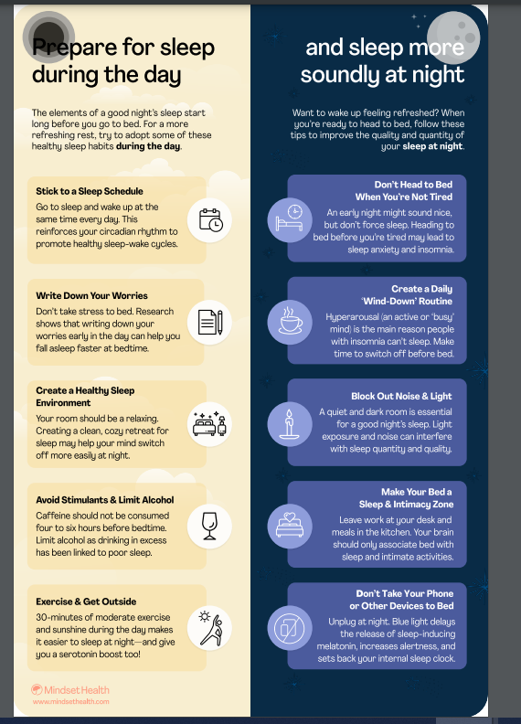

Slide 41
Download apps for your mobile device
Calm
Headspace
Insight Timer

Slide 42
Other resources
Explore Online Stress Management Programs
Depression Center Toolkit (by University of Michigan Depression Center)
Live Your Life Well (by Mental Health America)
Greater Good Science Center (a research-based collection of articles, practices, and expert opinions on positive practices)

Slide 43
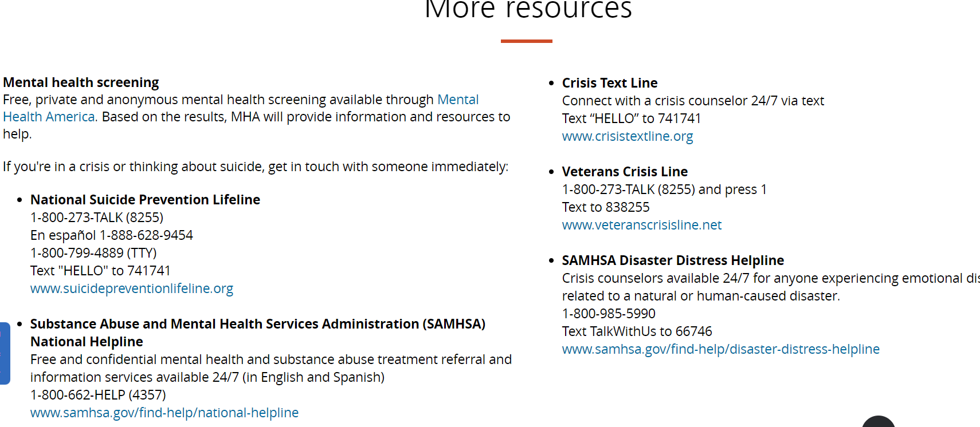

Slide 44
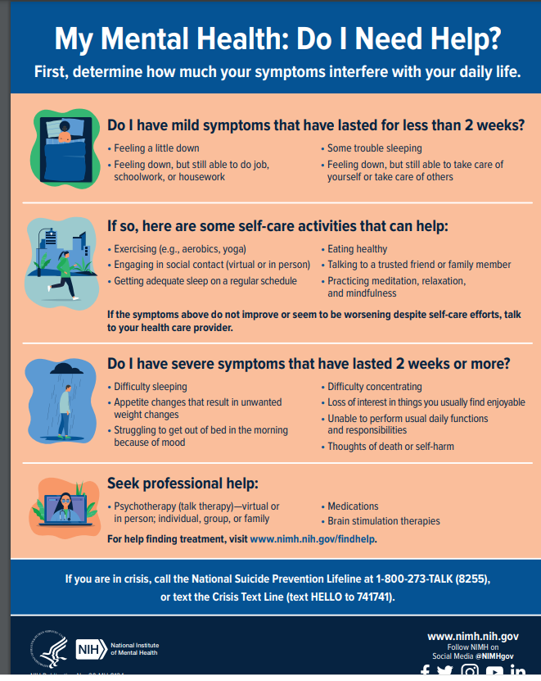

Slide 45
Thank you
Constance Rudnicki MS, RDN,LD
constancer@ncnmedd.com

Slide 46
References
National Alliance on Mental Illness. Stress management. Accessed June 9, 2022. https://www.nami.org/Your-Journey/Individuals-with-Mental-Illness/Taking-Care-of-Your-Body/Managing-Stress. Accessed June 9, 2022.
PositivePsychology.com. 62 Stress management techniques, strategies and activities. 23.Feb 2018. https://positivepsychology.com/stress-management-techniques-tips-burn-out.Accessed June 9, 2022.
Every mind matters. California Mental Health Movement. https://emmresourcecenter.org/resources/tips-self-care-during-covid-19.Accessed June 9, 2022.
National Institute of Mental Health. Taking care of your Mental Health. https://www.nimh.nih.gov/health/topics/caring-for-your-mental-health.Accessed June 9, 2022.
American Heart Association. What is stress management. Last Revised: November 2, 202. https://www.heart.org/en/healthy-living/healthy-lifestyle/stress-management/what-is-stress-management. Accessed June 9, 2022.
American Heart Association. Less stress. How does stress affect the body? Last Revised: October 20, 2021. https://www.heart.org/en/healthy-living/healthy-lifestyle/stress-management/lower-stress-how-does-stress-affect-the-body.. Accessed June 9, 2022.
Optum. Looking Out for Your Mental Health. Looking Out for Your Mental Health _ Optum.pdf (nm.gov). Accessed on June 3, 2022.

Slide 47


Slide 48
