Slide 1
How to identify validation errors for in-home services.

Slide 2
Select the service roster you are working on
Ensure you have the current month
Select Ok

Slide 3
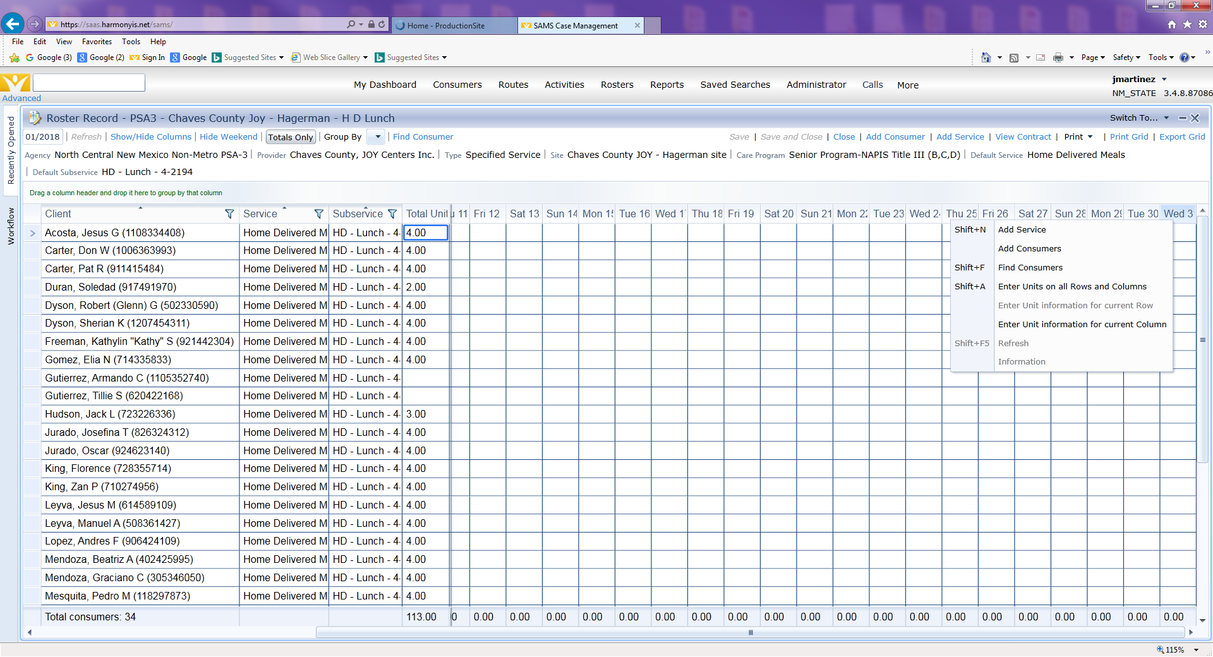
Scroll to the last day of the month, then right click on the column of the last day. From the drop down that appears select “Enter Unit information for current Column.

Slide 4
Then a pop up box will appear, enter 1.00 in the Enter Unit box then select ok

Slide 5
Now that column has a 1 for each consumer on that day. Click on Save at the top of the screen

Slide 6
If there are Validation Errors then a message like this one will appear. Click Ok

Slide 7
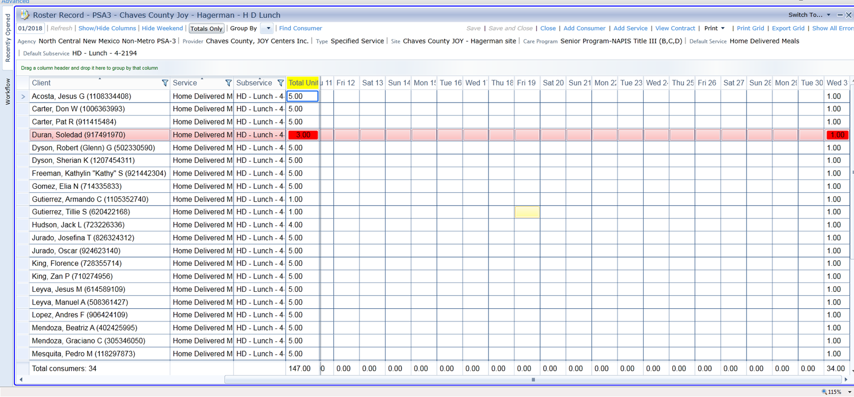
Now the consumers that have validation errors will be highlighted in red.

Slide 8
You can print out a list of the consumers with Validation Errors by clicking on Show all Errors on the top right corner of the screen

Slide 9
A message like this will appear once you click on Show all Errors. You can print the grid or select export grid so that you can check their record in SAMS and also compile your Validation Error log

