Slide 1



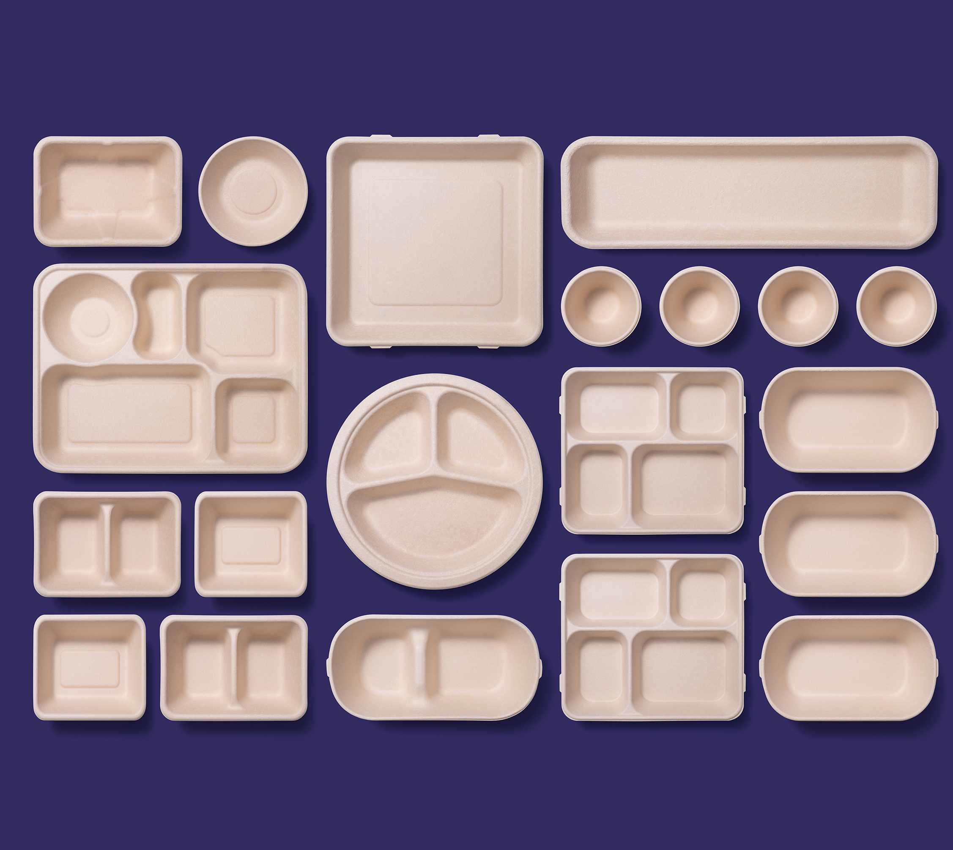

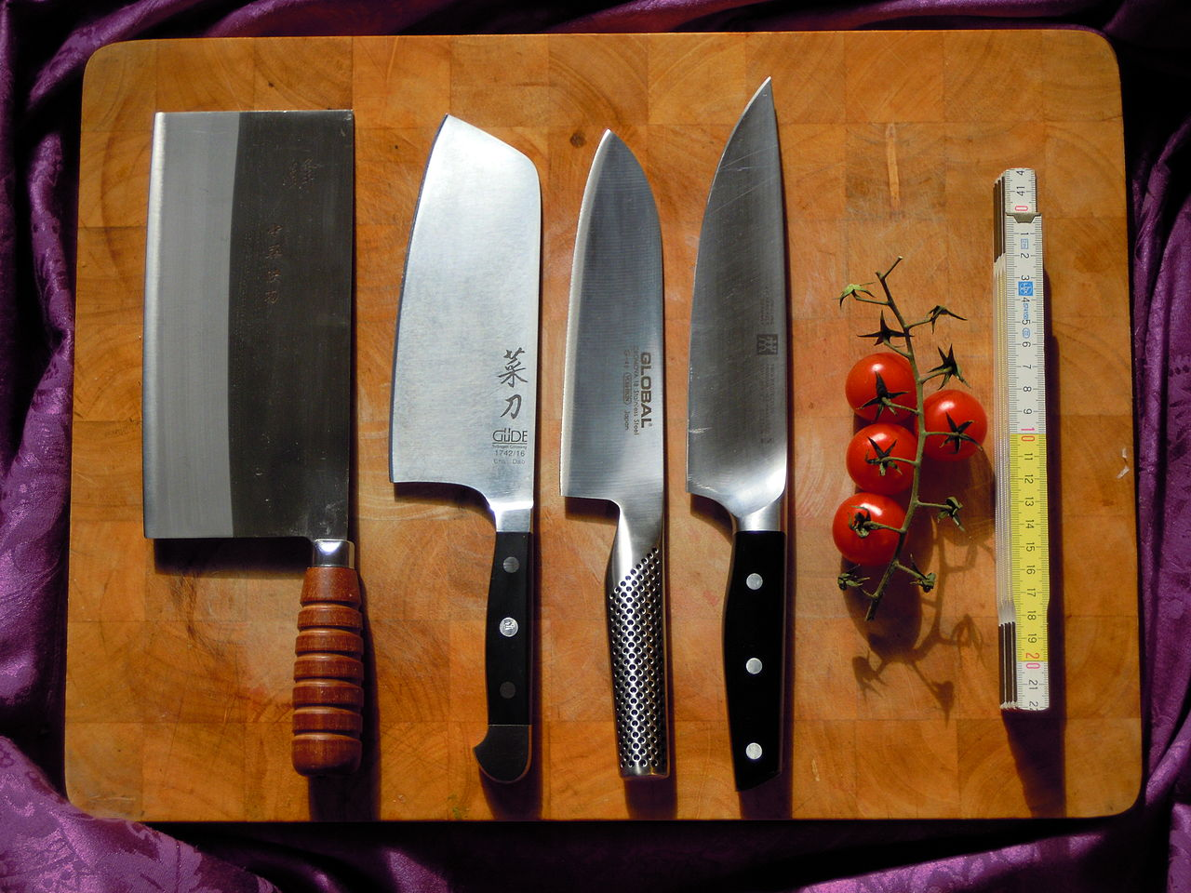
Food Service 102 (Back to Basics- Updated )
Parts 1 and 2
Constance Rudnicki MS, RDN, LD
Registered Dietitian/Nutritionist
Non-Metro Area Agency on Aging

Slide 2
OBJECTIVES
The learner will learn basic skills with the knife, including how to sharpen a knife and hold a knife.
The learner will learn the minimum internal cooking temperature of food
The learner will learn how to calibrate a thermometer using two methods.
The learner will learn about TCS food and the danger zone
The learner will learn about cutting boards
The learner will the basics of HACCP
The learner will learn about labeling and dating of food
The student will learn to read the label of a food

Slide 3
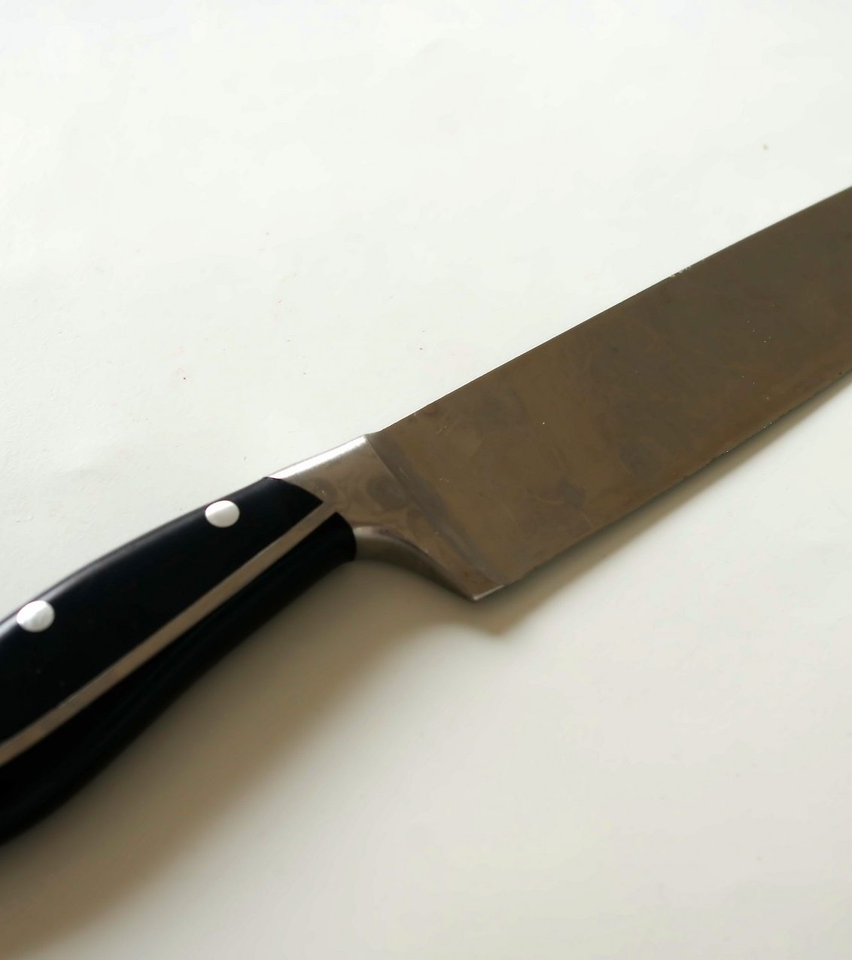
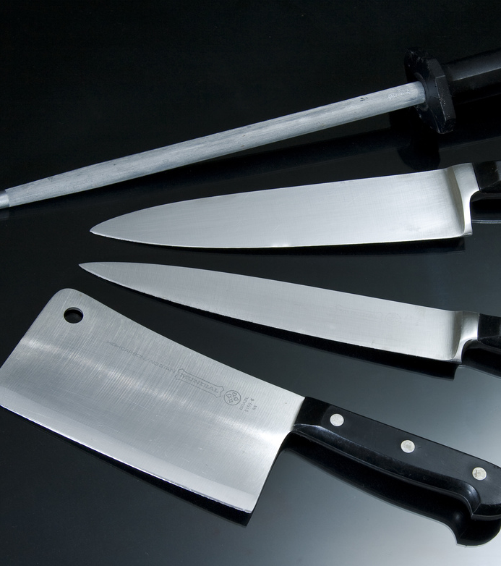
Part 1: Knife Skills
z

Slide 4
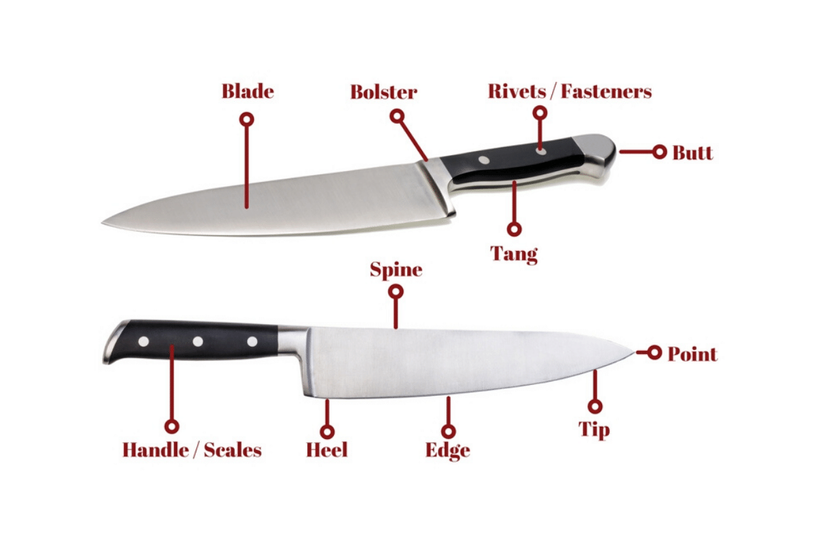
Parts of a Knife

Slide 5
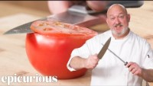
Different knife sharpening techniques

Slide 6
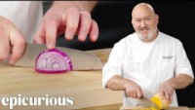
Basic Knife Skills

Slide 7
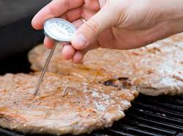
Part 2: Thermometers and Food Cooking Temperature
z

Slide 8
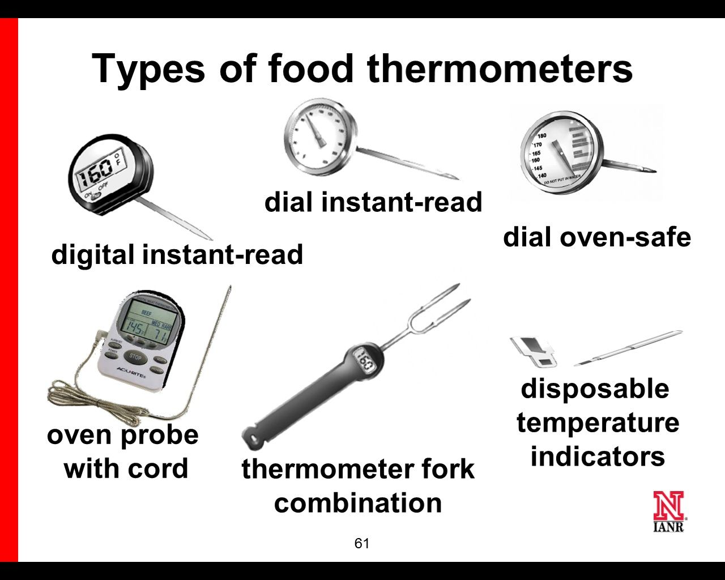

Slide 9

How to calibrate a thermometer using the ice water method

Slide 10

How to calibrate a thermometer using the boiling water method

Slide 11
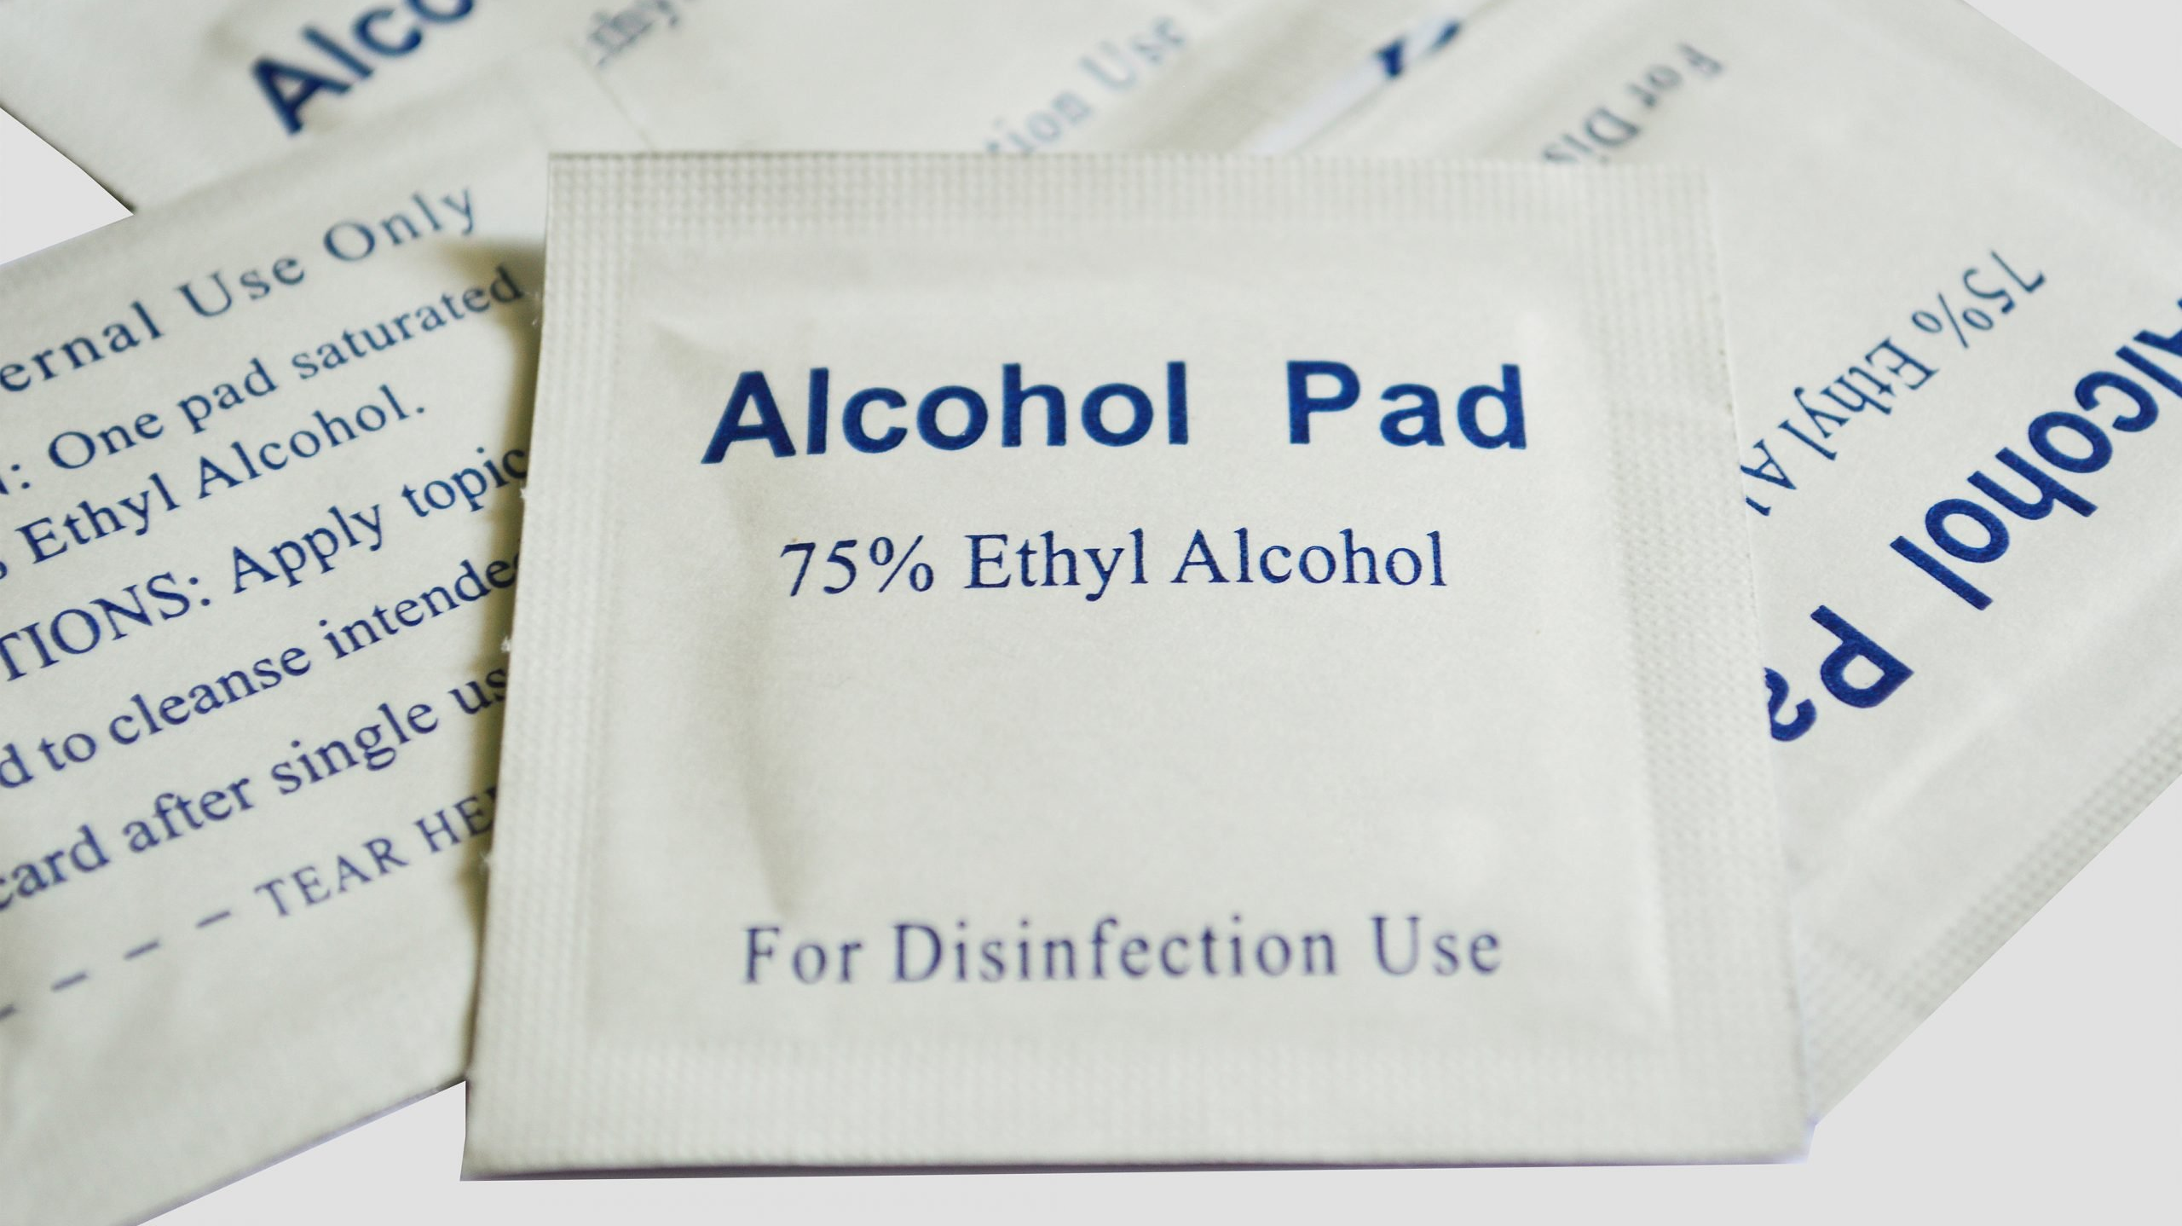
When using thermometers:
z
Wash, rinse, sanitize, and air-dry
Wash, rinse, sanitize, and air-dry thermometers before and after using them
Calibrate
Calibrate them before each shift to
ensure accuracy
Make sure thermometers used to measure the temperature of food are accurate to
+/- 2˚F or +/- 1˚C

Slide 12
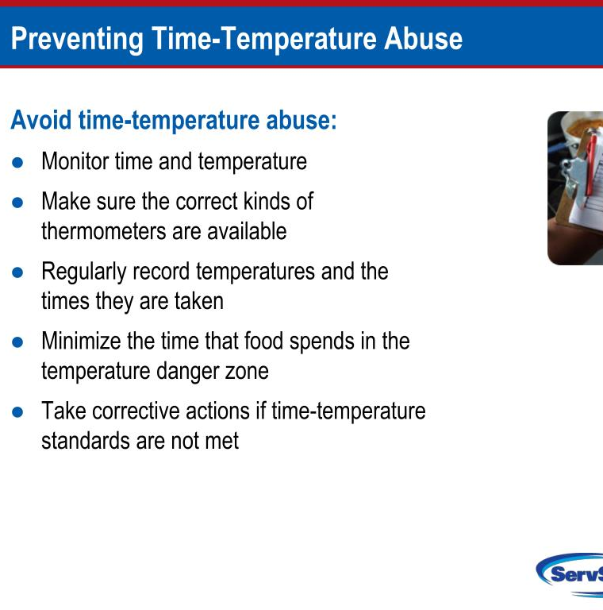
Why do we take temperatures?
z

Slide 13
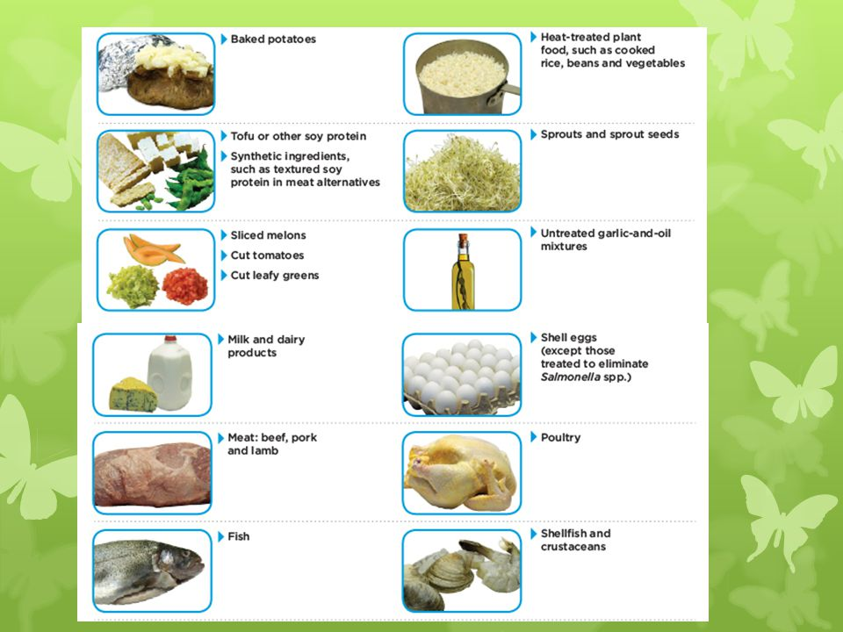
Time-Temperature Control
Food-Borne Illnesses happen because Time Control For Safety (TCS) has been time-temperature abused

Slide 14
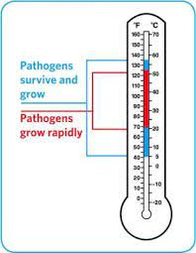
Time-Temperature Control
  TCS Food remains in between 41°F and 135 °F (5°C and 57°C)
    Temperature Danger Zone
      Pathogens grow in this range
    Most Pathogens grow much faster between 70°F and 125 °F (21°C and 52°C)
    Food is being temperature abused by the following ways:
      Cooked to the wrong internal temperature
      Held at the wrong temperature
      Cooked or reheated incorrectly
    If food is held in this range four or more hours-Throw it out

Slide 15
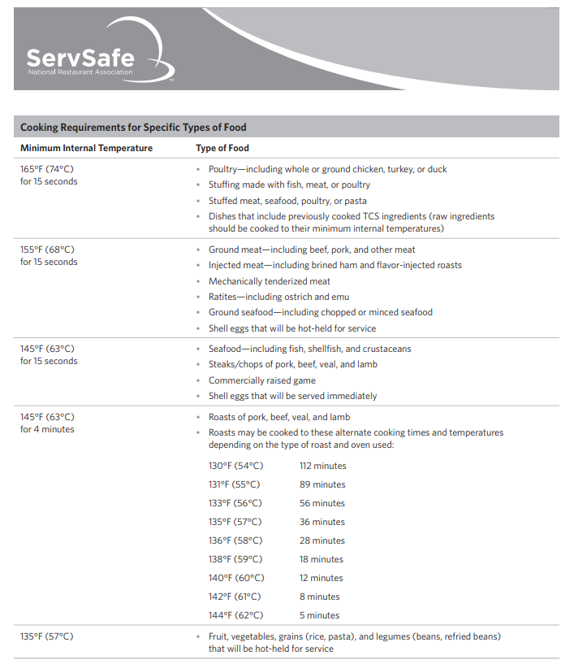

Slide 16
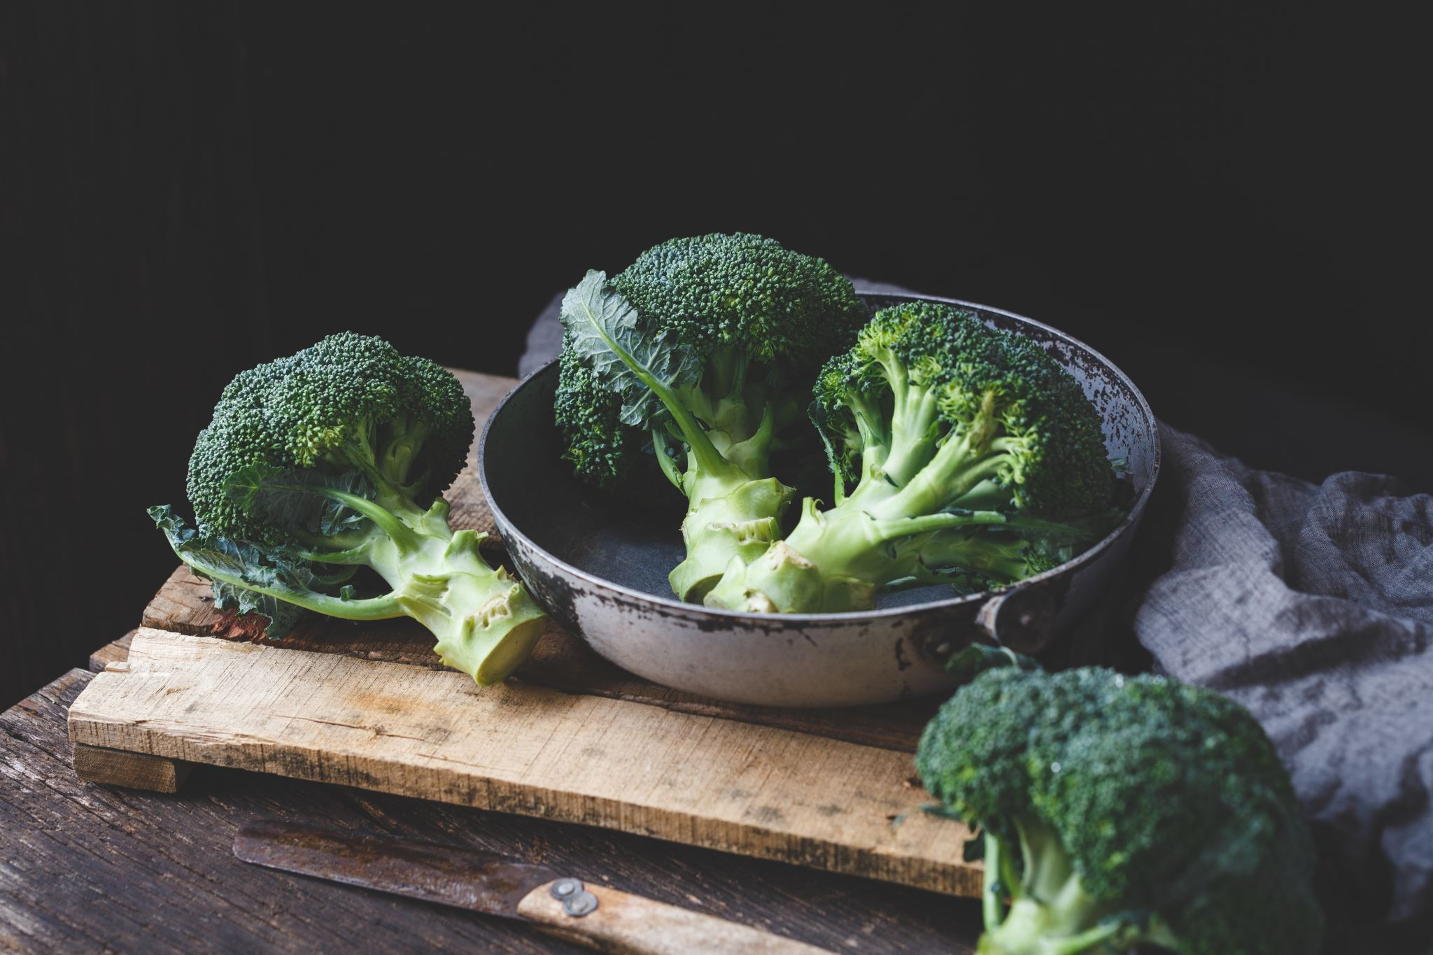
z
What is the required internal cooking temperature for each food?

Slide 17
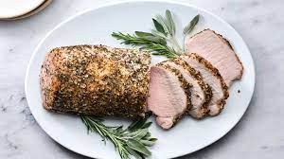
PORK ROAST
a. 135°F
b. 145°F
c. 155°F
d. 165°F

Slide 18
Correct!
Let’s move on!

Slide 19
Oops, that’s wrong…
Try Again

Slide 20
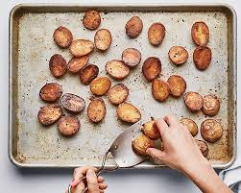
Roasted Potatoes that will be hot held
a. 135°F
b. 145°F
c. 155 °F
d. 165°F

Slide 21
Correct!
Let’s move on!

Slide 22
Oops, that’s wrong…
Try Again

Slide 23
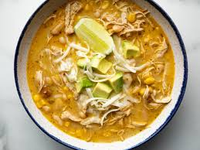
Chili made with previously cooked chicken
a. 135°F
b. 145°F
c. 155°F
d. 165°F

Slide 24
Correct!
Let’s move on!

Slide 25
Oops, that’s wrong…
Try Again

Slide 26
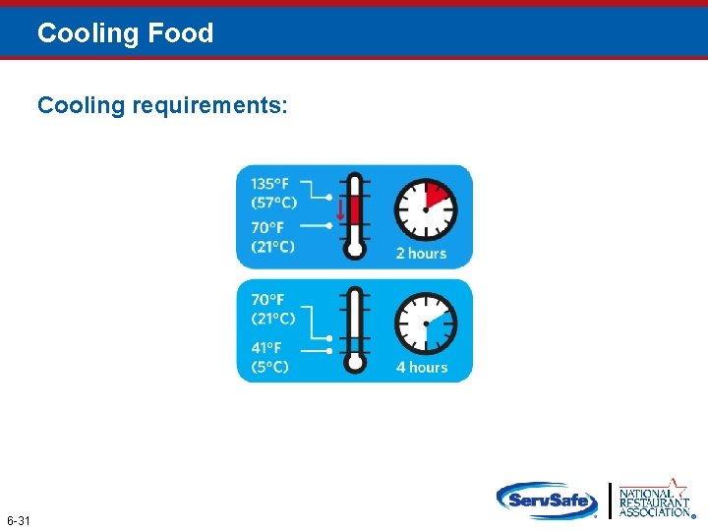

Slide 27
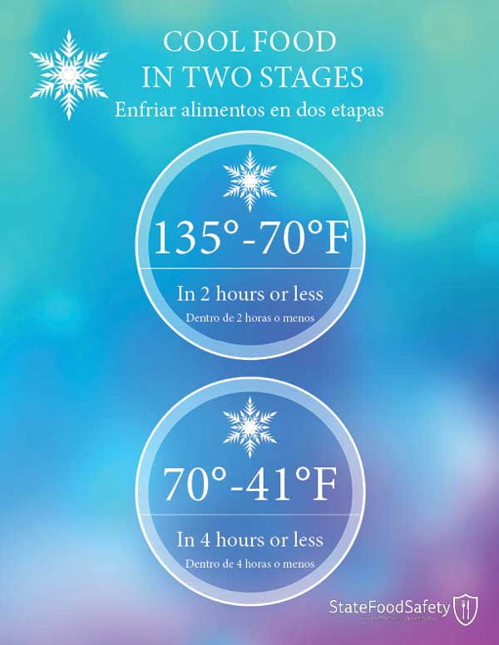

Slide 28


Slide 29
True or False
Has the food been cooled down correctly?
Beef barley soup was cooled from 135°F to 70°F (57°C to 21°C) in one hour and then from 70°F to 41°F (21°C to 5°C) in four hours
A. True
B. False

Slide 30
Correct!
Let’s move on!

Slide 31
Oops, that’s wrong…
Try Again

Slide 32
True or False
Has the food been cooled down correctly?
Mashed potatoes were cooled from 135°F to 70°F (57°C to 21°C) in three hours and then from 70°F to 41°F (21°C to 5°C) in two hours
A. True
B. False

Slide 33
Oops, that’s wrong…
Try Again

Slide 34
Correct!
Let’s move on!

Slide 35
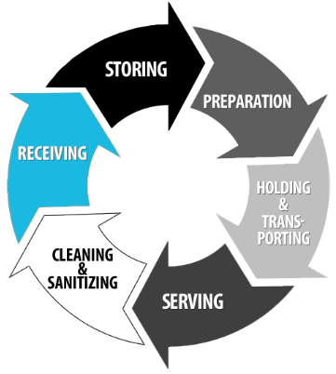
Part 3: Receiving, Storing Preparation Foods
z

Slide 36
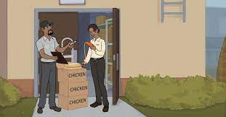
Receiving Foods
Use approve supplier-inspected and meets all applicable local, state, and federal laws
Notes:
Synergy Training Solutions. Serve Safe Food Protection Manager Study guide. Accessed March 13, 2023.

Slide 37

Temperature criteria for deliveries:
Cold TCS food: Receive at 41˚F (5˚C) or lower, unless otherwise specified
Live shellfish: Receive oysters, mussels, clams, and scallops at an air temperature of 45˚F (7˚C) and an internal temperature no greater than
50˚F (10˚C)
Once received, the shellfish must be cooled to 41˚F (5˚C) or lower in four hours
Shucked shellfish: Receive at 45˚F (7˚C)
or lower
Cool the shellfish to 41˚F (5˚F) or lower in
four hours

Slide 38
Receiving
Operators must plan their delivery so products can be handled promptly and correctly
Employees assigned to receive deliveries should be trained to inspect food properly
Be able to distinguish between products that are acceptable and those that are not
Packaging should be free of damage, clean, use by dates current, and show no signs of mishandling

Slide 39
Products must be delivered at the proper temperatures
Cold TCS food-41°F or lower
Live Shellfish and shell eggs-45°or lower
Hot TCS Foods-135°F or higher
Frozen-Frozen Solid- with no fluid's stains or large ice crystals

Slide 40
  Temperature criteria for deliveries:
Shell eggs: Receive at an air temperature of 45˚F (7˚C) or lower
Milk: Receive at 45˚F (7˚C) or lower
Cool the milk to 41˚F (5˚C) or lower in four hours
Hot TCS food: Receive at 135˚F (57˚C) or higher
Frozen food: Receive frozen solid
REJECT frozen food for the following reasons:
Fluids or water stain appear in case bottoms or on packaging
There are ice crystals or frozen liquids on the food or the packaging

Slide 41
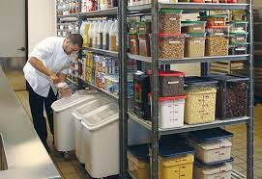
FIFO
(FIRST IN FIRST OUT)
Stock rotation should be followed
Some items with earlier use by dates in front
  Use them first

Slide 42
Items should be stored in original packaging
If removed
  Wrap in clean moisture proof material or place it in a lean sanitized container with tight fitting lid
  All packaging and containers should be labeled with NAME OF THE FOOD and EXPIRATIONS DATE

Slide 43
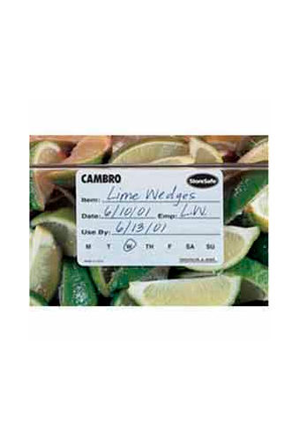
TCS FOODS PREPARED ON SITE
Must be labeled
  Name of the food
  The date is should be sold, consumed or discarded
  It can be stored at a maximum of SEVEN DAYS at 41°F or lower before it must be discarded.
  THROW OUT ALL FOOD THAT HAS PASSED THE MANUFACTURES EXPIRATION DATE

Slide 44
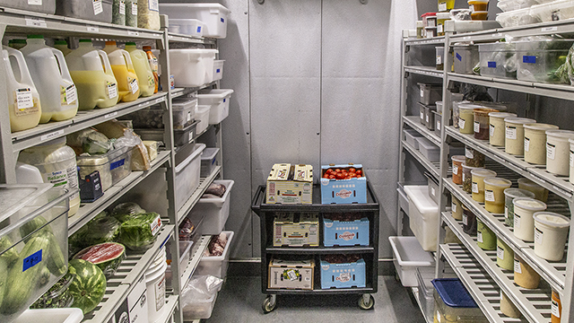
Refrigerators
Set at 39°F or lower
Never place hot food in refrigerators, which could raise the temperature inside
Cool food to 70°F before placing it in the refrigerator
Do not line refrigerator shelves, overload units or open doors too often
Internal and external thermometers must be maintained

Slide 45
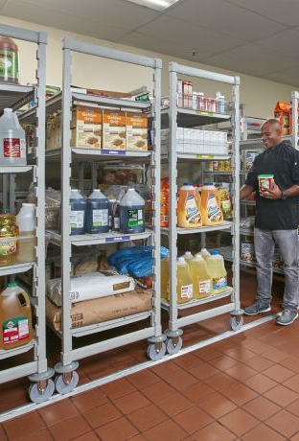
Dry Storage
Areas should be kept at the appropriate temperature, between 50°F and 70°F with a relative humidity of 50-60%
Should be clean and well ventilated to maintain food quality
Foods should be 6 inches off the floor
Do not store food products near chemicals or cleaning supplies since food can be easily contaminated
Opened dry food items should be labeled and stored in a sealed container

Slide 46
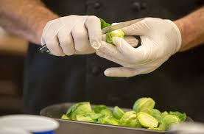
Preparation
THAW frozen food in the refrigerator, under cool running water, in a microwave oven, or as part of the cooking process
NEVER THAW AT ROOM TEMPERATURE
Control time and temperature
  Prepare food in small batch, used pre-chilled ingredients utensils and bowls

Slide 47
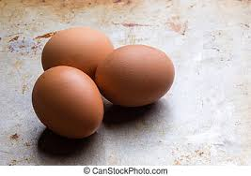
EGGS and EGG mixtures
  Pooled eggs that are cracked open and combined in a common container should be cooked promptly or stored at 41°F
  High risk establishments should only serve Pasteurized Eggs

Slide 48
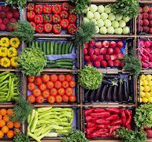
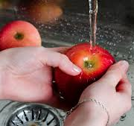
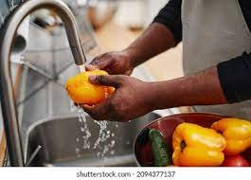
Produce and Fruit
Should only be washed before cooking, but do not mix different items or do multiple batches
If opening a new box of produce, needs to be washed before serving

Slide 49
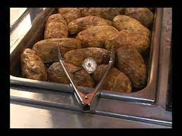
SERVICE
Holding Foods
  Check the internal temperature of food being held at leas every 4 hours and discard it if it not a proper temperature
    Hot Holding-135°or higher
    Cold Holding-41°or lower

Slide 50
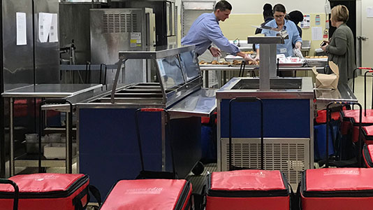
OFF SITE SERVICE
Delivery equipment must be insulted:
to keep food at 135°F if hot food
41° for cold food

Slide 51
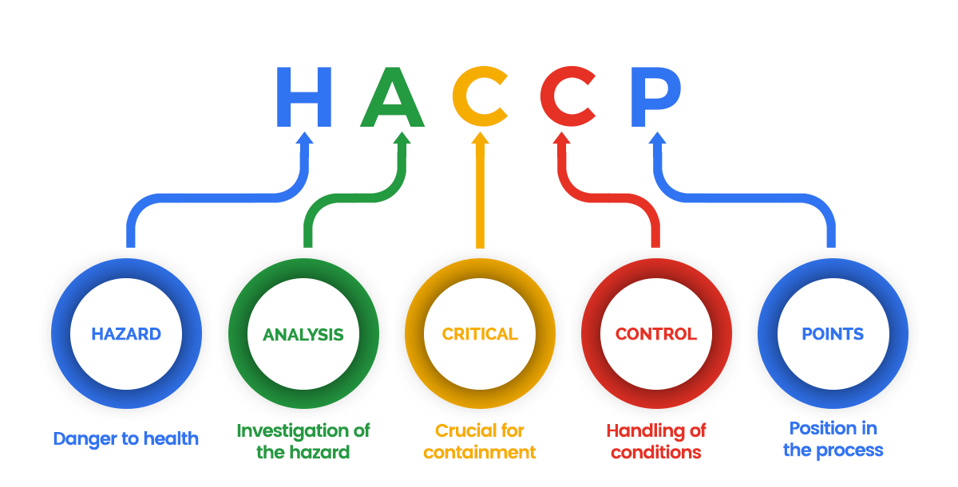
HAZARD ANALYSIS CRITICAL CONTROL POINT (HACCP)
HACCP system focuses on identifying specific point where it is essential to prevent, eliminate, or reduce biological, chemical, or physical hazards to a safe level

Slide 52
HACCP
Conduct a Hazard analysis
Determine the caracal control points where hazards can be prevented, eliminated or reduced to safe levels
Determine and establish maximum and minimum limits that must be met for each Critical Control Point (CCP).
Determine and establish monitoring procedures
Identify what corrective actions will be taken when critical limits have not been met
Verify that your plan is working
Establish procedures for record keeping and documentation

Slide 53
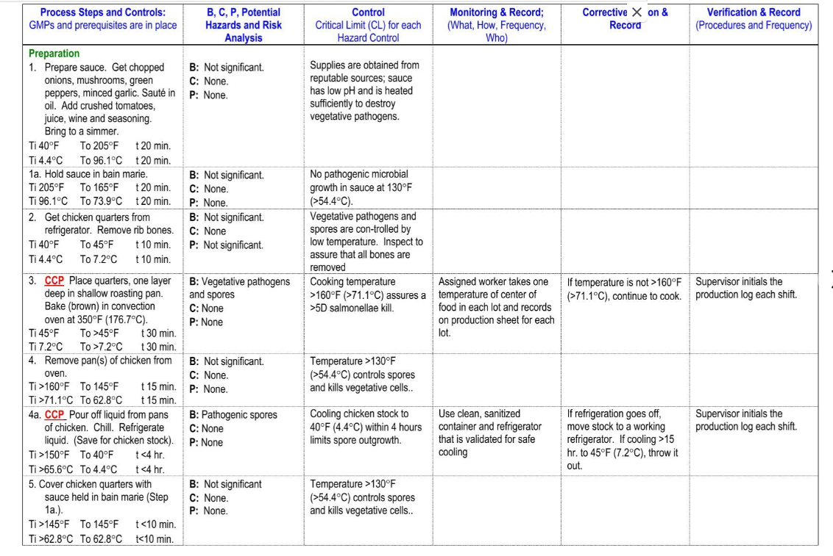

Slide 54
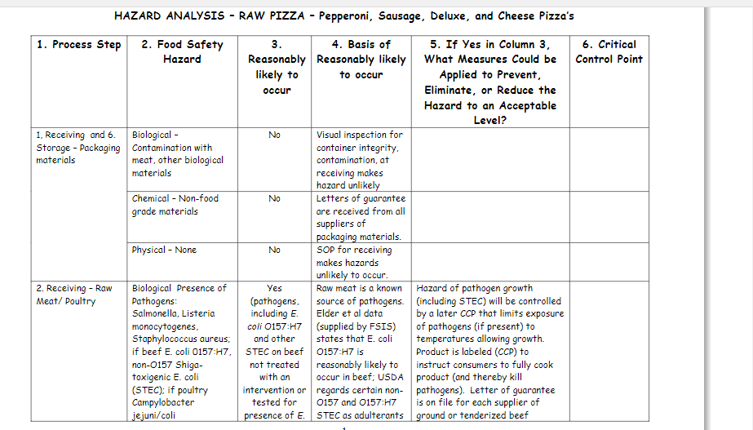

Slide 55
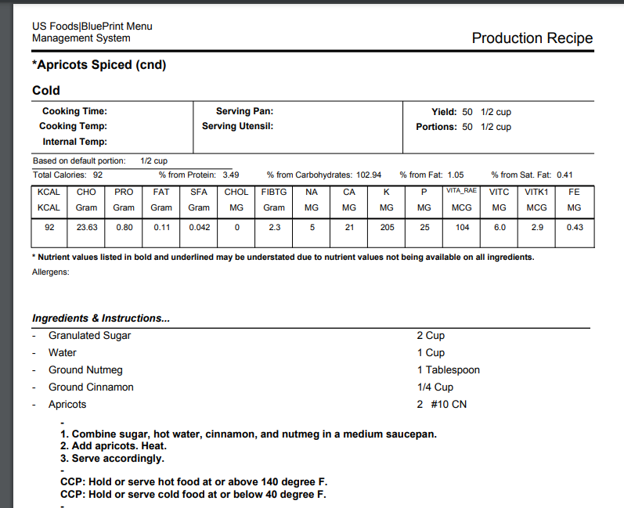

Slide 56


Slide 57


Slide 58
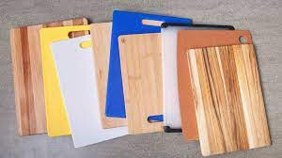
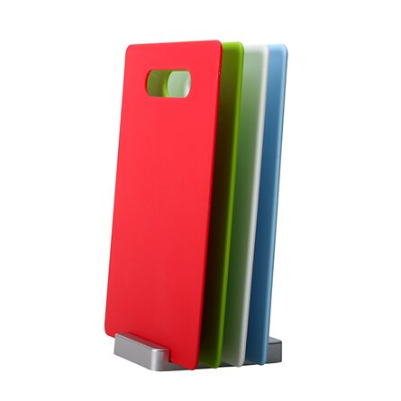
Part 4:Cutting Boards

Slide 59
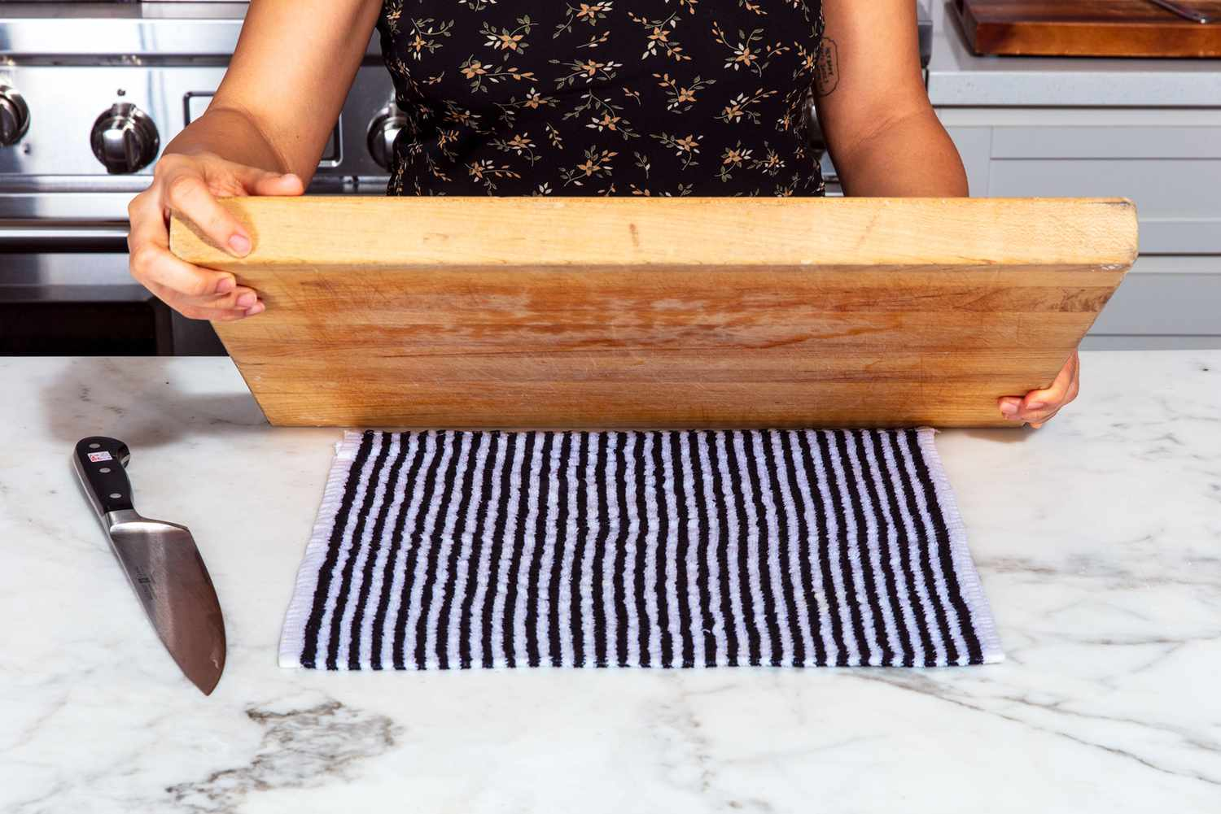
Cutting Board Safety
One of the most used items in a kitchen is cutting boards. When using cutting boards for various types of foods,
the most important consideration is to avoid cross-contamination.
Cross-contamination occurs when ready-to-eat food is placed on a surface that held raw meat, poultry, seafood, or egg;
spreading illness-causing bacteria to ready-to-eat foods.

Slide 60
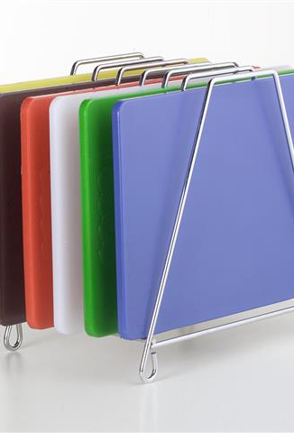
Cutting Board Safety
Always use a clean cutting board for food preparation.
After each use and before moving on to the next step while prepping food, clean cutting boards thoroughly in hot, soapy water, then rinse with water and air dry

Slide 61

Cutting board safety
Plastic, glass, nonporous acrylic and solid wood cutting boards can be washed in a dishwasher (laminated boards may crack and split).
After cutting raw meat, poultry or seafood on your cutting board, clean thoroughly with hot soapy water, then disinfect with chlorine bleach or other sanitizing solution and rinse with clean water.
To disinfect your cutting board, use a fresh solution of 1 tablespoon of unscented, liquid chlorine bleach per gallon of water.
Flood the surface with the bleach solution and allow it to stand for several minutes.
Rinse with water and air dry

Slide 62
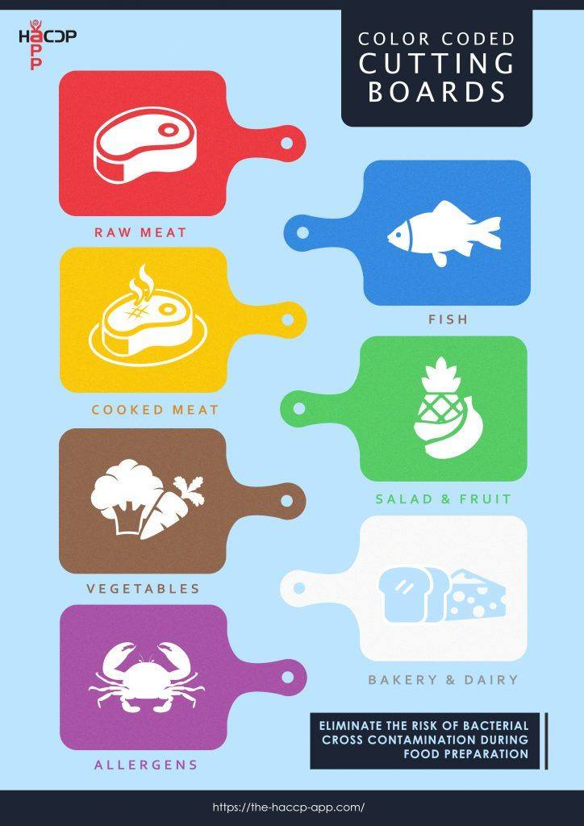
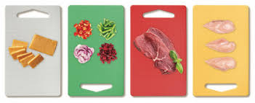
Colored Cutting Board Key
z

Slide 63
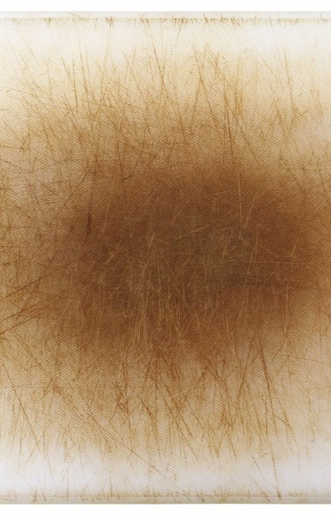
Replace Worn Cutting Boards
All plastic and wooden cutting boards wear out over time.
Once cutting boards become excessively worn or develop hard-to-clean grooves, they should be discarded.

Slide 64
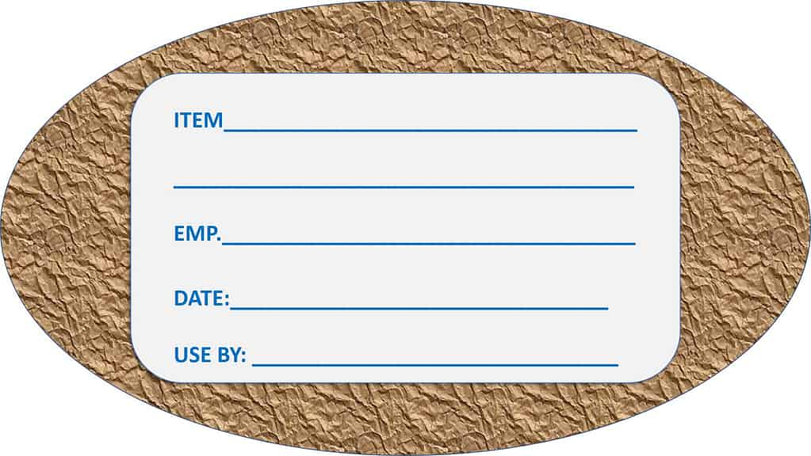
Part 5: Labeling and Dating

Slide 65
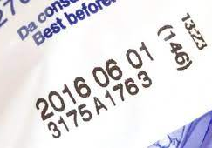
What Types of Food Are Dated?
Open dating is found on most foods including meat, poultry, egg and dairy products.
"Closed or coded dates" are a series of letters and/or numbers and typically appear on shelf-stable products such as cans and boxes of food.
Notes:
https://www.fsis.usda.gov/food-safety/safe-food-handling-and-preparation/food-safety-basics/food-product-dating

Slide 66
What Date-Labeling Phrases are Used?
There are no uniform or universally accepted descriptions used on food labels for open dating in the United States. As a result, there are a wide variety of phrases used on labels to describe quality dates.
Examples of commonly used phrases:
A "Best if Used By/Before" date indicates when a product will be of best flavor or quality. It is not a purchase or safety date.
A "Sell-By" date tells the store how long to display the product for sale for inventory management. It is not a safety date.
A “Use-By" date is the last date recommended for the use of the product while at peak quality. It is not a safety date except for when used on infant formula as described below.
A “Freeze-By” date indicates when a product should be frozen to maintain peak quality. It is not a purchase or safety date.

Slide 67
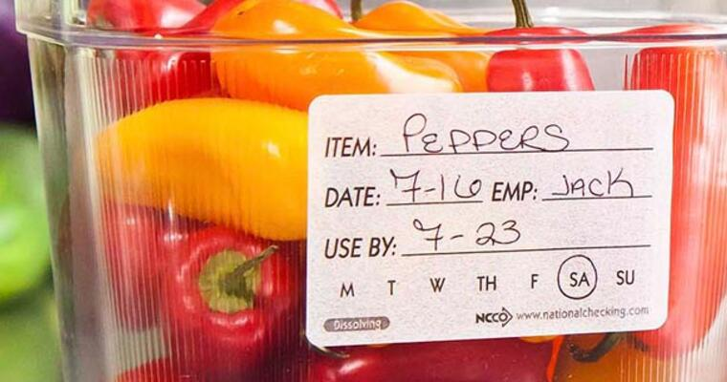
Labeling and dating food

Slide 68


Slide 69
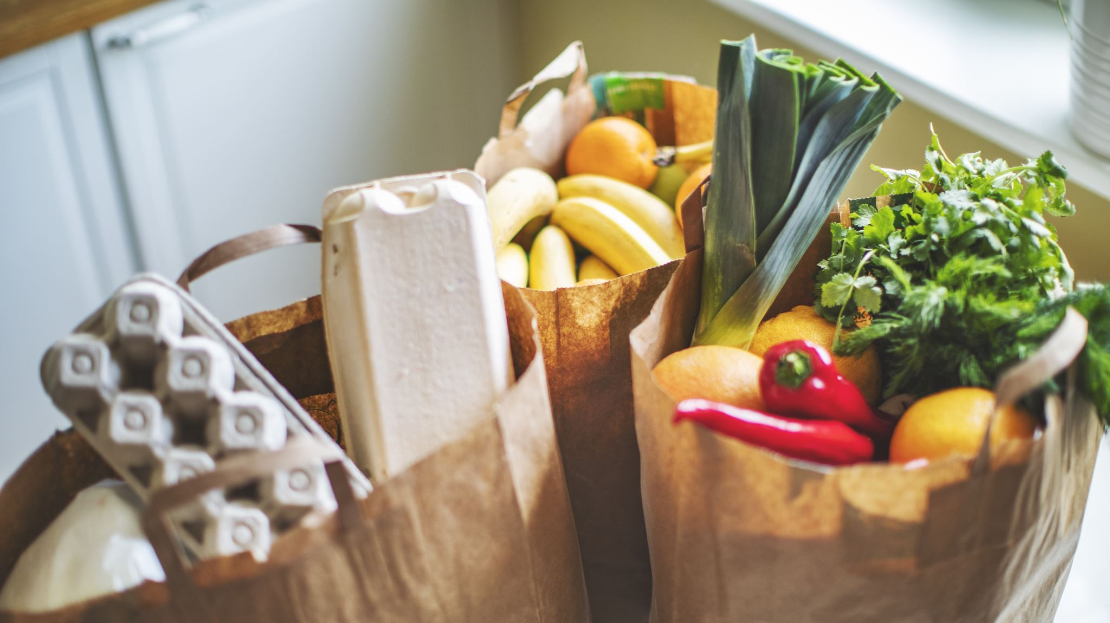
Part 6:
How To Read a Nutrition Facts Label
z

Slide 70
When and Why did the nutrition label change?
The food label on packaged foods was updated in 2016
To reflect the most up to date scientific information
About the link between diet and chronic diseases, such as obesity and heart disease
The updated label makes it easier for consumers to make better informed food choices.

Slide 71
When and Why did the nutrition label change? Con’t
Manufacturers $10 million or more in annual sales-January 1, 2020;
Manufacturers <$10 million in annual food sales-January 1, 2021.
Manufacturers of most single-ingredient sugars, such as honey and maple syrup, and certain cranberry products have until July 1,2021 to make the changes.

Slide 72
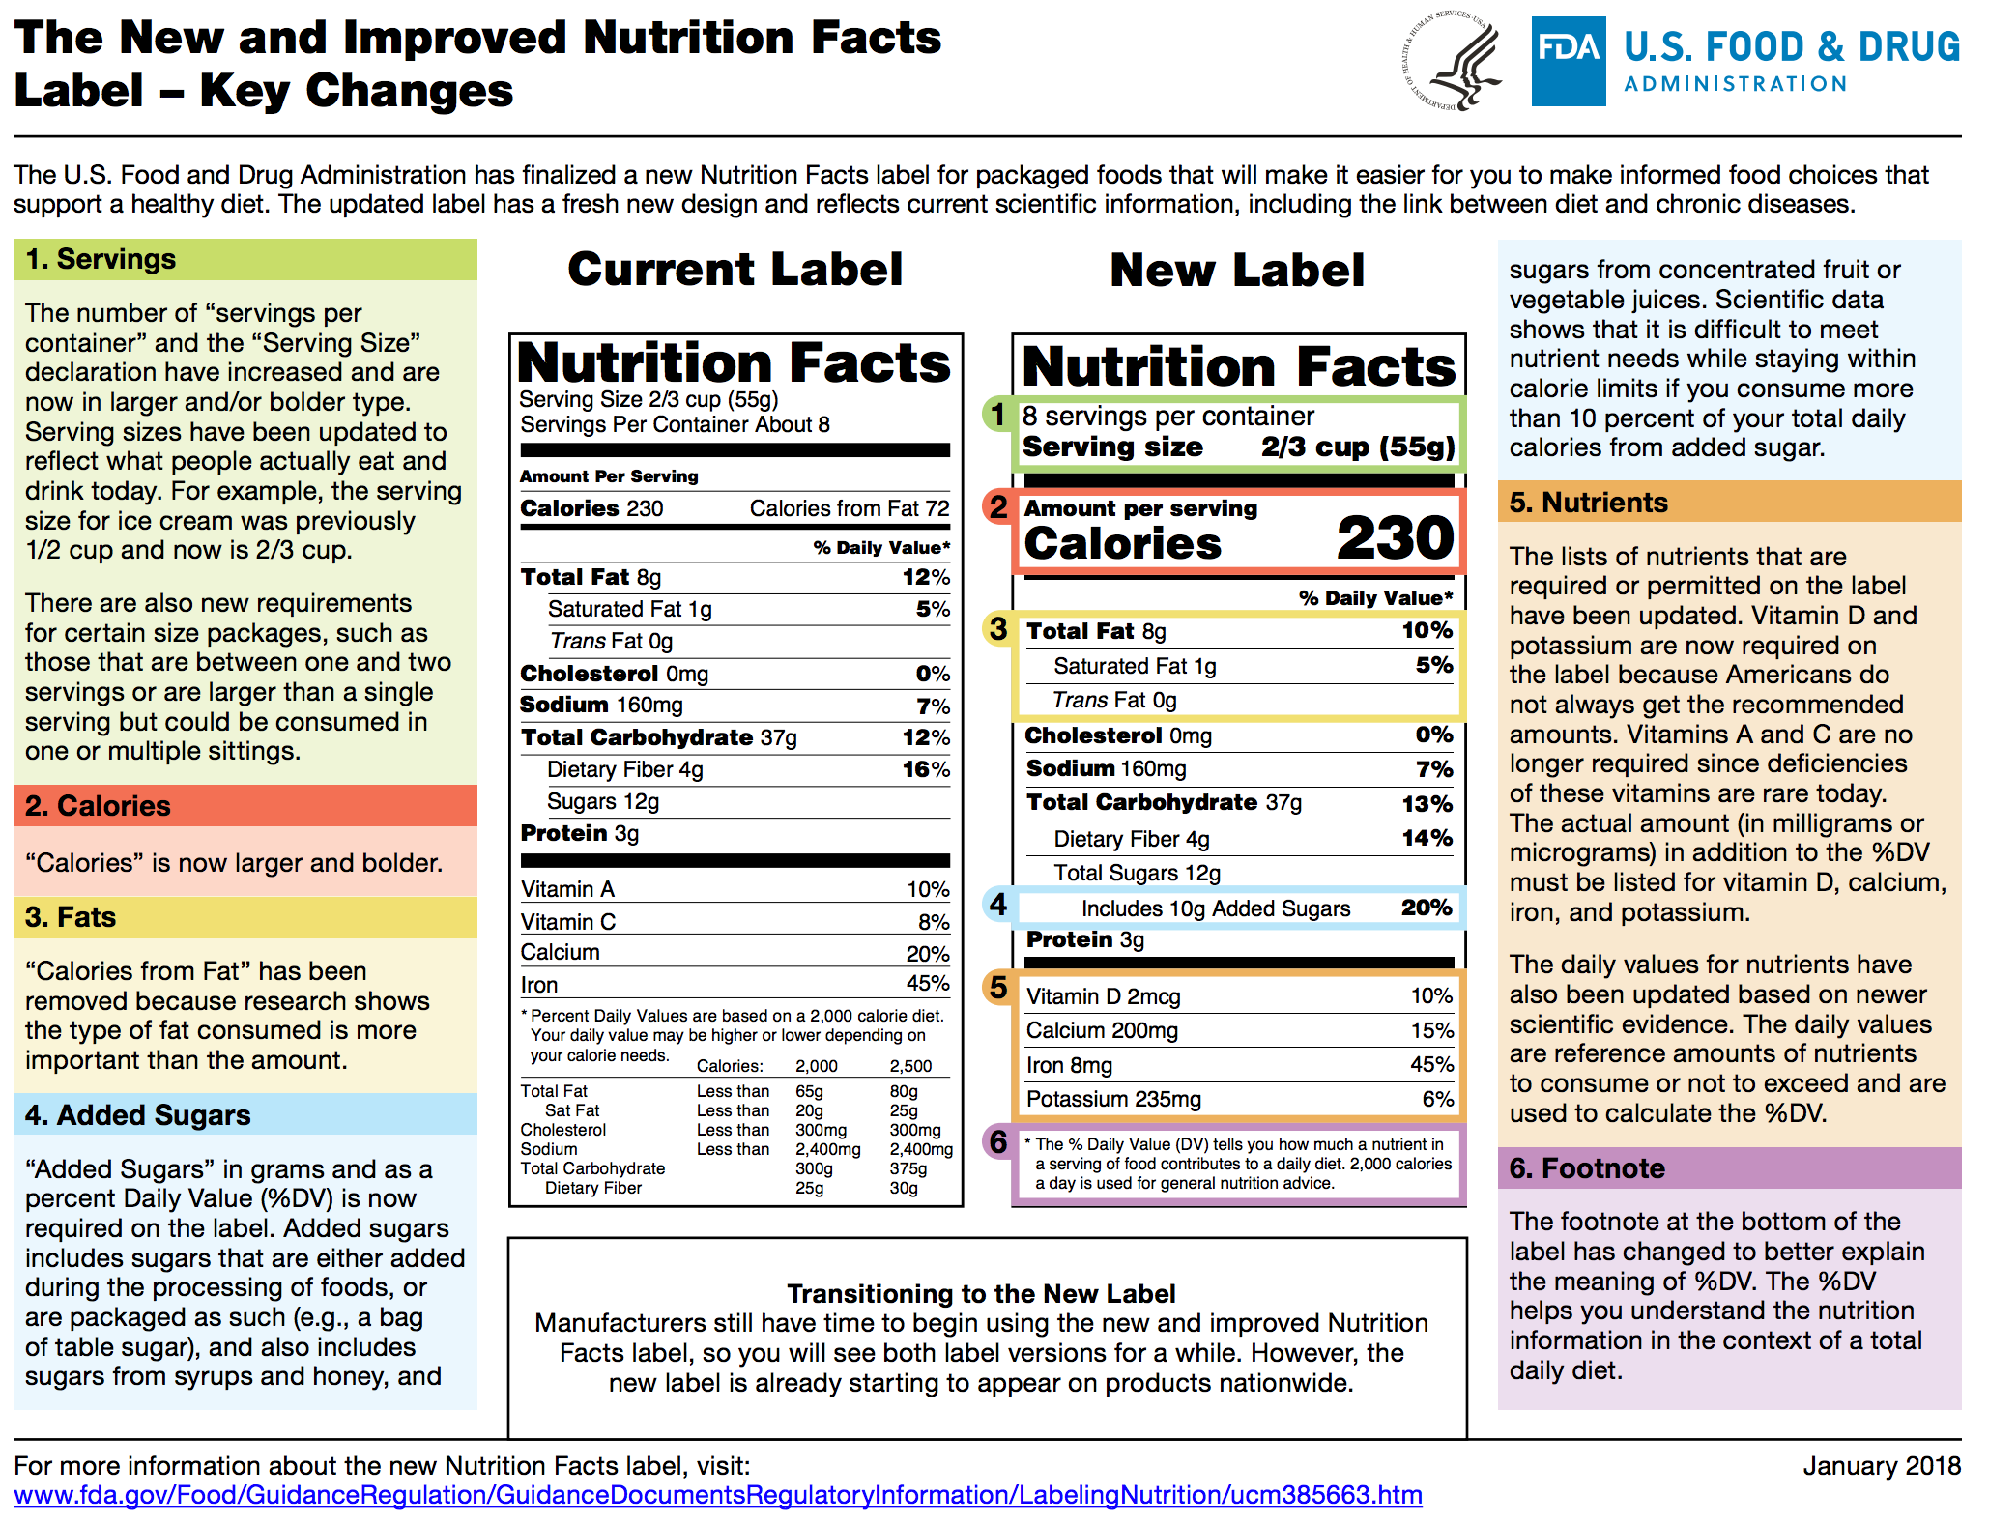

Slide 73
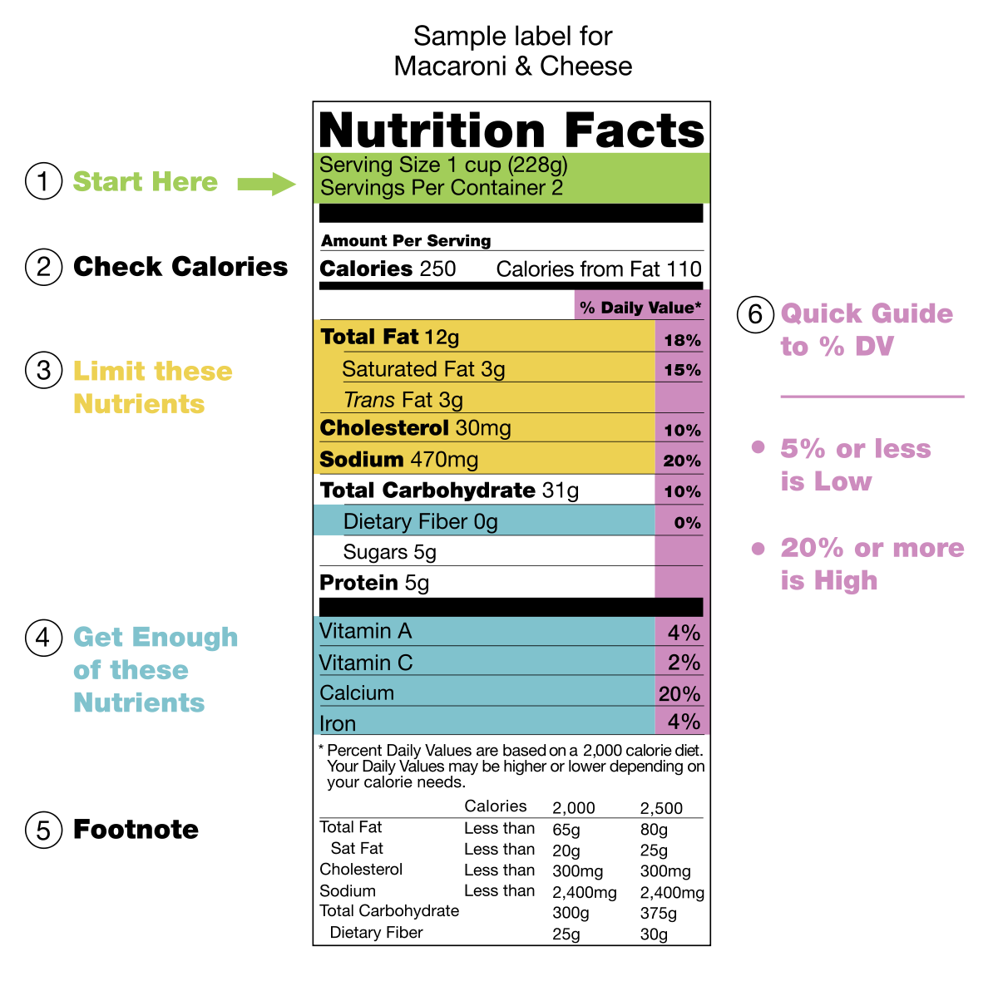

Slide 74


Slide 75


Slide 76

What you will see on a Nutrition label

Slide 77



Slide 78


Slide 79




