Slide 1
Nutrition Services incentive program (NSIP)

Slide 2
Nsip overview
What is the purpose of the Nutrition Services Incentive Program (NSIP)
Guidelines/How May NSIP funds be Used?
Definition of Domestic, U.S. Origin, Processed, Produced Food Items
Where Do I Purchase Domestic Food Products?

Slide 3
What is the purpose of NSIP
Section 311 (a) Older Americans Act
The purpose of NSIP is to “provide incentives in the form of cash and /or commodities to encourage and reward effective performance by States and tribal organizations in the efficient delivery of nutritious meals to older individuals”.

Slide 4
How May NSIP funds be Used? Guidelines
Older Americans Act Section 311 (d) (4)
“disbursements shall only be used by such recipients of grants and contracts to purchase domestically produced foods for their nutrition projects”
Older Americans Act Section 311 (d) (4)
NSIP funds may not be used for
Program cost
Administration costs
Meal production costs
such as labor,
transportation,
equipment,
congregate site operations,
home delivery costs or total catered cost of a meal
Other service cost such as nutrition education or nutrition counseling
NSIP funds may not be transferred to other allotments

Slide 5
How May NSIP funds be Used? Guidelines
New Mexico Administration Codes (9.2.18.16) (C)
“NSIP funding must only be used to purchase food which is grown or processed in the United States; coffee, tea, cocoa, decaffeinated beverages, fruits and vegetable grown outside of the U.S. are not reimbursable.”

Slide 6
Define Domestic/U.S. Origin Processed/Produced
Domestically produced foods are defined as:
Food grown in the U.S./Territories/Tribes
Food products processed/produced in the U.S./Territories/Tribes
Definition of Processed/Produced
All Food Items must be born, raised and/or grown in the U.S.
NSIP FUNDS can only be used to purchase domestically produced foods
Food products that do not meet this definition may be paid for with other funds; i.e. local programs or Title III funds

Slide 7
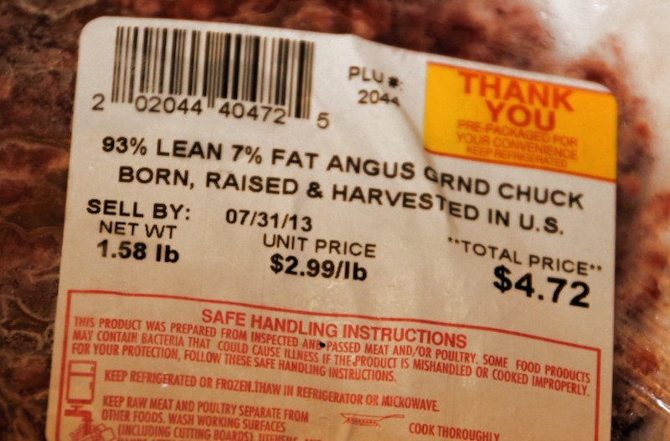
Definition of domestic/Processed/Produced All Food Items must be raised, BORN, grown, PROCESSED, PRODUCED and harvested in the U.S.

Slide 8
Definition of domestic/Processed/Produced All Food Items must be raised, BORN, grown, PROCESSED, PRODUCED and harvested in the U.S.

Slide 9
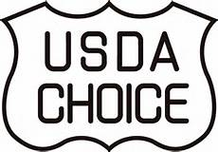
Definition of domestic/Processed/Produced All Food Items must be raised, BORN, grown, PROCESSED, PRODUCED and harvested in the U.S.

Slide 10
Is the food item DOMESTIC Or imported

Slide 11
Is the food item DOMESTIC Or imported

Slide 12
Is the food item DOMESTIC Or imported

Slide 13
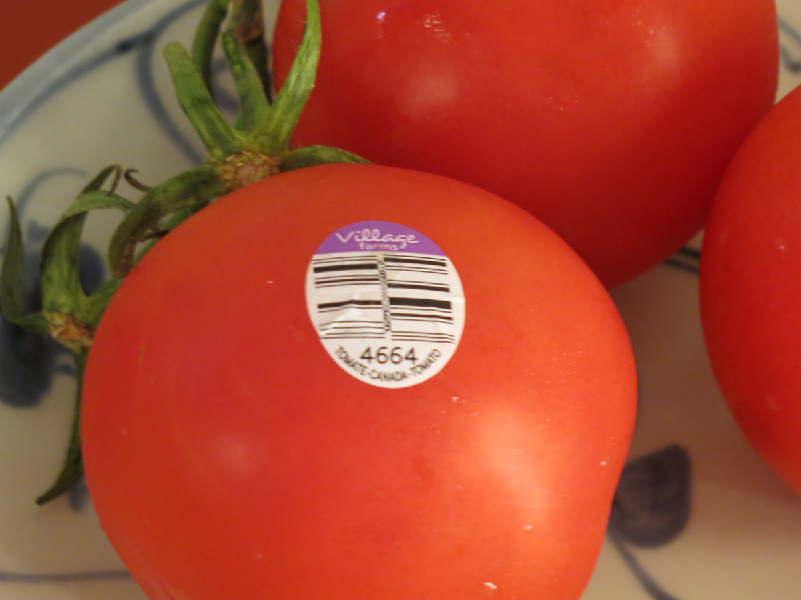
Is the food item DOMESTIC Or imported

Slide 14
Is the food item DOMESTIC Or imported

Slide 15
Where do I purchase domestic food items?
Authorized Vendors
Authorized Farmers
Must pass all government regulations

