Slide 1
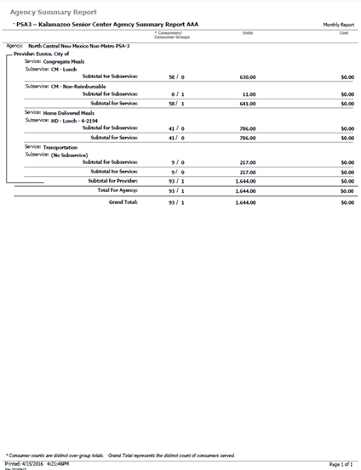
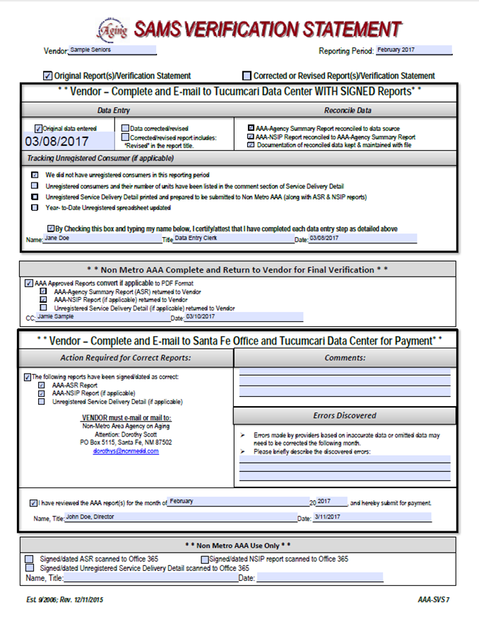
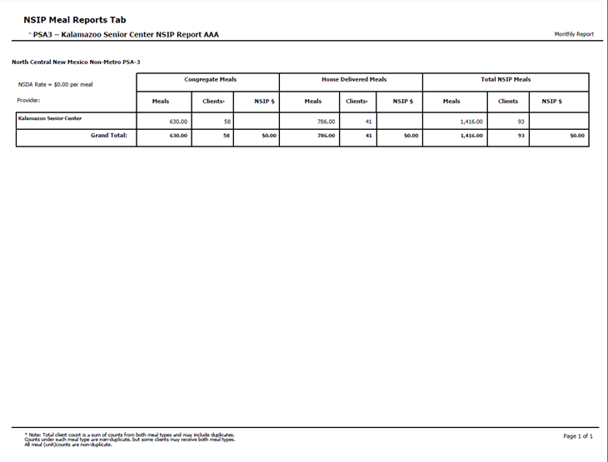
Reports
From Submission to Completion

Slide 2
Submitting Reports
To ensure accuracy your SAMS data should balance and reconcile with Hard Documentation for the respected service.
Ensure that all necessary reports are included in your submission, all documents should be thoroughly reviewed for accuracy and make any/all corrections prior to submission.
All report documentation shall be signed and dated.
SAMS Verification Statement
AAA Agency Summary Report (ASR)
AAA NSIP Report (if applicable)
Unregistered Service Delivery Print Out from SAMS (if applicable)
Excel Spreadsheet YTD List of Unregistered (if applicable)
Reports should be submitted via E-Mail to the SAMS E-mail Group: sams@ncnmedd.com

Slide 3
SAMS Verification Statement
Please make sure you are using the most recent version of the SAMS Verification Statement, if you do not have a copy, the Tucumcari Data Center Staff would be happy to make sure you get one.
The most recent version has Santa Fe’s physical address only

Slide 4
Top Portion of SAMS Verification Statement

Slide 5
Filling out the SAMS Verification Statement:
The first document you will complete is the SAMS Verification Statement.
You will need to make sure and fill out the Provider name and the correct reporting period.
You will then need to mark Original Report(s)/Verification Statement, Data Entry, Reconcile Data and Tracking Unregistered Consumer (if applicable)” sections and make sure the appropriate boxes in those sections are checked.
Please Note:
If your program serves meals, all 3 of these boxes will be checked, if you do not serve meals, only the top box and bottom box will be marked.
Please Note:
If your program has unregistered eligible consumers, the 3 bottom boxes will need to be marked, if they do not have Unregistered consumers, just the top box will be marked.
This section will always need to be completed

Slide 6
Compiling Reports:
After Filling out your Verification Statement, check your reports and run a quick scan to ensure all documents needed are included, signed and dated and the Verification matches the reports you will submit.

Slide 7
Checking the Agency Summary Report (ASR):
After the Verification Statement, you will need to check the Agency Summary Report or “ASR”
You will need to check and make sure that it is signed and dated, please do not submit ASR without signature and date, it will be sent back.
Please include only the “Agency Summary Report AAA”, if the ASR LOCAL is submitted to our office, it will be returned and the correct report will be requested, moving your reports out of order to be checked.

Slide 8
Checking the NSIP Report:
After the ASR, you will check the NSIP report please make sure this report also has a signature and date on it.
Please make sure that your meal totals on your ASR Reconcile with your meals listed on your NSIP
You will also want to make sure that this report is the NSIP Report AAA, rather than the LOCAL, any local report will be returned.
Things to keep in mind:
Only providers who serve meals will need to submit an NSIP report

Slide 9
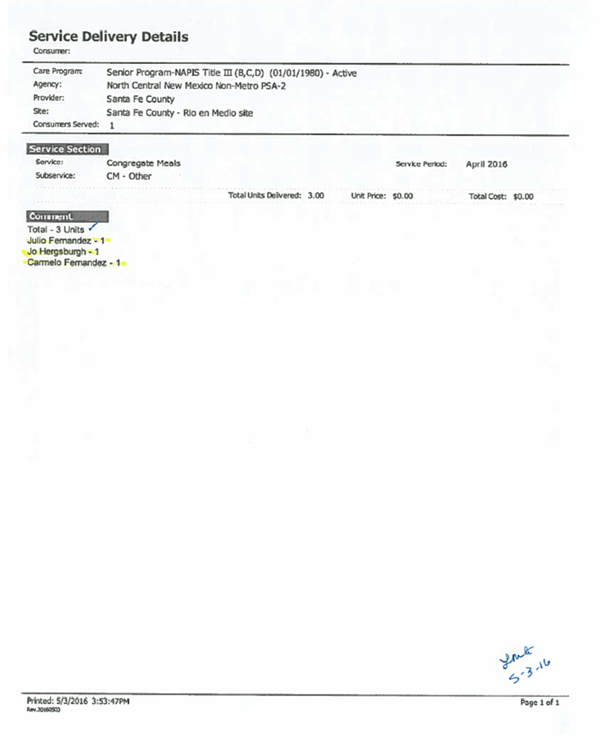
Unregistered Service Delivery Printouts and YTD Spreadsheets:
When you have Unregistered Eligible consumers or HD-Non-Reimbursable consumers, you will need to include the appropriate documents.
These units are recorded in a different section inside of SAMS and we require the Service Delivery Printouts as well as the YTD (year to date) Excel Spreadsheet to keep track of unregistered units.

Slide 10
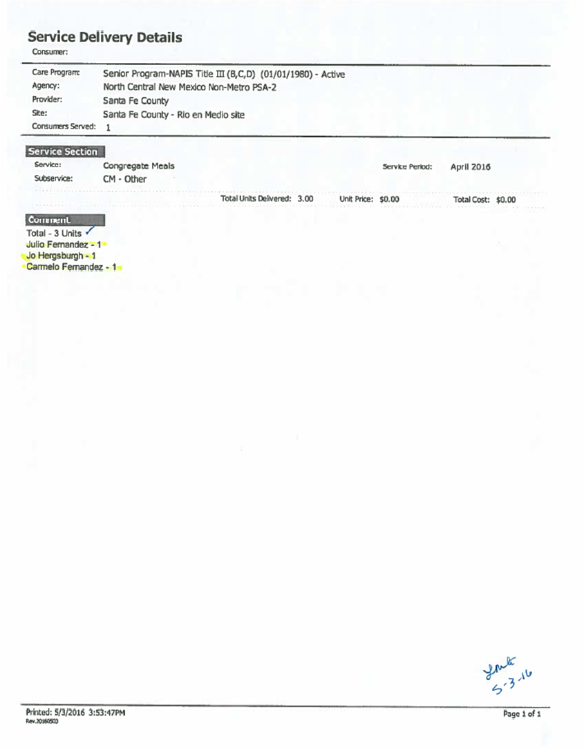
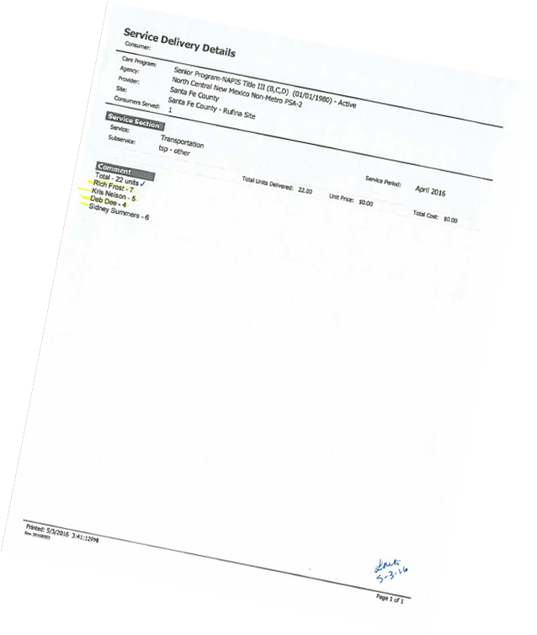
Unregistered Eligible Consumer Service Delivery Printouts:
For this example, you will see Santa Fe County’s Service Delivery Printouts.
These units are recorded as a consumer group, rather than individual consumers.
You will notice that these forms have also been signed and dated by the provider.

Slide 11
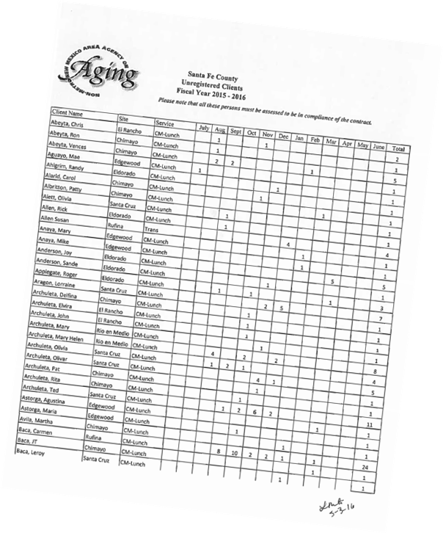
YTD (Year to Date Spreadsheets
Year to Date (YTD) Spreadsheets are excel workbooks we use to track unregistered consumers throughout the fiscal year.
When a provider has unregistered consumers, they will include these excel workbooks (converted into PDF format or printed out) with the rest of their report documents for the month.
You will need to check and make sure that the provider has signed and dated these forms as well.

Slide 12
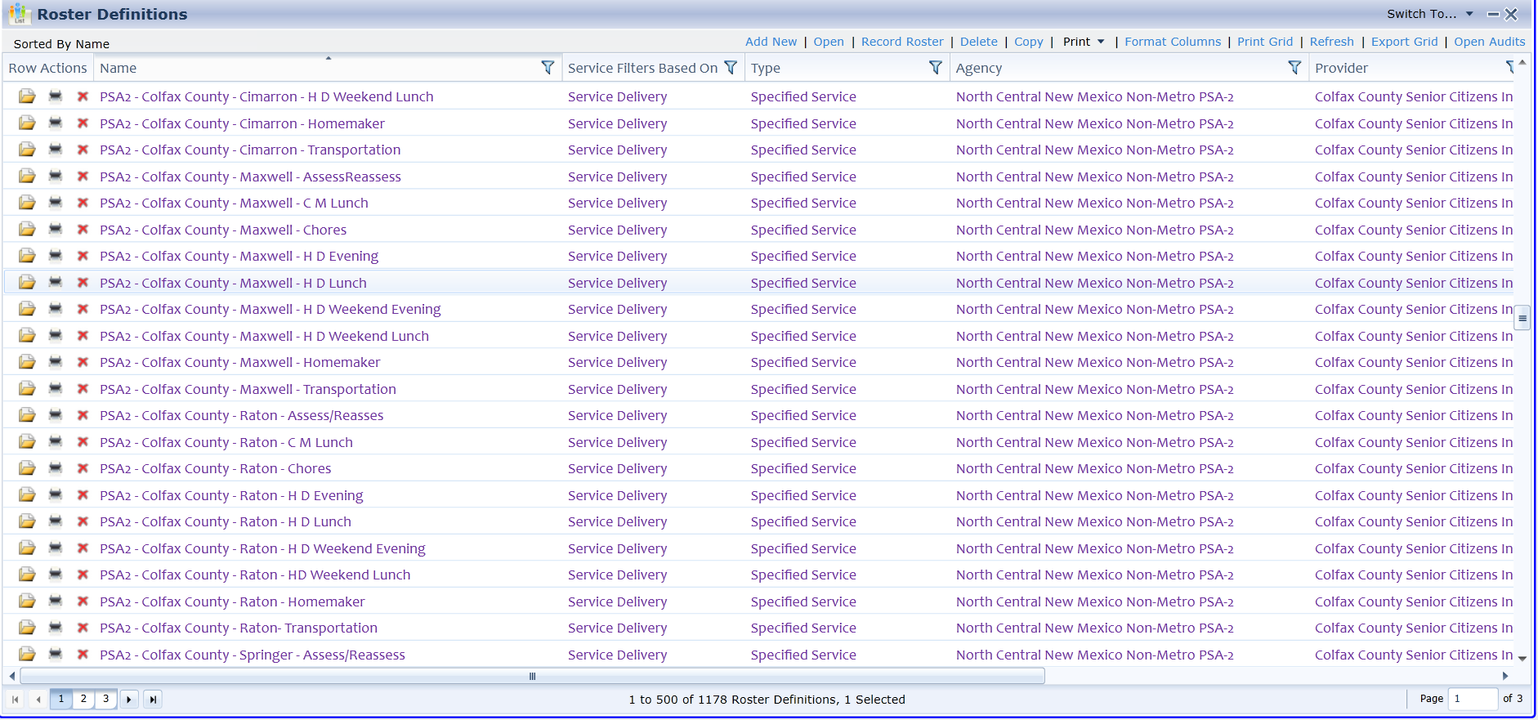
Now that you have an idea of what all needs to be included upon report submission and what to check for, we will now move on to checking these reports for accuracy inside SAMS.
The Tucumcari Data Center starts checking reports by running a local ASR report to help reconcile all data. We will compare the local report to the rosters, nutrition education units, guest & staff, unregistered units and assessment/reassessment rosters.

Slide 13
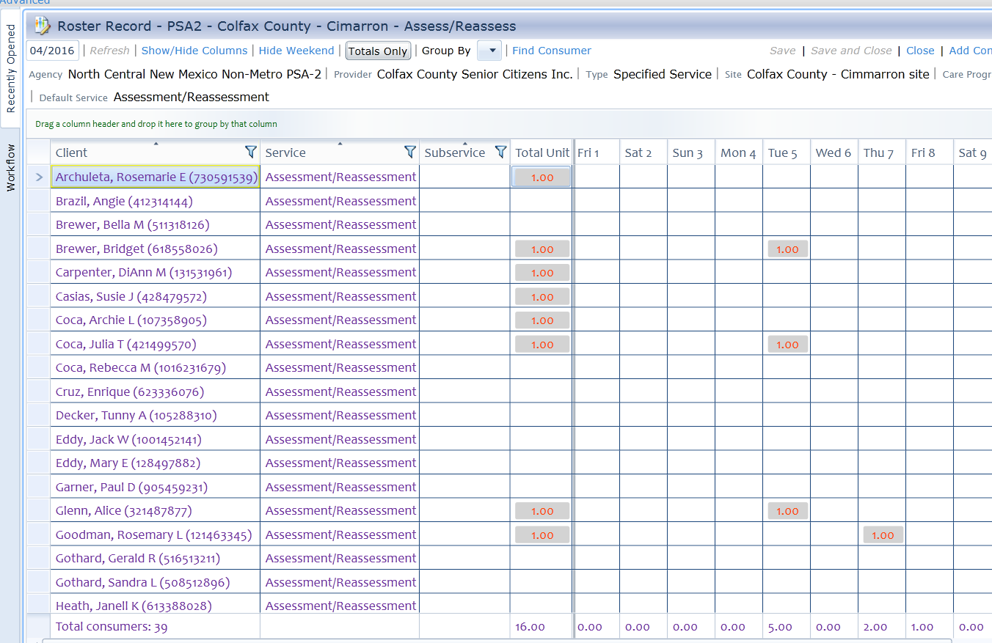
Reconciling Roster Data:
After your roster is opened, data in the roster gets checked against your local report and make sure it reconciles.
For this example, we will be checking the Assessment/Reassessment Roster for the Cimarron Site
You will want to make sure your totals from the roster match the totals on the ASR Local Report, if they match you will then close that roster and move on to the next roster on the list in SAMS

Slide 14
Things to keep in Mind:
When reconciling data, please keep in mind that different services have different allotted totals they are not allowed to surpass without proper justification.
For example:
Assessment/Reassessment units should never be more than 1 in a month
Chore, Homemaker, Adult Day Care & Respite Services are units determined by providers for each consumer, but they should be in increments of .25 (.00, .25, .50 or .75).
Congregate and Home Delivered Meals should not surpass the monthly limits set in the care plan
Please note, each consumer should only have 1 unit per day or no more than 5 units per week, if those totals are more than the allotted amount, the provider will need to be contacted for extra meal justification
Please enter roster data on a daily or weekly basis to ensure accuracy
CM-Lunch – 25.00 per month
HD-Lunch, Evening & Breakfast – 25.00 per month
Weekend meals – 10.00 per month
Transportation 100.00 units monthly

Slide 15
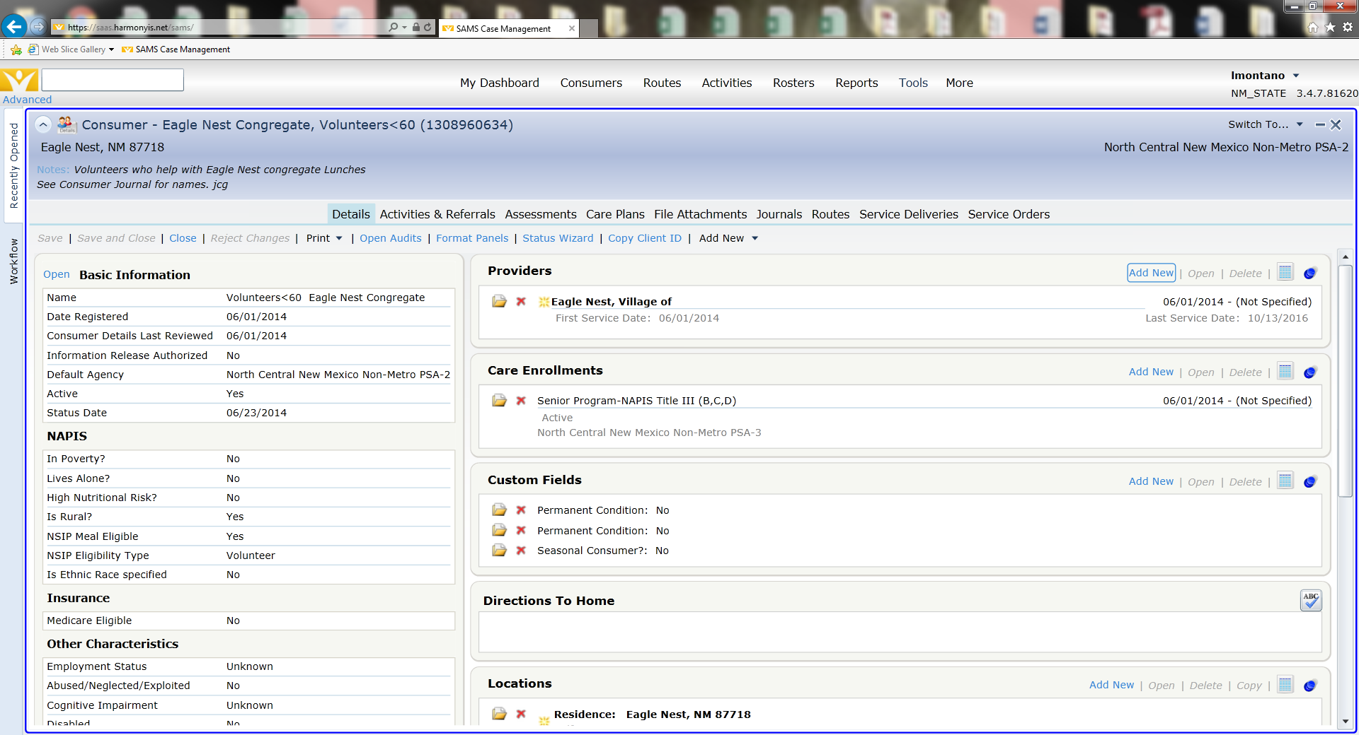
Volunteer Groups Under 60:
Some provider’s have volunteers under 60 who help out at the centers.
When volunteers are a constant variable at Centers, they have an assigned group in SAMS that is set up like a consumer.
For example, we will use the Village of Eagle Nest (they have volunteers monthly)
The Tucumcari Data Center has set up their group for them in SAMS with an ID number of 1308960634 or they can be found by searching “Eagle Nest Congregate, Volunteers<60”

Slide 16
Adding Congregate Volunteer Units:
When you need to add volunteer units to your created group, you will need to go to Service Deliveries
You will then click Add New

Slide 17
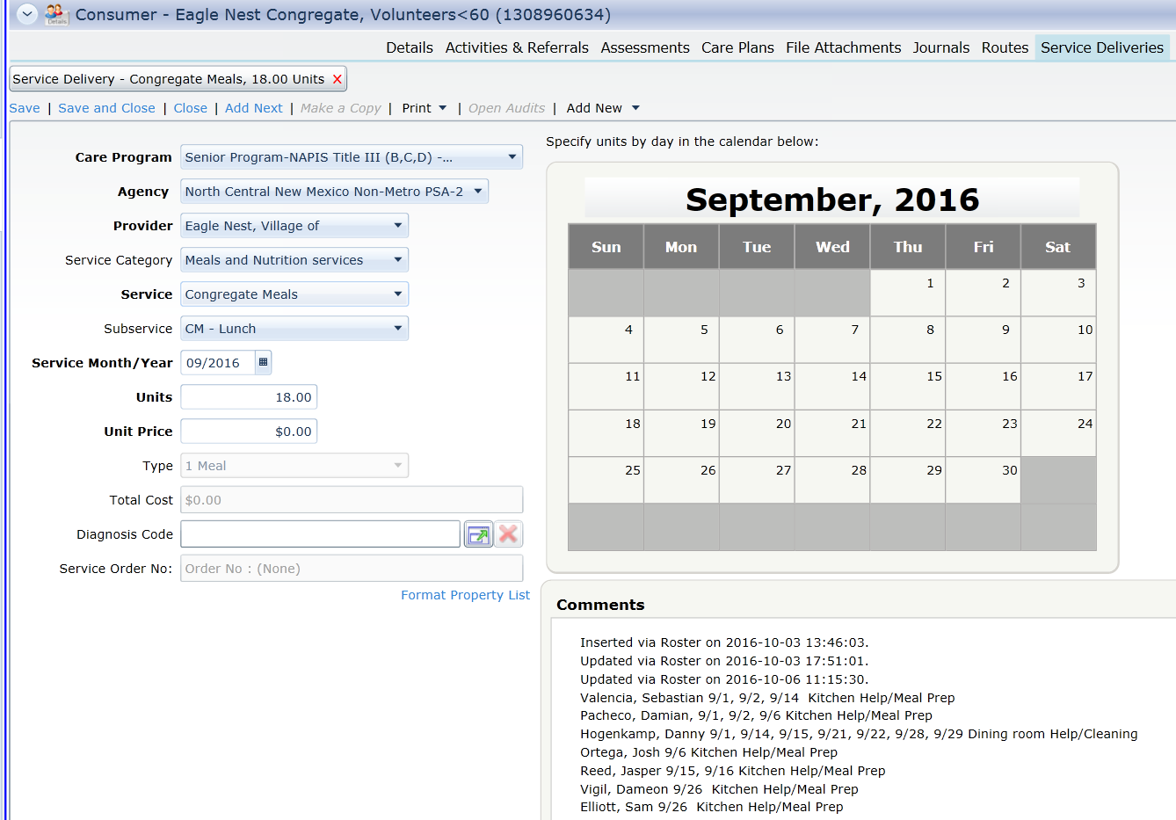
Once you have clicked Add New, you will be taken to a blank service delivery screen.
For this example we will view Eagle Nest’s September 2016 entry:
When adding a new Service Delivery please double check the following to make sure your entry is correct:
Care Program, Agency, Provider & Site (if applicable)
Correct Service & Subservice
Service Month/Year
Units
The unit breakdown should always be listed in the comments section, for volunteers, the name of the volunteer and how they volunteered must be listed in the breakdown.

Slide 18
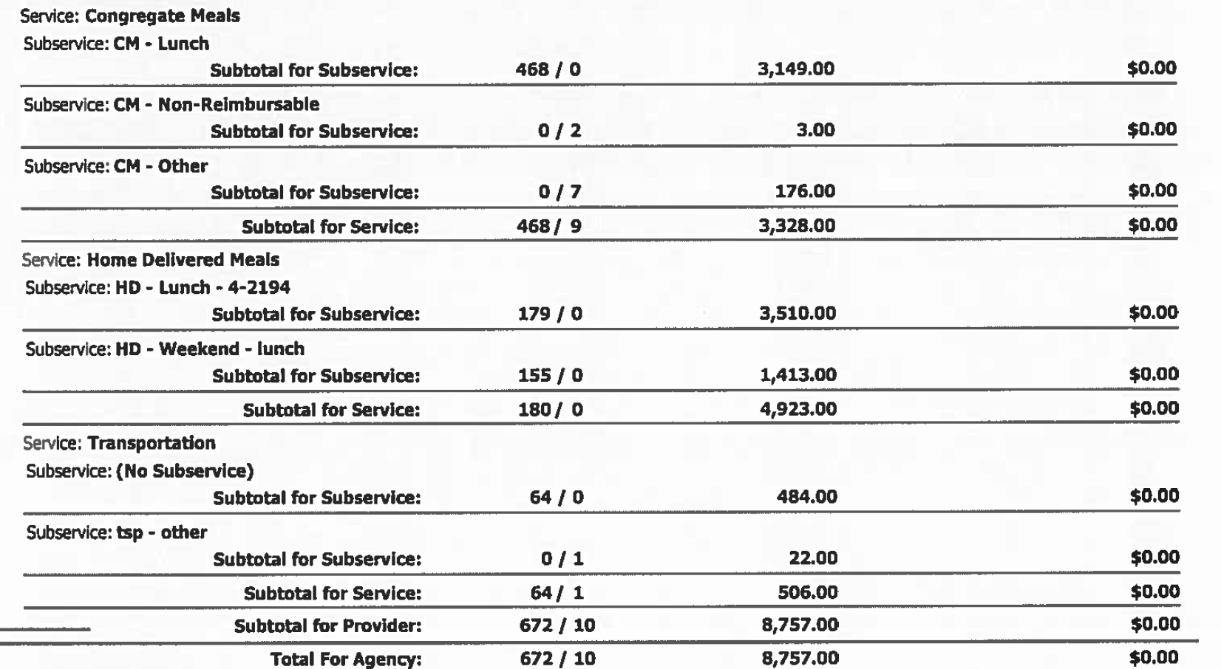
Consumer Groups:
Once you have checked all data in the Rosters Section and Congregate Volunteers under 60 (if applicable), you will then move on to the Consumers section.
In this section you will find all guest and staff meals (CM Non-Reimbursable), Nutrition Education and any unregistered eligible units (CM-Other, HD-Non-Reimbursable, Tsp-Other, etc)
You will then filter the Consumer’s tab the same way you filtered the Roster tab with one difference, only filter it by PSA.
Ex: psa2

Slide 19
Consumer Groups – Unregistered Units:
All unregistered units, including HD-Non-Reimbursable units will be found in the consumer’s Tab, make sure you select “Consumer Groups” under the “Consumer Type” Filter and click apply.
Once you have selected Consumer Groups, your unregistered units will be located in the top group, based on PSA.
For Example: PSA2 – A Unregistered Eligible Consumer
Right Click on the consumer group, hover over “Open To. . .” and select “Service Deliveries” from the drop down Menu.

Slide 20
Now that we are in the Unregistered Service Delivery Area, you can filter your results, by Provider to reflect only the one you are searching for.
In this example, we will filter our results to reflect Santa Fe County.
Once you filter your provider, you will only see service deliveries for that program.
You will then check each service delivery for the corresponding reporting period, matching each entry to what is listed on your ASR Local Report.

Slide 21
Things to Keep in Mind:
When checking unregistered eligible units for any provider, please be sure to open the actual service delivery and check for the following:
Care Program, Agency, Provider & Site
Correct Service & Subservice
Service Month/Year
Units
If it is transportation, your subservice will need to be tsp – other
Congregate Meals will be CM – Other
And Home Delivered Meals will be HD – Non-Reimbursable
The unit breakdown should always be listed in the comments section for all of these services
The “Consumers Served” should always be 1
Unit Breakdown

Slide 22
Consumer Groups - Guest & Staff Meals:
Guest and Staff Meals are listed by PSA and also by Provider, each Provider has their own listing for Guest and Staff.
It will be listed as PSA# - Provider – Aggregate Guest
Or PSA# - Provider – Aggregate Staff
For this example we will use Colfax County
PSA2 – Colfax County – Aggregate Guests
Right click on the group, hover over “Open to . . .” and select “Service Deliveries” from the dropdown menu

Slide 23
Once in the consumer group, you will need to check the units entered against the units reported on the ASR Local.
Please Note: Guest and Staff meals may be a combination of both consumer groups, always be sure to check both groups if your numbers are not matching up.
In this case, all meals are reported in the same consumer group.

Slide 24
Things to Keep in Mind:
When checking Guest & Staff units for any provider, please be sure to open the actual service delivery and check for the following:
Care Program, Agency, Provider & Site
Correct Service & Subservice
Service Month/Year
Units
All Guest and Staff meals will have a subservice of CM – Non-Reimbursable
The unit breakdown should always be listed in the comments section. If a question should arise, check previous entries and see if it is reoccurring.
The “Consumers Served” should always be 1
Unit Breakdown

Slide 25
Consumer Groups – Aggregate Visitor:
Aggregate Victors: Prior written approval from the AAA is required to count consumers for a special event who are not registered in SAMS however they do meet the eligibility criteria.
Aggregate Visitors are listed by PSA and also by Provider, each Provider has their own listing for Guest and Staff.
It will be listed as PSA# - Provider – Aggregate Visitor
For this example we will use Colfax County
PSA2 – Colfax County – Aggregate Visitors
Right click on the group, hover over “Open to . . .” and select “Service Deliveries” from the dropdown menu

Slide 26
Things to Keep in Mind:
When checking Aggregate Visitor units for any provider, please be sure to open the actual service delivery and check for the following:
Care Program, Agency, Provider & Site
Correct Service
Service Month/Year
Units
The unit breakdown should always be listed in the comments section, make sure to check the breakdown for Approved date of event and unit breakdown.
The “Consumers Served” should always be 1.
Approved Date of event /Unit Breakdown

Slide 27
Consumer Groups – Nutrition Education:
The last consumer group to be checked is Nutrition Education.
You can find Nutrition Education the same way as guest and staff.
Please Note: The consumer group is not named Nutrition Education.
Nutrition Education listed by PSA and also by Provider, each Provider has their own listing.
It will be listed as PSA# - Provider – Aggregate Visitor
For this example we will use Colfax County
PSA2 – Colfax County – Aggregate Visitors
Right click on the group, hover over “Open to . . .” and select “Service Deliveries” from the dropdown menu

Slide 28
Things to Keep in Mind:
When checking Nutrition Education units for any provider, please be sure to open the actual service delivery and check for the following:
Care Program, Agency, Provider & Site
Correct Service
Service Month/Year
Units
The unit breakdown should always be listed in the comments section, make sure to check the breakdown for both Congregate and Home Delivered units.
The “Consumers Served” should always match the number of units.
Nutrition Education is the only group where these numbers will match.
Unit Breakdown

Slide 29
Reconciling Data:
After Nutrition Education is checked, its time to reconcile reports.
You will want to go through your ASR Local Report and make sure the services add up and match the totals on the AAA ASR.

Slide 30
Reconciling YTD Spreadsheet to Unregistered Units
After reconciling the ASR Local to the AAA ASR, you will need to double check and make sure all unregistered eligible units on the ASR (CM-Other, HD-Non-Reimbursable, tsp-other, etc.), match the grand total at the bottom of the YTD spreadsheet for that corresponding month.
Add together

Slide 31
Reconciling Data:
If all data matches from your Local report to your AAA report and your YTD reconciles as well, it’s time to check and see if the AAA ASR matches your AAA NSIP report.
Please keep in mind that CM – Non-Reimbursable meals will not reflect on your NSIP report, only CM-Lunch, Evening, etc, and CM-Other, along with all Home Delivered Meal Units will reflect here.
make sure to subtract CM – Non-Reimbursable units from your unit total.

Slide 32
Signing Reports:
Once all reports have reconciled, a consumer coordinator from the Tucumcari Data Center will then sign and date all corresponding reports and fill out the “Non Metro AAA” section of the Verification Statement.
*Consumer Coordinators will sign and date every page the provider has signed and dated

Slide 33
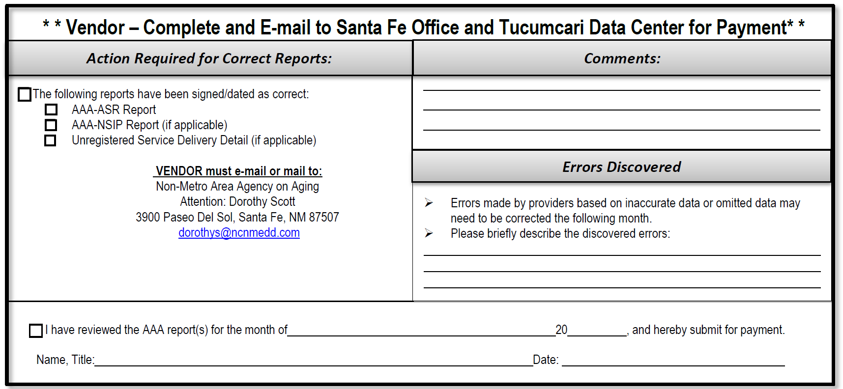
Providers will need to submit the reports that contain both the provider staff and data management staff signatures, as well as complete the SAMS Verification Statement, this middle section will be the last step completed before your reports are sent on to Santa Fe.
All appropriate boxes in this section that pertain to your program will need to be checked, we also require a signature, the reporting month and year and the title of the person signing this section.

Slide 34
This is an example of how your SAMS Verification will look before submission to the Santa Fe office for reimbursement.
When sending it to Dorothy Scott please make sure to CC the SAMS E-Mail Group: sams@ncnmedd.com

Slide 35
Questions?

