Slide 1
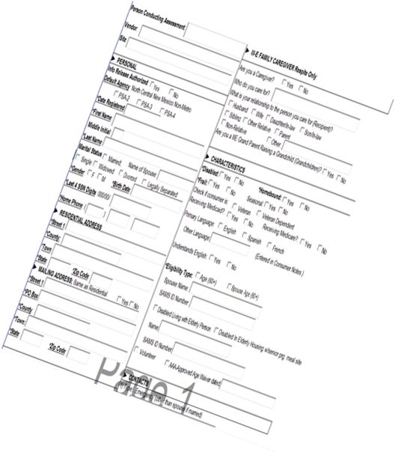
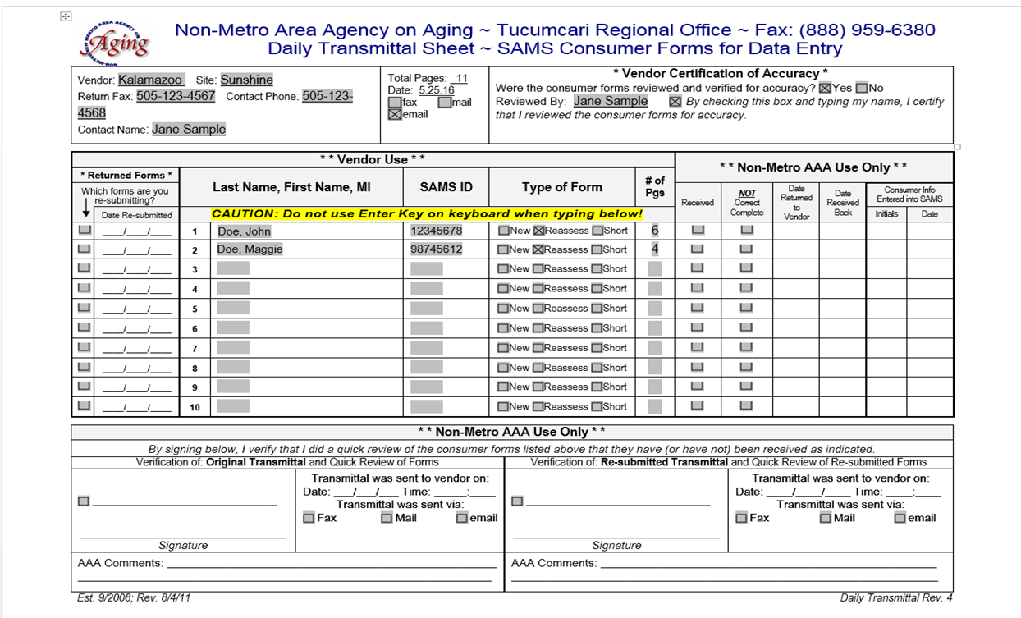
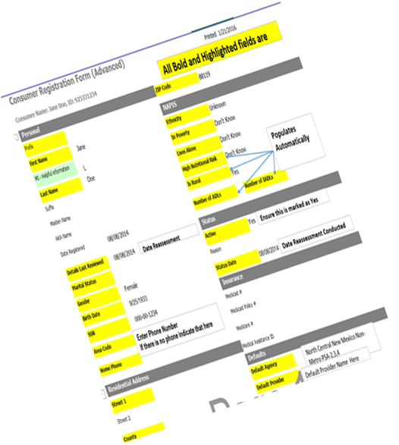
Data Submission Review

Slide 2
What Forms are Uploaded to ShareFile
A Daily Transmittal should be used with the following forms
Initial Assessments and/or Short Forms
Initial Assessments and/or Shorts Forms may be submitted to the data center on the same daily transmittal sheet.
Reassessments
Reassessments should be submitted to data center on a daily transmittal sheet separately from both Initial Assessments and Short Forms
Additional Forms that would be uploaded separately to ShareFile
Change Forms
Deactivation Forms

Slide 3
How to Complete a Daily Transmittal
Prior to Submission, the following should be completed
Verification of Accuracy completed
Ensure all consumers that are listed are included
Total number of pages for each consumer listed

Slide 4
File Naming Conventions
Single Site Vendors
Vendor Name– Date Submitted to AAA – New – 1st Consumer listed on the Daily Transmittal.
Vendor Name – Date Submitted to AAA – Short Form– 1st Consumer listed on the Daily Transmittal.
Vendor Name – Date Submitted to AAA – Reassess– 1st Consumer listed on the Daily Transmittal.
Vendor Name – Date Submitted to AAA – Deactivation– 1st Consumer listed on the Deactivation Request.
Vendor Name – Date Submitted to AAA – Change Form– 1st Consumer listed on the Change Request.
Multi Site Vendors
Vendor Name (Site) – Date Submitted to AAA – New – 1st Consumer listed on the Daily Transmittal.
Vendor Name (Site) – Date Submitted to AAA – Short Form– 1st Consumer listed on the Daily Transmittal.
Vendor Name (Site) – Date Submitted to AAA – Reassess– 1st Consumer listed on the Daily Transmittal.
Vendor Name (Site) – Date Submitted to AAA – Deactivation– 1st Consumer listed the Deactivation Request.
Vendor Name (Site) – Date Submitted to AAA – Change Form– 1st Consumer listed on the Change Request.

Slide 5
Uploading to ShareFile
Utilize the upload link contained in our e-mails
Once you click on the link your web browser will open

Slide 6
Uploading to ShareFile
Enter the required information, then click Continue
Upload Screen

Slide 7
Uploading to ShareFile
Once on the upload screen you have two options
Drag your files to the center and drop
Browse for Files
The Upload button on the bottom of the screen will darken once a file is placed on the upload section.

Slide 8
Uploading to ShareFile
Once you have dropped or browsed for your file then you can either click Add more if there are more files to be uploaded or Click Upload
Once the upload has been processed you should see a green banner at the top of the screen. If you get an error the banner will be red, please try submission again.

Slide 9
Things to Keep in Mind
Only the person who uploads to ShareFile will receive an e-mail confirmation.
Please be sure to check your junk folder if the e-mail is not coming directly to your inbox folder.
Ensure that the e-mail is correct on the Sign In screen so it goes to the correct e-mail.
Once you are sure the e-mail is correct left click the box next to Remember Me, the system will remember you and this e-mail address.
Be sure to notify our office if your e-mail address should change.

Slide 10
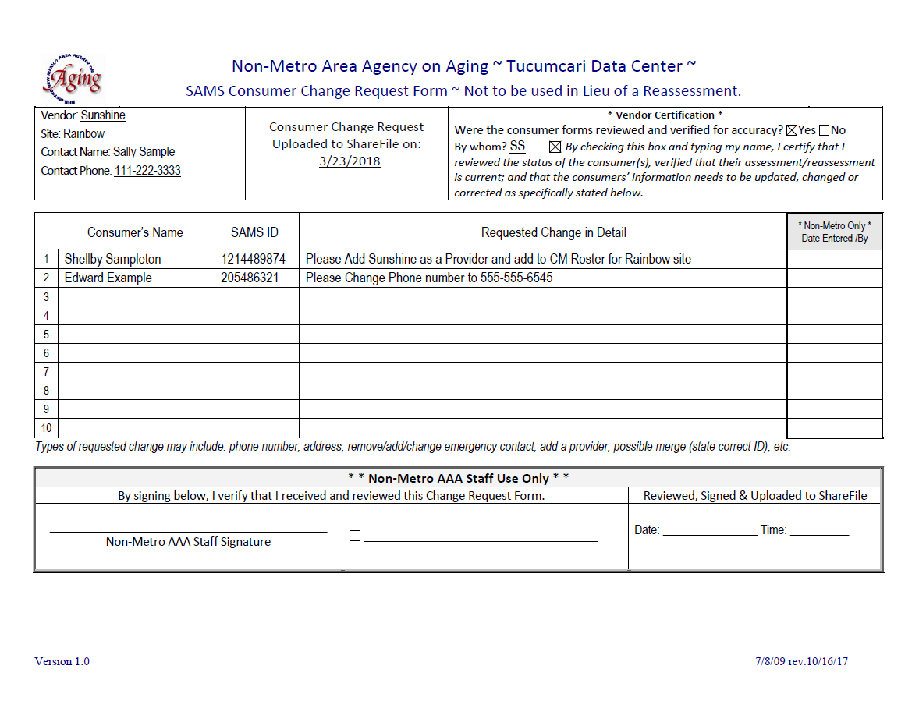
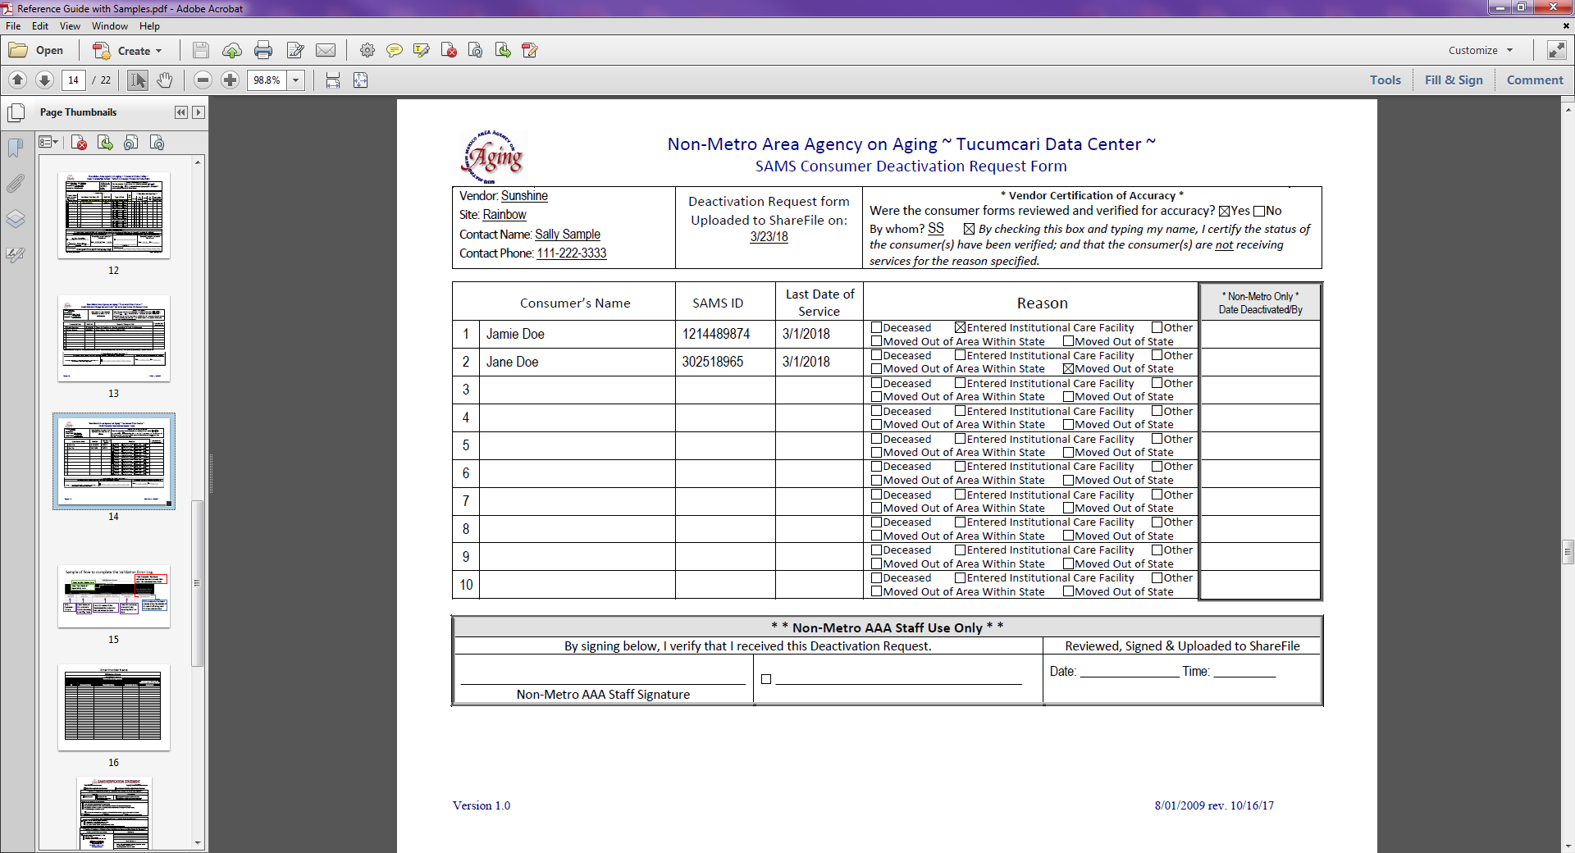
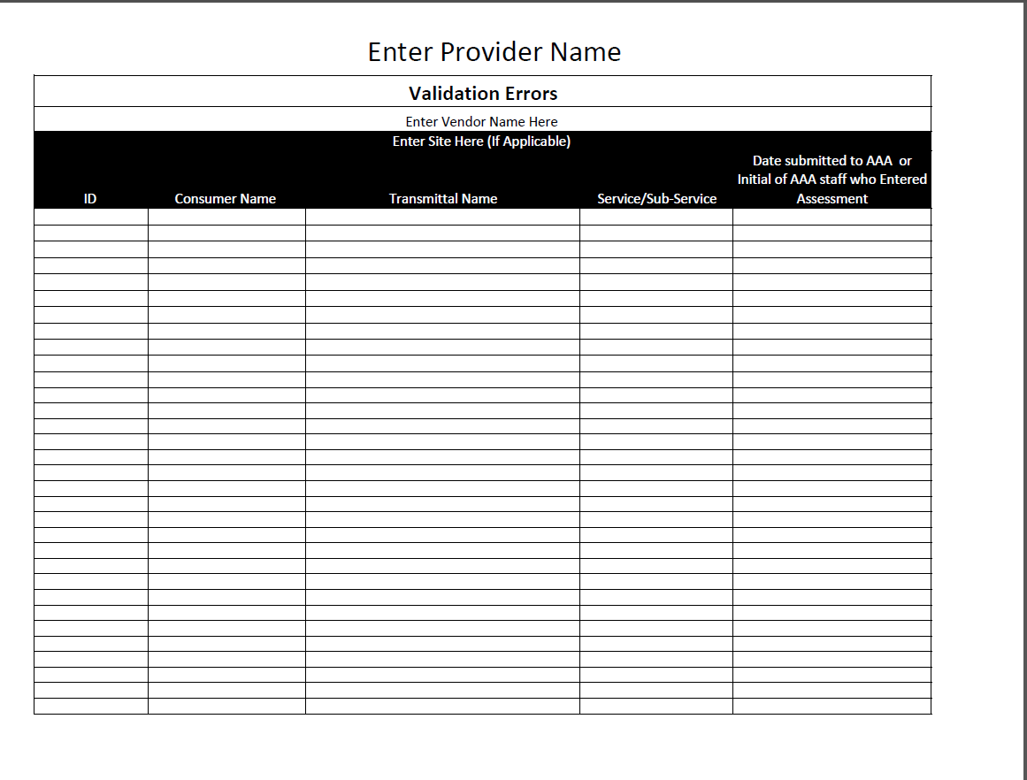
Non-Metro AAA Data Center Reference Sheet & Sample Forms
A quick reference guide

Slide 11
Initial Assessments/Short Forms

Slide 12
Prior to submitting an Initial assessment or Short Form, search in the SAMS database to ensure the consumer is not already in SAMS
Using the Search Bar
Type the consumer’s name

Slide 13
Left Click on Advanced under the search bar
Using the Advance search
Search By:
Last 4 Digits of Social Security Number
Telephone number
Birthdate
Address

Slide 14
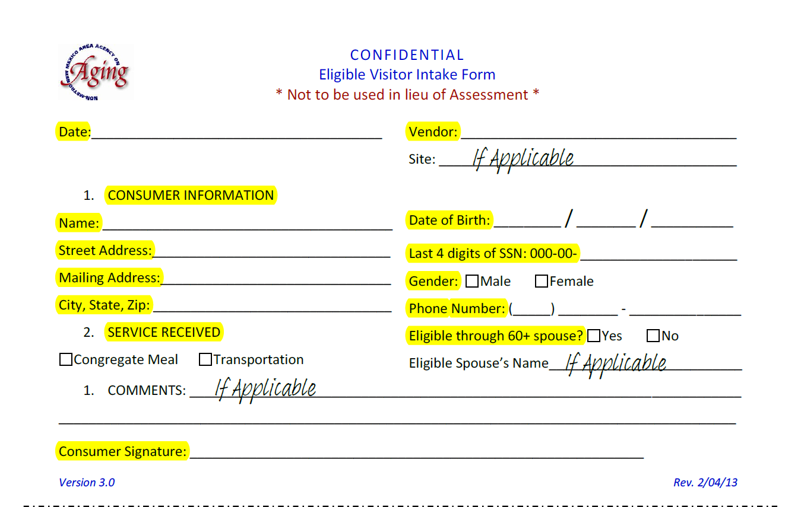
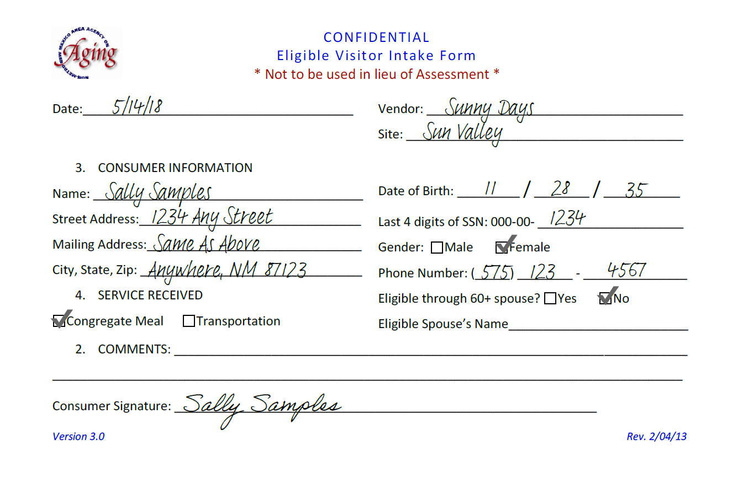
Short Forms
Should be used for one time visitors
Visitors from out of state who may be passing through
Visitors from within state who may be passing through
Short Forms should be completed by trained volunteer/staff
Ensure that all applicable fields are completed
Prior to submitting a Short Form, Please check the SAMS data base to verify that the consumer is not already registered.
If they are already in SAMS then a Change Form should be used

Slide 15
Initial Assessments
Utilize the forms in the Assessment Forms Packet 4.0 to conduct all assessments/reassessments. Forms can be completed either electronically or handwritten
Assessments should consist of
Initial Assessment 4.0
Nutritional Health Screening 4.0
ADL/IADL 4.0
Consumer Notes 4.0 (if applicable)
Rating Scale 4.0 (if applicable)

Slide 16
Reassessments

Slide 17
Re-Assessments
Utilize the forms in the Assessment Forms Packet 4.0 to conduct all assessments/reassessments. Forms can be completed either electronically or handwritten
Reassessments should consist of
2 page Pre Filled Form from SAMS – Advanced (see example in Assessment Forms Packet 4.0)
Nutritional Health Screening 4.0
ADL/IADL 4.0
Consumer Notes 4.0 (if applicable)
Rating Scale 4.0 (if applicable)

Slide 18
Change Forms

Slide 19
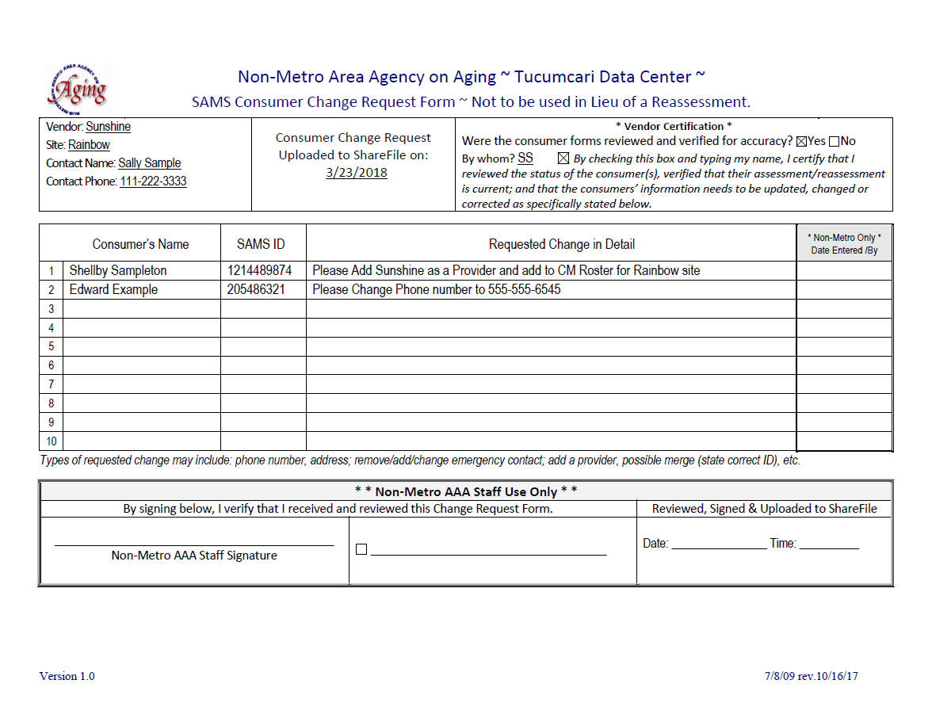
Change Form
Types of requested changes may include:
Phone Number
Address
Adding a Provider
Remove/Add/Change Emergency Contact
Possible Merge
Remove/Add/Change a Service – in instances where a reassessment is not required such as transportation.
Change Forms should be submitted separately from other documents/transmittals.

Slide 20
Deactivation Forms

Slide 21
Deactivation Forms
Reason for deactivation would include
Deceased
Entered Institutional Care Facility
Moved Out of State or Other
Moved Out of Area Within State
Please be sure to mark the reason for deactivation

Slide 22
Returned Daily Transmittal

Slide 23
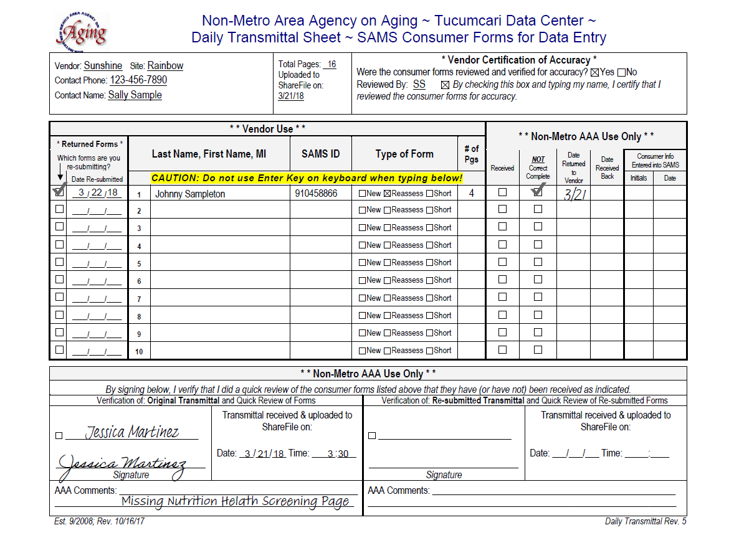
Returned Daily Transmittals
Daily Transmittals will be marked as Returned
Some examples would include but are not limited to
Missing Pages
Missing pertinent information
Wrong forms used
Services not clarified
Not due for reassessment

Slide 24
File Naming Conventions for Resubmitted Transmittals
Single Site Vendors
Vendor Name– Date Submitted to AAA – New – 1st Consumer resubmitted listed on the Daily Transmittal.
Vendor Name – Date Submitted to AAA – Short Form – 1st Consumer resubmitted listed on the Daily Transmittal.
Vendor Name – Date Submitted to AAA – Reassess – 1st Consumer resubmitted listed on the Daily Transmittal.
Multi Site Vendors
Vendor Name (Site) – Date Submitted to AAA – New – 1st Consumer resubmitted listed on the Daily Transmittal.
Vendor Name (Site) – Date Submitted to AAA – Short Form – 1st Consumer resubmitted listed on the Daily Transmittal.
Vendor Name (Site) – Date Submitted to AAA – Reassess – 1st Consumer resubmitted listed on the Daily Transmittal.

Slide 25
Validation Errors: In-Home Services

Slide 26
Validation Errors: In-Home Services
Consumer name will be highlighted in Red on the roster
Reasons for a validation error could be
Reassessment is not up to date
Not listed as provider
New sub-service identified – needs to be added to the consumer service plan.

Slide 27
Validation Errors: Congregate Meals & Transportation

Slide 28
Validation Errors: Congregate Meals & Transportation
Consumer’s name not appearing on roster
Reasons for a validation error could be
Reassessment is not up to date
Not listed as provider
Not listed as provider site (if applicable)
New sub-service identified – needs to be added to the consumer service plan.

Slide 29
Monthly Reports

Slide 30
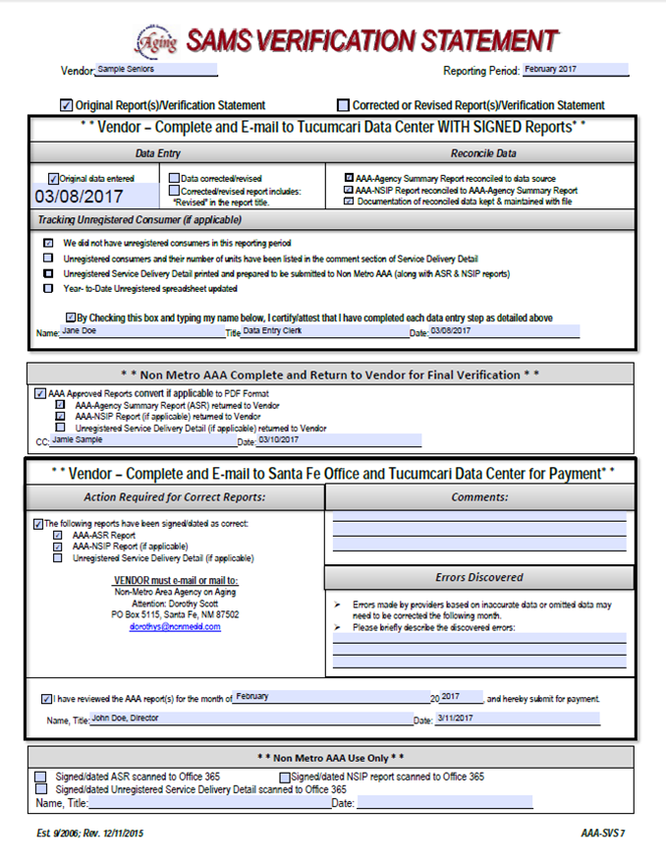
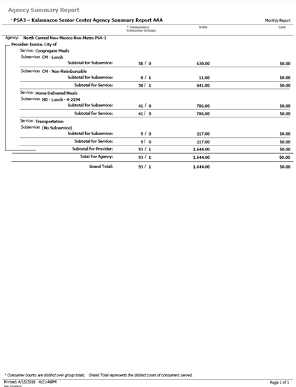
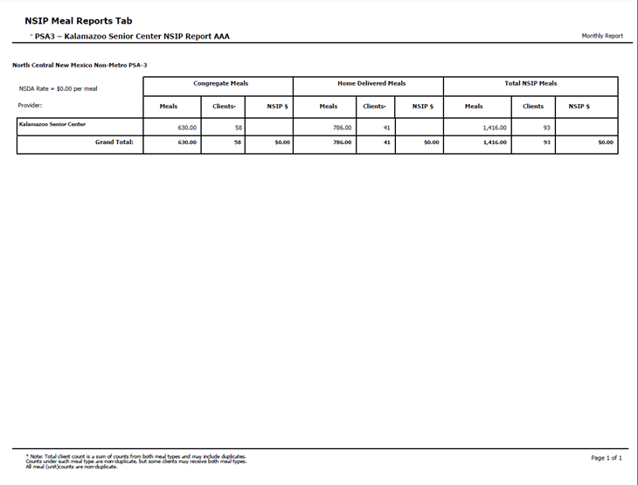
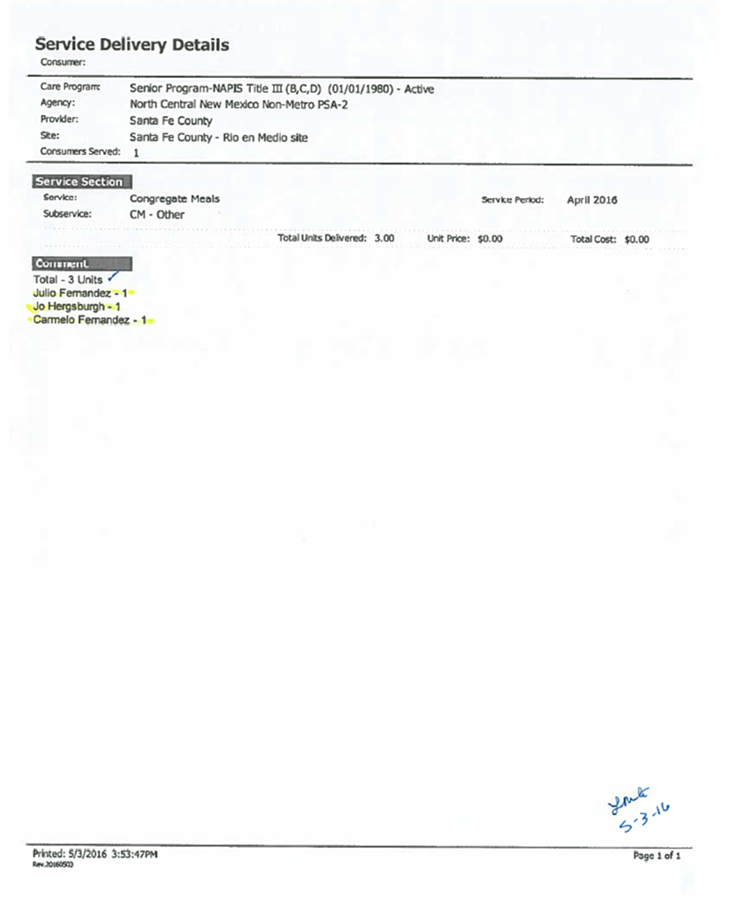
Monthly Reports
SAMS Monthly Reports for Reimbursement would include:
SAMS Verification Statement
AAA ASR (Agency Summary Report)
AAA NSIP Report (Nutrition Services Incentive Program) – if applicable
Unregistered Eligible Consumer Print Out (Service Delivery Print Out Sheet from SAMS) – if applicable
Excel YTD Unregistered Eligible Consumers – if applicable

