Slide 1


NM-AAA Training #2 FOOD Allergies
Constance Rudnicki MS, RDN, LD
Registered Dietitian/Nutritionist
Non-Metro Area Agency on Aging

Slide 2
Objectives
The learner will learn the difference between food allergies and food allergens
01
The learner will learn what foods can cause allergic reactions.
02
The learner will learn the big 8 food allergies
03
The learner will learn about cross contamination
04
The learner will learn how to read food labels for food allergies
05

Slide 3
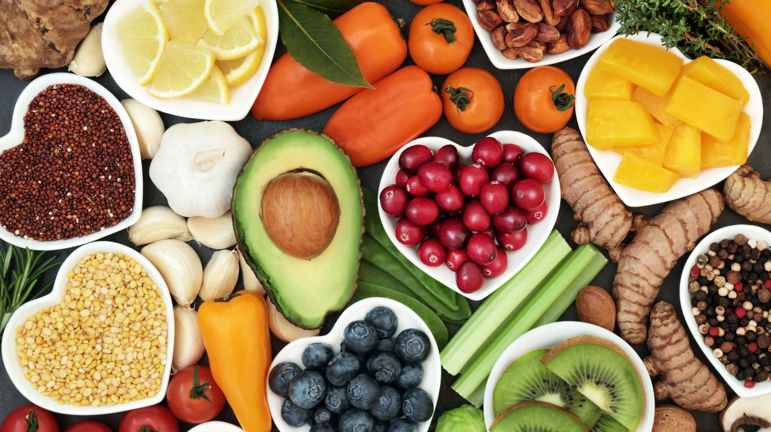
Section 1: Food Allergens

Slide 4
What are they?
Food allergens are substances inside food that cause allergic reactions. Some examples are celery, barley and oats, seafood, eggs, milk, mustard, peanuts, lupin, soybeans and tree nuts.^{[1]} It doesn't matter if these substances are consumed whole or put into food as an additive. If they exist in a food product, they may cause an allergic reaction in some people.
https://www.food.gov.uk/business-guidance/allergen-guidance-for-food-businesses.

Slide 5
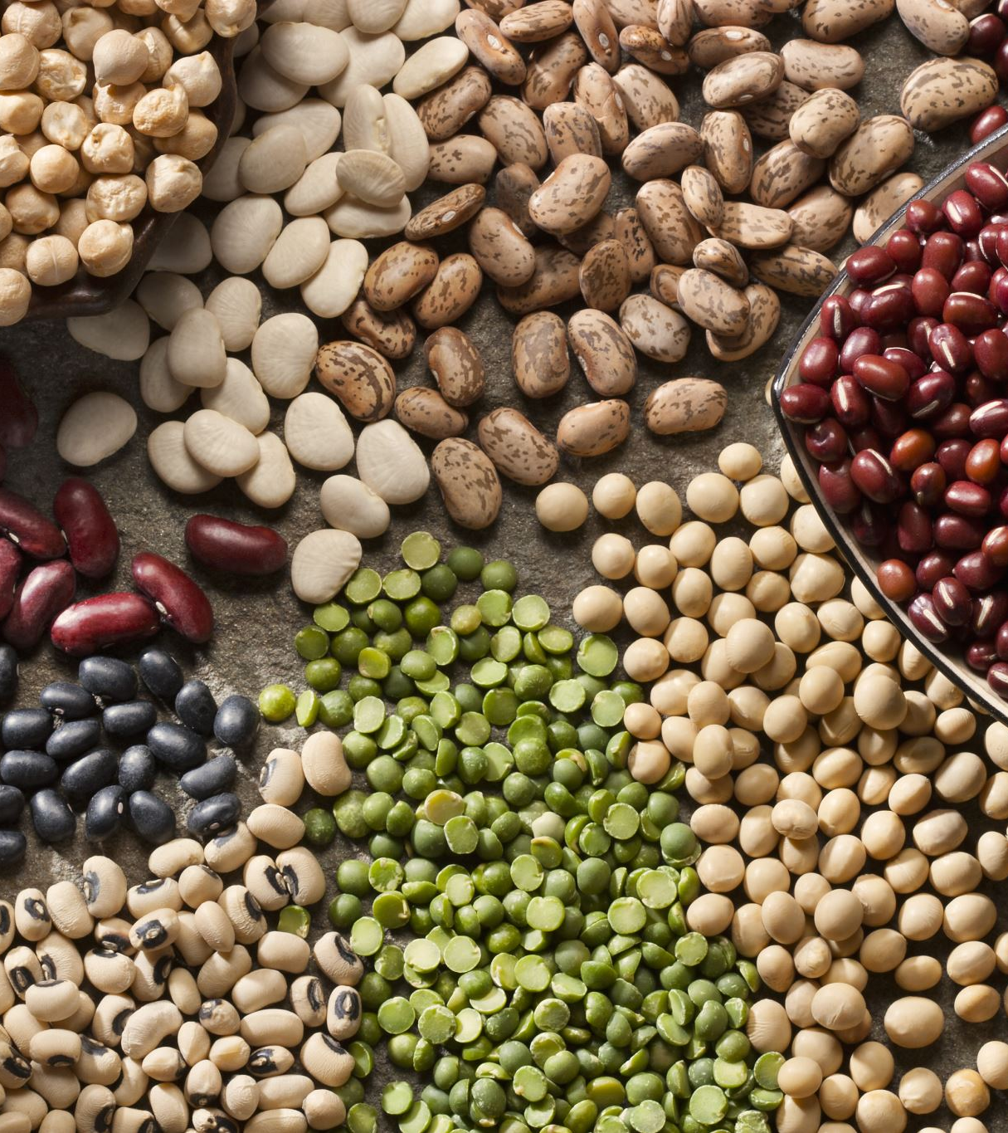
Food allergy vs. food allergen
A food allergen causes a food allergy, which is an abnormal immune response to food. A food allergy, on the other hand, is the body's response to a food allergen.

Slide 6
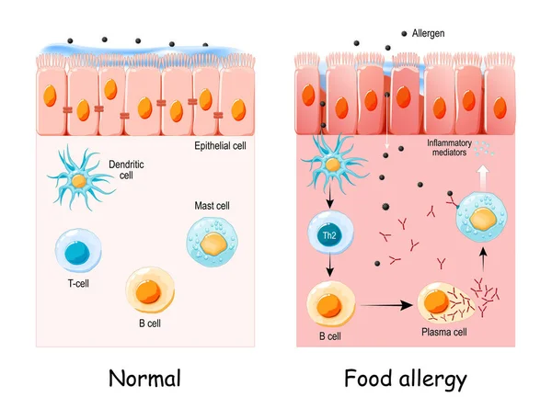
What causes an allergic reaction?
An allergic reaction happens when a part of the body's immune system, immunoglobulin E (IgE), binds to protein in food. Immunoglobulin E (IgE) is one of five immunoglobulins, and it's mostly found in the skin and mucous membranes. When the two react, they release chemicals like histamine – a natural chemical in the body that plays a role in inflammation and itching.^{[1, 2]}
Sicherer SH, Sampson HA (February 2014). "Food allergy: Epidemiology, pathogenesis, diagnosis, and treatment". J Allergy Clin Immunol. 133 (2): 291–307, quiz 308.
National Institute of Allergy and Infectious Diseases (July 2012). "Food Allergy An Overview"
Andersen HH, Elberling J, Arendt-Nielsen L (September 2015). "Human surrogate models of histaminergic and non-histaminergic itch". Acta Dermato-Venereologica. 95 (7): 771–7.

Slide 7
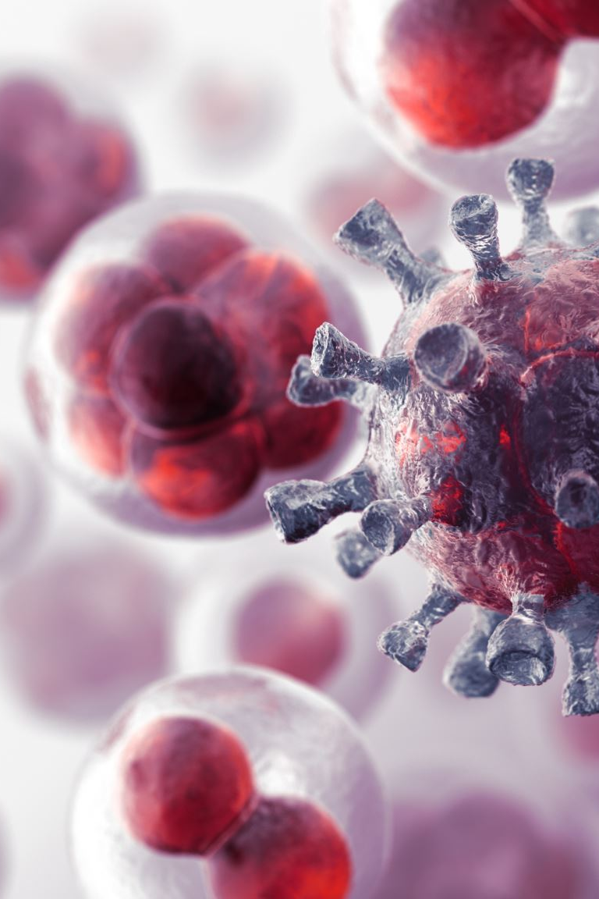
How does it affect the immune system?
The response to allergens starts in the immune system by overreacting to some food substances and by producing antibodies in an effort to attack them. The body's response to that attack (sneezing, itching, etc.) can weaken the immune system's ability to fight off actual viruses and germs.
What starts off as a series of sneezes or itching could make the body more susceptible to sinus, ear, or upper respiratory infections.^{[1]}
https://www.intercoastalmedical.com/2018/01/12/can-allergies-lower-your-immune-system.

Slide 8
Statistics
In total, about four percent of adults have a food allergy of some sort, and six to eight percent of children under the age of three also have one. Twelve million of them are in the United States. Shellfish, peanuts, tree nuts, fish, and eggs make up about 90% of all food allergies.^{[1]} Adults are mostly allergic to shellfish, peanuts, tree nuts, fish, and eggs, while children are mostly allergic to milk, eggs, peanuts, and tree nuts.^{[2]}
Of the children who are allergic to milk protein, 75% of them can tolerate baked-in milk products such as cookies, cakes, and dried formulas.^{[3]} And about half of young children who are allergic to milk, eggs, soy, peanuts, tree nuts, and wheat will outgrow their allergy by the time they turn six years of age. But those who remain allergic by the time they turn twelve years of age have less than an eight percent chance of outgrowing the allergy.^{[4]}
About 20% of people who are allergic to peanuts and 9% of people who are allergic to tree nuts outgrow their allergies,^{[5]} but these types of allergies are less likely to be outgrown overall.
About Food Allergies Allergens". Food Allergy Initiative. December 9, 2013
National Institute of Allergy and Infectious Diseases (July 2004). "Food Allergy: An Overview" (PDF). National Institutes of Health. p. 35.
Lucendo AJ, Arias A, Gonzalez-Cervera J, Mota-Huertas T, Yague-Compadre JL. Tolerance of a cow's milk-based hydrolyzed formula in patients with eosinophilic esophagitis triggered by milk. Allergy; 68:1065–72.
"What Are Food Allergies? Food Allergy Summary". Asthma and Allergy Foundation of America. March 28, 2007
Fleischer DM, Conover-Walker MK, Matsui EC, et al. (November 2005). "The natural history of tree nut allergy". J Allergy Clin Immunol. 116 (5): 1087–93.

Slide 9
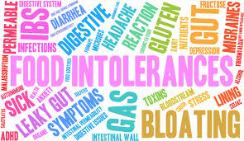
Food intolerance
Gluten
Gluten is substance that creates food intolerance for a lot of people. It's a general name for the proteins in wheat, barley, rye and triticale. And it can create a celiac disease. Celiac disease results when the immune system attacks the small intestine in an effort to fight off the gluten.
People who suffer symptoms after being exposed to gluten, but test negative may have a non-celiac gluten sensitivity, which is a mild form of gluten intolerance. About 0.5% to 13% of the population suffers from a non-celiac gluten sensitivity.^{[1]}
Dairy
Dairy products can also create food intolerance among many. And the culprit is lactose - a sugar found in milk. Inside the body, lactase (an enzyme) breaks down the lactose so that it can be digested and absorbed. But inside intolerant persons, there isn't enough lactase to break it down, making its digestion extremely difficult. About 65% of the entire human population has trouble digesting lactose.^{[2, 3]}
olina-Infante J, Santolaria S, Sanders DS, Fernández-Bañares F. Systematic review: noncoeliac gluten sensitivity. Aliment Pharmacol Ther. 2015 May;41(9):807-20.
https://medlineplus.gov/genetics/condition/lactose-intolerance/#statistics
https://www.healthline.com/nutrition/common-food-intolerances#TOC_TITLE_HDR_4

Slide 10
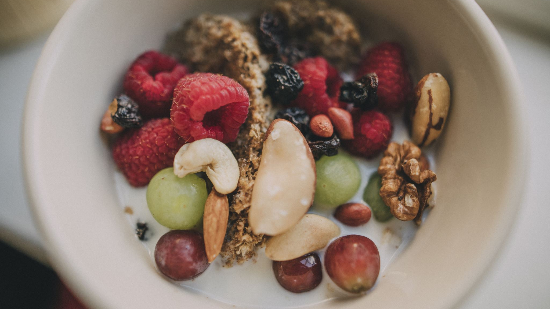
Food sensitivity
Unlike both food allergens and food intolerance, food sensitivity isn't life-threatening. Nor is it related to the immune system. It is, instead, an inability to digest a particular type of food, and it's the result of the body failing to properly break the food down. Lactose intolerance is a common example in which the body can't break down lactose, a sugar found in dairy products.
Reasons may be a lack of the needed enzymes, reactions to food additives or preservatives (like MSG or artificial colors), a sensitivity to caffeine, sugars, or other chemicals.^{[1]}
https://www.healthline.com/health/allergies/food-allergy-sensitivity-difference#food-sensitivities.

Slide 11
Food-related diseases
A food-related disease is a condition that causes the digestive system to act abnormally.
A good example is celiac disease.
Celiac disease is an autoimmune disorder that results from an intolerance to gluten, a group of various proteins that are found in foods like as wheat, rye and barley.^{[1]} Its symptoms include chronic diarrhea, bloating, malabsorption, and a loss of appetite. It can also prevent children between six months and two years of age from growing normally.^{[2]}
The only treatment is a strict, lifelong gluten-free diet.^{[3]} Without treatment, people may suffer from intestinal lymphoma and an increased chance of an early death.^{[4]}

Slide 12
Minor symptoms of food allergy
Rashes
A rash is a red, warm, flat or bumpy, cracked and blistering eruption of the skin. It can occur on one part of the body or the entire body.
Hives
Hives is a temporary rash that creates large, red, raised, itchy bumps.^{[1]} They might burn or sting as well.^{[2]}
Itching
Itching may occur in the mouth, on the lips and tongue, in the throat, eyes, skin, or other area.
Swelling
Swelling is common too, and could inflame the lips, tongue, eyelids, or entire face.
https://medlineplus.gov/hives.html
Jafilan, L; James, C (December 2015). "Urticaria and Allergy-Mediated Conditions". Primary Care. 42 (4): 473–83.

Slide 13
Severe symptoms of food allergy
Breathing issues
Breathing issues related to food allergens can include wheezing, coughing, and/or shortness of breath. This could also lead to loss of consciousness.
Anaphylaxis
Anaphylaxis is a reaction resulting from mere contact with a particular substance. Because it's an allergic reaction that comes on quickly and may cause death, it's considered a medical emergency that requires immediate treatment such as an injectable epinephrine and follow-up care. It starts when the immune system overreacts to an allergen.^{[1]}
Death
In the United States, around 12 million people have food allergies. And that number is increasing.^{[2, 3, 4]} These allergies bring about approximately 30,000 emergency room visits and 150 deaths per year.^{[5]}
https://www.aaaai.org/tools-for-the-public/conditions-library/allergies/anaphylaxis
Kagan RS (February 2003). "Food allergy: an overview". Environ Health Perspect. 111 (2): 223–5.
Branum AM, Lukacs SL (2008). "Food allergy among U.S. children: trends in prevalence and hospitalizations". NCHS Data Brief (10): 1–8.
Ben-Shoshan M, Turnbull E, Clarke A (2012). "Food allergy: temporal trends and determinants". Curr Allergy Asthma Rep. 12 (4): 346–72.
https://www.fda.gov/food/food-allergensgluten-free-guidance-documents-regulatory-information/food-allergen-labeling-and-consumer-protection-act-2004-questions-and-answers#q6

Slide 14
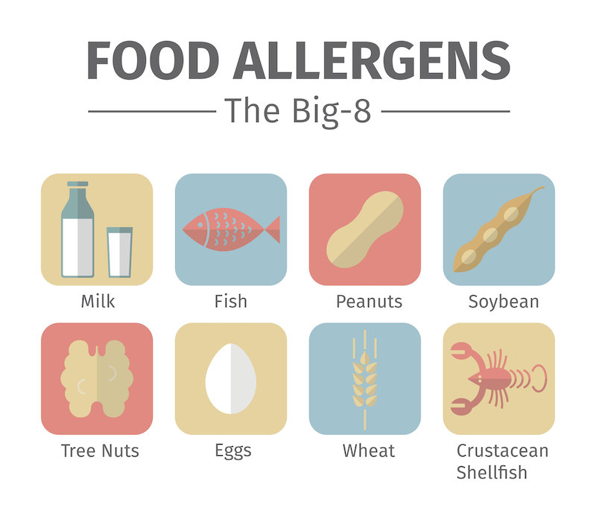
The Big 8
The Food Allergen Labeling and Consumer Protection Act of 2004 (FALCPA) lists the foods covered in this section as the most allergenic, which consequently make up 90 percent of food-related allergies in the United States.^{[1]}
https://www.fda.gov/media/79019/download.

Slide 15
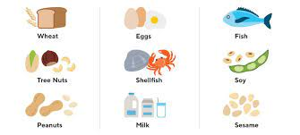
Section 2: What Foods Can Cause Allergic Reactions?

Slide 16

Milk Allergy
A milk allergy differs from a milk intolerance in that a milk intolerance doesn't involve the immune system. A milk intolerance also requires a different type of treatment. The signs of a milk intolerance include bloating, gas or diarrhea.
Milk allergies, on the other hand, work from an immune system malfunction, where the immune system identifies certain milk proteins as harmful and then produces immunoglobulin E (IgE) antibodies to neutralize the proteins. IgE antibodies tell the immune system to release histamine and other chemicals, which is what brings on allergic symptoms.
One of the problematic proteins is casein, found in the solid part of milk that curdles. The other protein is whey, found in the liquid part of milk. A person can be allergic to one milk protein or both of them.

Slide 17
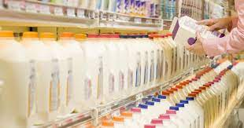
Milk Allergy
A milk allergy is an abnormal response to milk and products containing milk. It's very common in children, with cow's milk being the usual cause. However, sheep, goat, buffalo, and other mammal milk can also cause a reaction.

Slide 18
The signs and symptoms of a milk allergy range from mild to severe and include:
wheezing
vomiting
hives
digestive problems
itching or tingling around the lips or mouth
swelling of the lips, tongue or throat
coughing
shortness of breath
loose stools or diarrhea containing blood
abdominal cramps
a runny nose
watery eyes
colic (in babies)

Slide 19
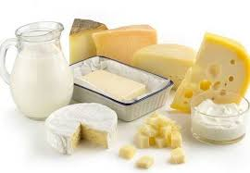
When studying food labels for milk and milk product allergens, staff should specifically look for casein, which can be hidden in canned tuna, sausage and other nondairy products. More obvious sources are:
whole milk, low-fat milk, skim milk, and buttermilk
butter
yogurt
ice cream
cheese and anything that contains cheese
half-and-half
baked goods
processed meats
whey
https://www.mayoclinic.org/diseases-conditions/milk-allergy/symptoms-causes/syc-20375101?p=1
casein
ingredients spelled with the prefix "lact" (such as lactose and lactate)
chocolate, nougat and caramel
protein powders
artificial butter flavor
artificial cheese flavor
hydrolysates
Even if a food item is labeled "milk-free" or "nondairy," it could still contain allergy-causing milk proteins. So, staff must always contact an item's manufacturer for clarification.^{[1]}

Slide 20
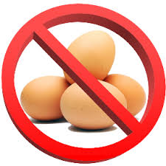
Eggs
An egg allergy is the result of the body's immune system overreacting to proteins found in eggs. Approximately two percent of children are allergic to eggs, but they may outgrow the allergy by the time they're 16 years old.

Slide 21
The signs and symptoms of an egg allergy include:
wheezing
trouble breathing
coughing
hoarseness
throat tightness
stomachache
vomiting
diarrhea
itchy, watery, or swollen eyes
hives
red spots
swelling
a drop in blood pressure
lightheadedness or loss of consciousness

Slide 22
Egg Allergy
Like with some other allergies, an egg allergy can affect the same person differently at different times. They may be mild and affect just only one system of the body, like the skin. Or they may be more severe and affect several parts of the body. It can also cause anaphylaxis despite the severity of previous reactions.
Because eggs can be found in unexpected places, reading the labels of ingredients is extremely important. Statements to look out for include "may contain egg," "processed in a facility that also processes eggs," or "manufactured on equipment also used for eggs." Questions about cross-contamination should be directed to a food item's manufacturer since federal law does not require that information on labels.
If a guest shows signs of an egg allergy, 911 should be dialed immediately if the guest cannot get access to or self-administer an epinephrine shot. Epinephrine should be administered if the symptoms involve two different parts of the body, or if there's swelling of the mouth or throat, or difficulty breathing.
https://kidshealth.org/en/parents/egg-allergy.html/

Slide 23
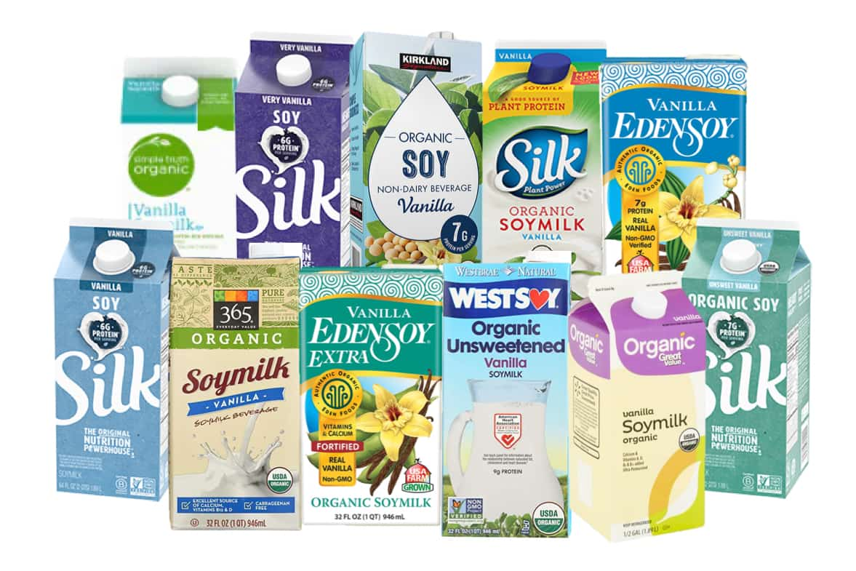
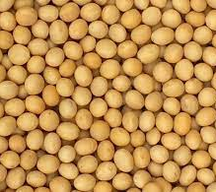
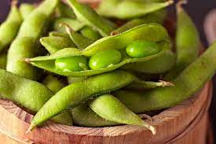
Soybeans
A soy allergy is more common in infants and young children. Many children outgrow this type of allergy; however, some people keep the allergy for a lifetime. The allergy works when proteins in the soy bind to specific IgE antibodies made by the immune system. This triggers immune defenses and causes mild or very severe symptoms.
One study found that up to 88% of people allergic to soy products were also sensitive to peanuts, tree nuts, eggs, milk and sesame. And although reactions are usually mild, all of them can be unpredictable.
People with this type of allergy should avoid soy and all soy products. Soybeans are widely used in processed food products. Fortunately, federal law requires that it be listed on packaged foods sold in the U.S. within an ingredient list or in a separate "Contains" statement.

Slide 24
Some food items that contain soy include:
cold-pressed, expelled or extruded soy oil
edamame
miso
natto
okara
shoyu
soy (soy albumin, soy cheese, soy fiber, soy flour, soy grits, soy ice cream, soy milk, soy nuts, soy sprouts, soy yogurt)
soya
soybean (curd, granules)
soy protein (concentrate, hydrolyzed, isolate)
soy sauce
tamari
tempeh
textured vegetable protein (TVP)
tofu

Slide 25
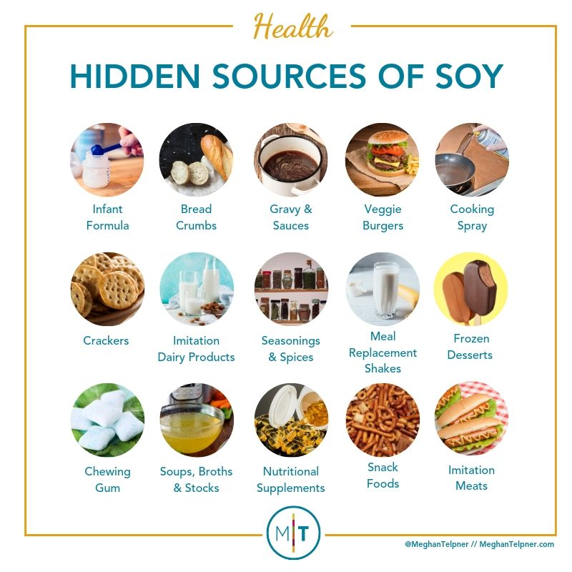
Soy Allergy
It's important to note that most people with soy allergy can safely eat highly refined soy oil as well as soy lecithin. Therefore, federal laws do not require it to be labeled as an allergen. Guest must still avoid cold-pressed, expelled or extruded soy oils – or – gourmet soy oils because they're not highly refined and could contain small amounts of soy protein.

Slide 26

Other foods that may contain soy include:
Chinese, Indian, Indonesian, Thai and Vietnamese cuisine
cereals, breads, chips, crackers, pasta, rice, tortillas and rice prepared with soy
vegetable gum
vegetable starch
vegetable broth
https://www.foodallergy.org/living-food-allergies/food-allergy-essentials/common-allergens/soy

Slide 27
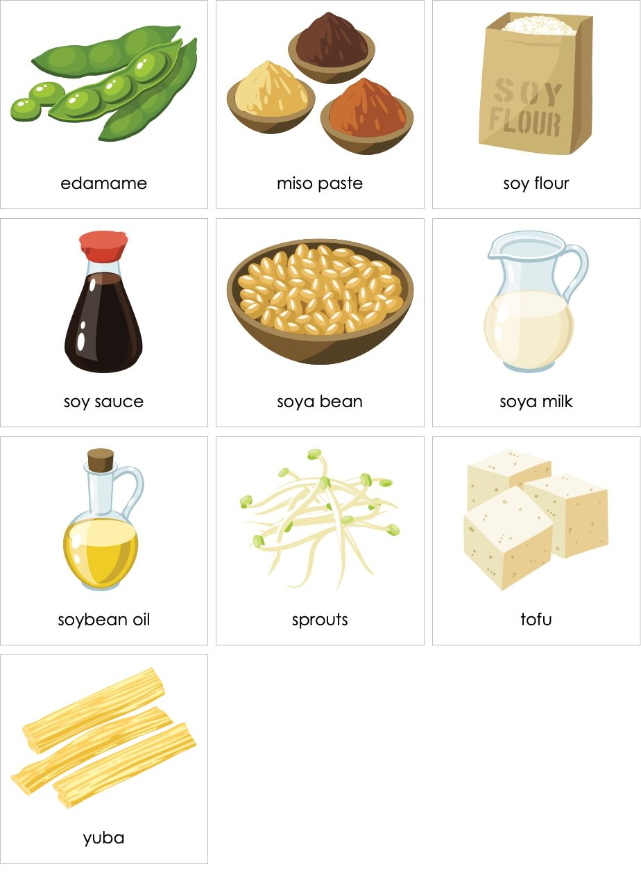
Unexpected sources include:
baked goods
canned broths and soups
canned tuna and meat
cereals
cookies
high-protein energy bars and snacks
dairy products (like ice cream and yogurt)
low-fat peanut butter
processed meats
sauces
sausages^{[1]}

Slide 28
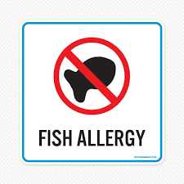
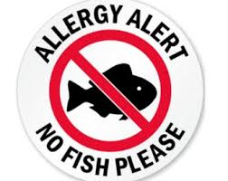
Fish
Fish allergies differ from seafood allergies in that seafood includes both fish (tuna or cod) and shellfish (lobster or clams). Also, people may be allergic to only some fish and not others. Reactions may occur after consumption, after touching fish, or after breathing vapors from cooking fish.
A fish allergy can develop at any age too, so even people who may have been able to eat fish in the past could develop an allergy that will last a lifetime.

Slide 29
The signs and symptoms of a fish allergy, which is the result of the body's immune system overreacting to proteins in the fish, include:
wheezing
trouble breathing
coughing
hoarseness
throat tightness
belly pain
vomiting
diarrhea
itchy, watery, or swollen eyes
hives
red spots
swelling
a drop in blood pressure
lightheadedness or loss of consciousness

Slide 30
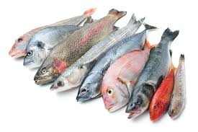
Fish Allergy
People who are allergic to fish should not eat it or any food that contains fish as ingredients. People who are sensitive to just the smell of cooking fish should avoid areas where it's being cooked as well.
In addition, staff should always read food labels to see if a food item contains fish. By law, manufacturers must state whether food items contain fish and list it in an ingredient list or display "Contains fish," "May contain fish," "Processed in a facility that also processes fish," or "Manufactured on equipment also used for fish" on a label.
Confirming the possibility of cross-contamination with the manufacturer is advised since cross-contamination labeling is not required. Most cross-contamination happens in Chinese, Vietnamese, Thai, or Japanese restaurants, where staff uses the same surfaces, utensils, or oil to prepare fish and other foods. Fried foods are also at risk since they may be fried in the same oil used to fry fish.
Calling 911 is recommended for any guest who experiences swelling of the mouth or throat or has difficulty breathing if they don't have access to epinephrine. If symptoms affect two different parts of the body, like hives with vomiting, calling 911 is necessary as well. And just like with shellfish (described later), guests having an allergic reaction will need supervision until help arrives because a second wave of serious symptoms can occur even if the first wave was mild.^{[1]}
https://kidshealth.org/en/parents/fish-allergy.html

Slide 31
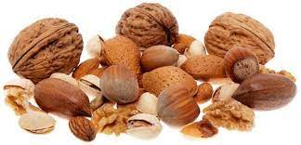
Tree Nut Allergy
Tree nut allergies are reactions to walnuts, almonds, hazelnuts, pecans, cashews and pistachios. About 50% of children who are allergic to one tree nut are allergic to another one.^{[1]} And about two-thirds of patients who react to cashews or walnuts will react to pistachios or pecans – in that order. Many children who are allergic to one or more tree nuts stay allergic to them for a lifetime.
The allergy works by the nut's proteins binding to specific IgE antibodies in the immune system. This triggers immune defenses and causes symptoms that can be mild or very severe. In fact, tree nuts can cause anaphylaxis, be unpredictable, and cause a reaction even in very small amounts.
To prevent a reaction, susceptible people must avoid all tree nuts and tree nut products because if they're allergic to one type, chances are they're allergic to other types. They should additionally avoid peanuts since the probability of cross-contact with tree nuts during manufacturing and processing is high.

Slide 32
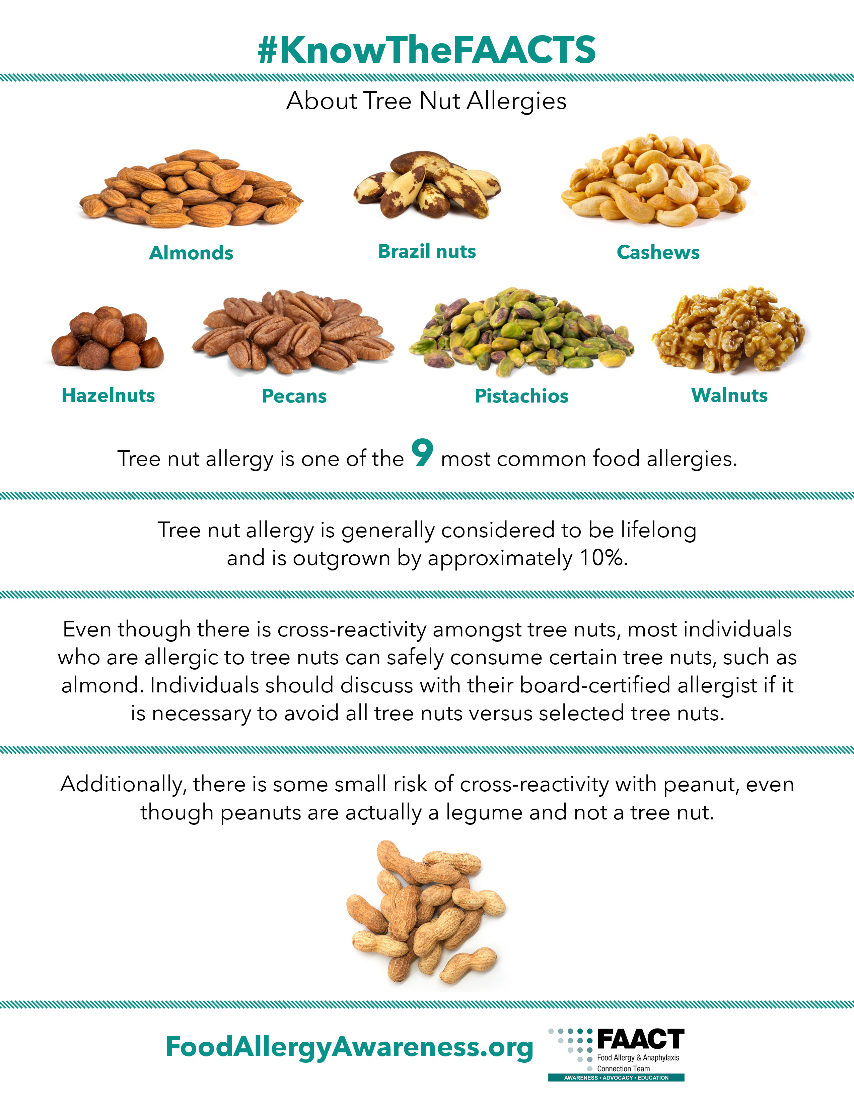

Slide 33
Foods that contain tree nuts include:
nangai nuts
natural nut extract (almond, walnut, etc.)
nut butters (like cashew butter)
nut distillates/alcoholic extracts
nut meal
nut meat
nut milk (almond milk, cashew milk, etc.)
nut oils (walnut oil, almond oil, etc.)
nut paste (like almond paste)
nut pieces
pecan
pesto
pili nuts
pine nuts (also known as indian, pignoli, pigñolia, pignon, piñon and pinyon nuts)
pistachios
pralines
shea nuts
walnuts
walnut hull extract (flavoring)
almonds
artificial nuts
beechnuts
black walnut hull extract (flavoring)
brazil nuts
butternuts
cashews
chestnuts
chinquapin nuts
coconuts
filbert/hazelnuts
gianduja (a chocolate-nut mixture)
ginkgo nuts
hickory nuts
litchi/lichee/lychee nuts
macadamia nuts
marzipan/almond paste

Slide 34
Tree Nuts
Some unexpected sources of tree nut proteins include cereals, crackers, cookies, candy, chocolates, energy bars, flavored coffee, frozen desserts, marinades, barbeque sauces and some cold cuts like mortadella. Even some alcoholic beverages may contain nut flavoring. And because these beverages are not federally regulated for allergens, staff may need to call the manufacturer to determine the safety of their ingredients.
McWilliam V, et al. Patterns of tree nut sensitization and allergy in the first 60 years of life in a population-based cohort. J Allergy Clin Immunol 2019;143(2):644.
https://www.foodallergy.org/living-food-allergies/food-allergy-essentials/common-allergens/tree-nut

Slide 35
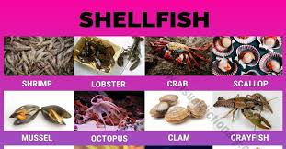
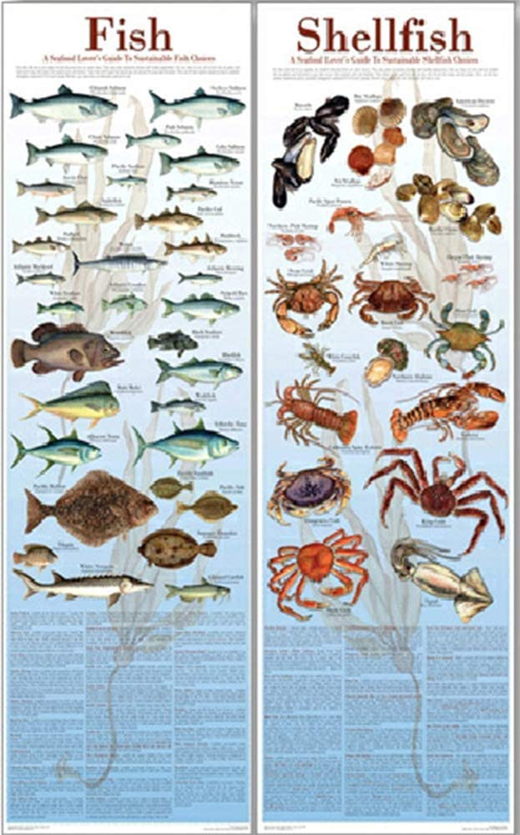
Shellfish
A shellfish allergy is a reaction to crustaceans (shrimp, crab, or lobster) and mollusks (clams, mussels, oysters, scallops, octopus, or squid). Some people who are allergic to crustaceans are also allergic to mollusks. The others are allergic only to one. And most allergic reactions happen after their consumption.
Sometimes, however, just touching shellfish or breathing in the vapors from cooking shellfish is enough to cause a reaction. A shellfish allergy can also develop at any age – even for people who've eaten shellfish without a problem in the past. And it usually lasts for a lifetime.

Slide 36
The signs and symptoms of a shellfish allergy are:
wheezing
trouble breathing
coughing
hoarseness
throat tightness
stomachache
vomiting
diarrhea
itchy, watery, or swollen eyes
hives
red spots
swelling
a drop in blood pressure
lightheadedness or loss of consciousness

Slide 37
Shellfish Allergy
all these symptoms occur when the body's immune system overreacts to the proteins found in shellfish. Once consumed, touched, or inhaled, the body responds to these proteins as invaders and then releases chemicals like histamine.
This type of allergy can affect the same person differently at different times. Symptoms may be mild and affect just only one system of the body, like the skin. Or they may be more severe and affect several parts of the body. It can also cause anaphylaxis despite the severity of previous reactions.
To prevent allergic reactions, shellfish-sensitive guests must not eat any foods that contain shellfish. Kitchen staff should therefore look for it on food labels and in the ingredient list of recipes. Food that contains shellfish will show "Contains shellfish," "May contain fish," "Processed in a facility that also processes fish," or "Manufactured on equipment also used for fish" on the label.
https://kidshealth.org/en/parents/shellfish-allergy.html

Slide 38
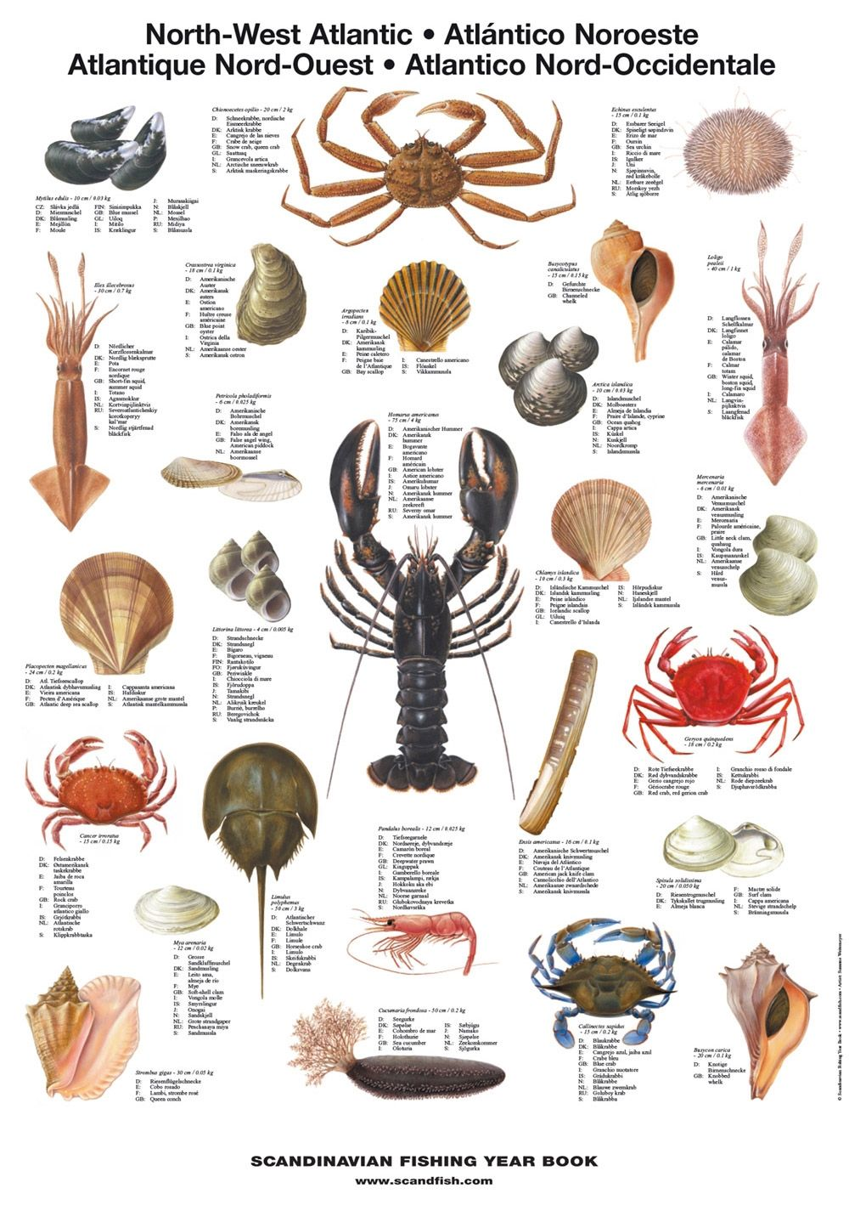
Shellfish
Since not all companies include cross-contamination labeling, staff should contact a food's manufacturer to be sure it's safe. By law, manufacturers do not have to list shellfish cross-contamination information or mollusk shellfish ingredients. Mollusk shellfish aren't considered a major food allergen. So, when a label states a food item contains shellfish, it's referring to crustacean shellfish.
When it comes to cross-contamination, shellfish is especially prone to cross-contact in seafood restaurants and in a lot of Chinese, Vietnamese, Thai, or Japanese restaurants. People who are allergic to shellfish are often warned to stay away from those types of restaurants, steam tables, or wherever it's cooked on a communal grill.
If a guest shows signs of shellfish allergy, 911 should be dialed immediately if they cannot get access to or self-administer an epinephrine shot. Epinephrine should be administered if the symptoms involve two different parts of the body, or if there's swelling of the mouth or throat, or difficulty breathing.
Guests having an allergic reaction also need supervision until help arrives because a second wave of serious symptoms can occur even if the first wave was mild.^{[1]}

Slide 39
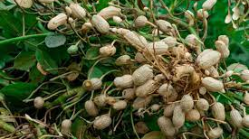
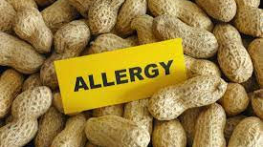
Peanuts
A peanut allergy is known for causing severe allergy attacks. It's the most common cause of food-induced anaphylaxis, and just a small amount of peanuts is life-threatening for some people.
The symptoms of a peanut allergy usually show up within minutes after exposure and include:
hives, redness, or swelling on the skin
itching or tingling in or around the mouth and throat
diarrhea, stomach cramps, nausea or vomiting
a tightening of the throat
shortness of breath or wheezing
a runny nose
https://www.mayoclinic.org/diseases-conditions/peanut-allergy/symptoms-causes/syc-20376175?p=1.

Slide 40
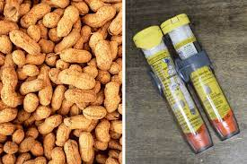
Peanut allergy
Exposure to peanuts can occur by direct contact (eating peanuts or peanut-containing foods and direct skin contact) or by cross-contact (peanut matter in a product introduced during processing or handling). Inhaling dust or aerosols containing peanuts, like peanut flour or peanut oil cooking spray, can cause a reaction, too.
A guest who shows signs of a severe peanut allergy needs emergency treatment as soon as possible. But if a guest shows signs of anaphylaxis, 911 should be dialed immediately – especially if they experience severe dizziness, severe trouble breathing or loss of consciousness.^{[1]}

Slide 41

Wheat
A wheat allergy is an allergic reaction to foods containing wheat. And it does not need to be eaten to have an effect. Inhaling wheat flour will cause an allergic reaction as well. Unfortunately, wheat is in many foods, including soy sauce, ice cream, and hot dogs.
A wheat allergy is also sometimes confused with celiac disease. But there's a significant difference. A wheat allergy is the result of the body producing antibodies to the proteins found in wheat. A celiac disease is the result of an abnormal immune system reaction to gluten, a specific protein in wheat.

Slide 42
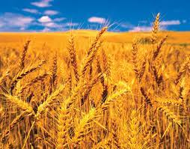
Wheat Allergy
The signs and symptoms of a wheat allergy are:
swelling and/or itching of the mouth or throat
hives, an itchy rash, and swelling of the skin
nasal congestion
headache
difficulty breathing
cramps, nausea, or vomiting
diarrhea
anaphylaxis

Slide 43
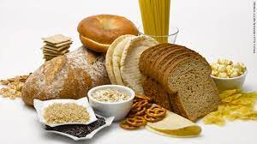
Wheat proteins are found in:
bread and bread crumbs
cakes, muffins and cookies
breakfast cereals
pasta
couscous
farina
semolina
spelt
crackers
Hydrolyzed vegetable protein
Soy sauce
Meat products like hot dogs
Dairy products like ice cream
Natural flavorings
Gelatinized starch
Modified food starch
Vegetable gum

Slide 44
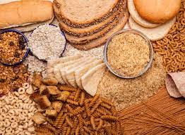
Wheat Allergy
Persons who have wheat allergy might also be allergic to barley, oats and rye.
If someone shows signs of anaphylaxis, 911 should be dialed immediately – especially since a child or adult with wheat allergy is likely to develop these signs and symptoms within minutes to hours after consuming a wheat product or wheat protein product that contains albumin, globulin, gliadin, or gluten.^{[1]}
https://www.mayoclinic.org/diseases-conditions/wheat-allergy/symptoms-causes/syc-20378897?p=1.

Slide 45
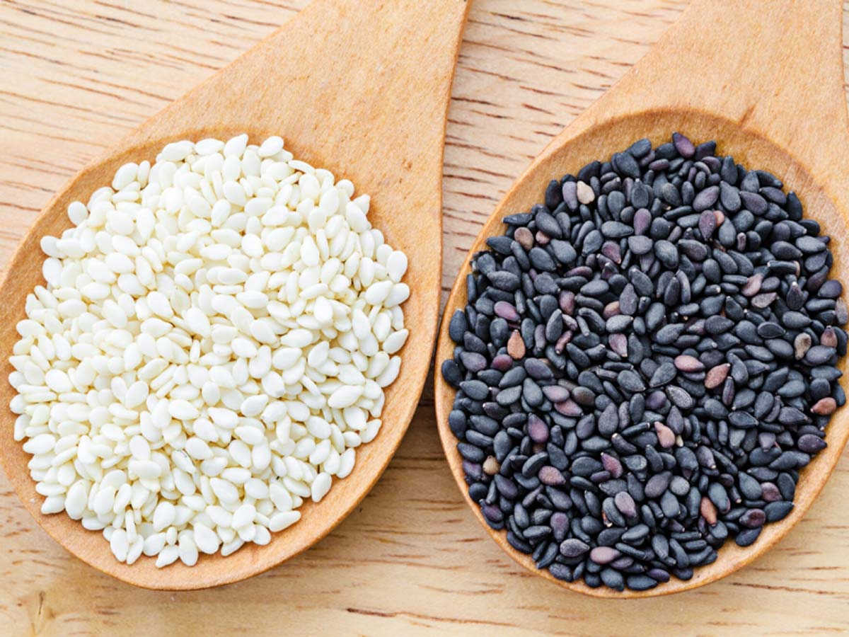
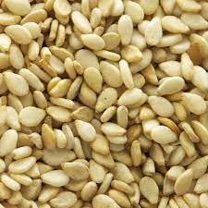
SESAME
9th most common food allergen and is found in many popular dishes, including hummus, under the name “tahini.” According to the FDA, “Under the FASTER Act of 2021, sesame is being added as the 9th major food allergen effective January 1, 2023. Until that time, manufacturers do not have to list it as an allergen, although in most cases it must appear in the ingredient statement. An exception is when sesame is part of a natural flavoring or spice.”

Slide 46
Symptoms of an allergic reaction may involve the skin, the gastrointestinal tract, the cardiovascular system and the respiratory tract. They can surface in one or more of the following ways:
Vomiting and/or stomach cramps
Hives
Shortness of breath
Wheezing
Repetitive cough
Shock or circulatory collapse
Tight, hoarse throat; trouble swallowing
Swelling of the tongue, affecting the ability to talk or breathe
Weak pulse
Pale or blue coloring of skin
Dizziness or feeling faint

Slide 47
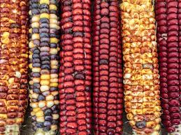
Other common foods that cause allergies
Corn Allergy
Although rare, allergic reactions to corn may result after consuming it raw or cooked.
Meat Allergy
Allergic reactions to beef, chicken, mutton or pork, are rare as well. However, according to one study, almost eight percent of 62 children with a milk allergy were also allergic to beef. And people who are allergic to mammalian meat may experience allergic symptoms three to six hours after consuming beef, pork or lamb. This is typically the result of consuming meat of an animal that suffered from a bad case of tick bites.
https://www.foodallergy.org/living-food-allergies/food-allergy-essentials/common-allergens/other-food-allergens

Slide 48
Other allergies:
Gelatin Allergy
Gelatin is a by-product formed from boiling an animal's skin or connective tissue. Allergic reactions to gelatin are rare, which is good since porcine (pig) gelatin is commonly used in vaccines. People who are allergic to gelatin have to seek out vaccines without this type of ingredient.
Seed Allergy
Sesame, sunflower, and poppy seeds can produce a severe reaction in about 0.1 percent of the American population. This is important because they can be used in bakery and bread products and even hair care products. Fortunately, the way some seeds are processed removes allergy-causing proteins from the oil.

Slide 49
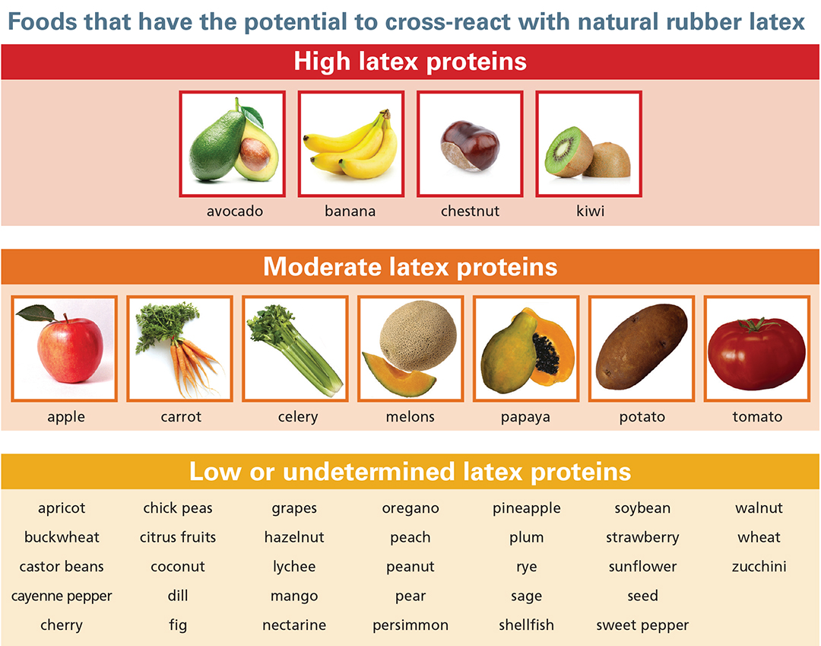
Spice and Fruit and Vegetable allergies
Spice Allergy
Coriander, garlic and mustard allergies are rare and typically mild. People who are already sensitive to mugwort and/or birch pollen in the environment, however, may develop a spice allergy quicker than others.
Fruits and Vegetables
People who are allergic to fruits and vegetables like apples, carrots, peaches, plums, tomatoes and bananas are often diagnosed with Oral Allergy Syndrome.^{[1]}

Slide 50
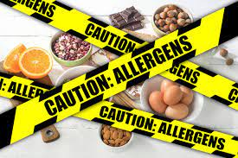
How long do allergic reactions take?
Almost all severe allergic reactions occur within seconds or minutes after a person has been exposed to an allergen. Anaphylaxis is an example. And without treatment, the condition could worsen and cause death within just 15 minutes. Allergens that typically occur after food is consumed could occur after several hours. Only in very rare cases do reactions develop after 24 hours.

Slide 51
Cures/Treatments/Medications
The most common treatment for food allergies is avoidance of the foods that trigger them. That includes avoiding both consumption and touch. Allergens can enter the body after someone touches a food product or the surface that the product contacted, and then touches their eyes or nose. It can also even mean avoiding inhaling specific spices.
Unfortunately, it isn't always easy to avoid these allergens because companies don't always have to declare their presence on food labels. This makes it extremely important for people with food allergies to have the necessary medications on hand.
https://www.drugs.com/monograph/epinephrine-systemic.html
"European Food Allergy and Anaphalaxis Public Declaration". the European Academy of Allergy and Clinical Immunology (EAACI).
Sicherer 2006, p. 131

Slide 52
Medications to treat allergens:
Epinephrine
Epinephrine is used to treat anaphylaxis.^{[1]} It's required immediately after coming into contact with an allergen -- often with a second dose. Additional treatment such as antihistamines and steroids may be administered in an emergency room.^{[2]}
On hand, portable, single-dose epinephrine autoinjectors can be used while a person is being transported to a hospital. And it works by reducing swelling and obstruction in the airway and improving blood circulation. In fact, if taken immediately after a severe reaction, it can reverse the effects of anaphylaxis.
Antihistamines
Antihistamines are used to relieve mild symptoms of an allergic reaction. But they're ineffective against all the symptoms of anaphylaxis. They work by (1) blocking histamine, which dilates blood vessels, and (2) affecting sensory nerve terminals, which causes itchiness. Diphenhydramine is the most common antihistamine administered for food allergies.
Steroids
During an allergic reaction, released chemicals attack immune cells. So glucocorticoid steroids -- in the form of a nasal spray, pills, or injection -- are used to calm the cells down. But it too is ineffective against anaphylaxis. Steroids only relieve symptoms in the area in which they contact. They also delay efforts to reduce inflammation. This is because steroids in general take a long time to take effect.^{[3]}

Slide 53
Section 3: Allergic Reaction Prevention

Slide 54
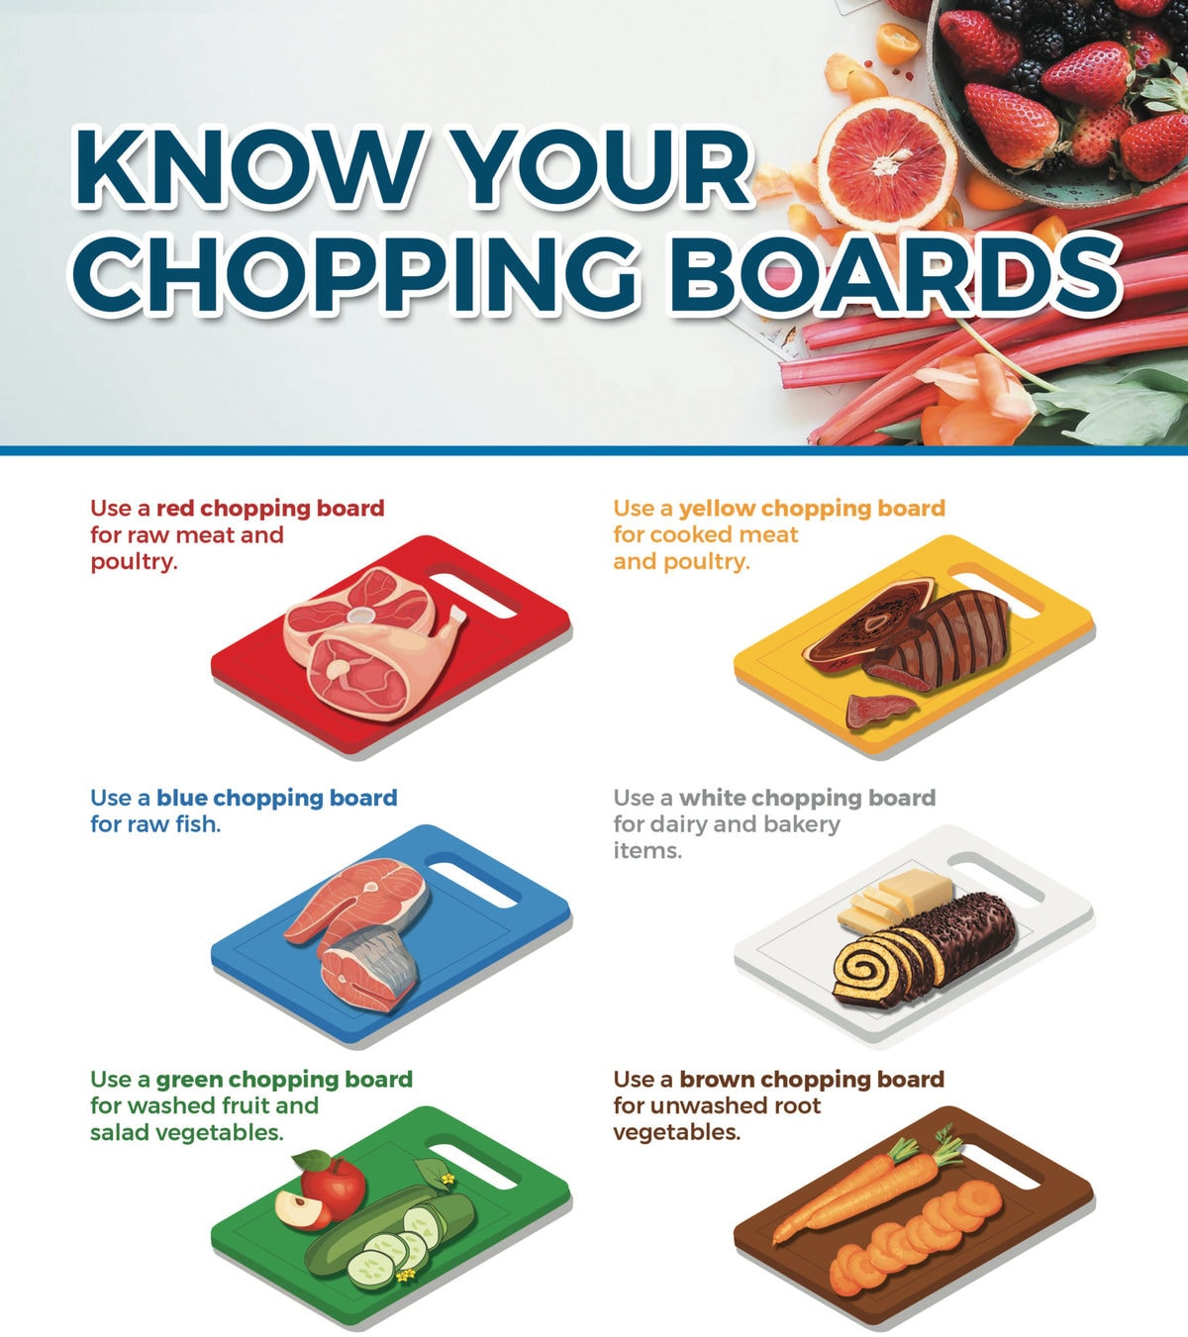
Cross contamination
Cross-contamination occurs when allergens transfer from one item to another. This transfer can take place during direct contact (unclean hands, foods, equipment, or equipment touching other foods), and from surfaces and sinks that have not been properly cleansed before coming into contact with other foods.
A good example of cross-contamination is when one cutting board is used to cut both raw chicken and raw vegetables without washing or changing the board between foods.
Importance of using separate cookware and oils
Food Handling Class, North American Learning Institute, https://nalearning.org.

Slide 55

Cross-Contamination
Keeping specific foods, equipment, and utensils separated from each other is a very effective way to reduce cross-contamination. Remnants from non-allergy-free food items, for example, must never touch allergy-free food items.

Slide 56
Cross-Contamination:
Bacteria/viruses
Bacteria can cause severe illnesses such as tuberculosis, pneumonia, foodborne illnesses, tetanus, typhoid fever, diphtheria, syphilis, and leprosy. It's actually a broad term that describes any bacteria that causes an illness.
Like bacteria, viruses are microorganisms that can cause illnesses. But unlike bacteria, viruses don't reproduce on food. They reproduce in living things only and merely use food as transportation. They're also 100 times smaller than bacteria.

Slide 57
Foodborne illness
A foodborne illness (food poisoning) is an illness that occurs after people eat food that's contaminated with germs, toxins, or some other form of physical contamination. Symptoms of a foodborne illness include diarrhea, vomiting, fever, cramping, and nausea; and they may last for several days and even cause death.^{[1]}

Slide 58

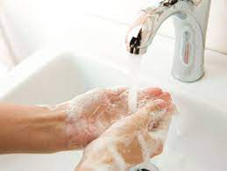
PROPER HAND WASHING
When to wash
All staff must wash their hands after sneezing, coughing, touching the mouth, touching the nose, using the bathroom, smoking, using toothpicks, handling raw foods, cleaning, and handling toxic objects, soiled objects, garbage, and money.
Kitchen staff members must wash their hands (including exposed portions of their arms) before they start food preparation, working with exposed food, and cleaning equipment and utensils. They must additionally wash their hands:
after handling dirty equipment or utensils
when changing tasks that involved exposed food
when switching between raw food and ready-to-eat food
before putting on gloves for tasks that involve food
after all other activities that might contaminate the hands

Slide 59
HOW TO WASH
Kitchen staff must follow a specific procedure to clean their hands (including exposed portions of their arms):
rinse hands under clean, running warm water
apply a generous amount of the recommended soap
vigorously rub the hands together for at least 10 to 15 seconds while removing dirt under the fingernails
thoroughly rinse the hands under clean, running warm water
Immediately follow hand washing with the recommended drying method like disposable paper towels.

Slide 60
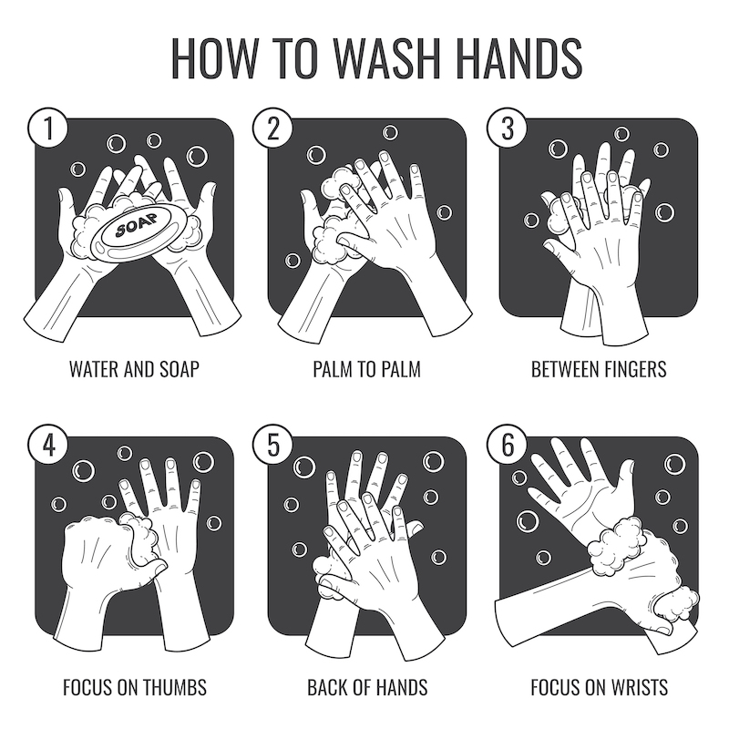
HANDWASHING

Slide 61
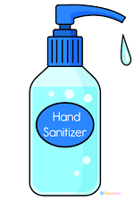
Using hand sanitizer
Hand sanitizing lotions or solutions may be used in addition to handwashing, but they are too inefficient to be used alone. They must, therefore, be used only on cleaned hands.
They must also be made with approved antimicrobial ingredients listed in the FDA publication Approved Drug Products with Therapeutic Equivalence Evaluations or the FDA monograph for OTC Health-Care Antiseptic Drug Products. Hand sanitizers that are used as a hand dip must be as strong as 100 MG/L chlorine.
Hand sanitizers that don't meet the above criteria may be used only if they're followed by (1) thorough hand rinsing in clean water before contacting food or using gloves or (2) situations that don't involve touching food.^{[1]}
https://www.agriculture.pa.gov/consumer_protection/FoodSafety/Retail%20Food/Retail%20Foods%20Facilities%20and%20Restaurants/Documents/FDA%20Food%20Code%202017.pdf.

Slide 62

PERSONAL HYGIENE
Outerwear
Both clothing and footwear, including uniforms, must be kept clean. They should be used for work only.^{[1]} Clean clothing helps prevent contamination of food, equipment, utensils, linens, and other service items. If applicable to the staff's responsibilities, the use of clean aprons is always a must.
Jewelry
Kitchen staff can wear a plain ring only, such as a wedding band, while preparing food. No medical information jewelry may be worn on the arms or hands.
BC Cook Articulation Committee. (2015). Food Safety, Sanitation, and Personal Hygiene. Victoria, B.C.: BCcampus. Retrieved from https://opentextbc.ca/foodsafety.

Slide 63
Body and hair washing
Hair must be kept clean and covered or tied back prior to preparing and serving food. In addition, food workers must perform the following each day:
shave
shampoo
shower
comb hair
Federal law requires kitchen staff to wear hair restraints, like hats, hair coverings or nets, beard restraints, and clothing that covers body hair, to prevent hair from contacting exposed food, clean equipment, utensils, and linens. Employees who work in other areas, such as the counter staff, hosts, and wait staff, don't have to follow this rule if they have a small risk of contaminating food, equipment, utensils, and linens.
The kitchen staff is required to keep their fingernails clean, trimmed, and filed so that the edges are not rough and cannot catch any food, rip open packages of food, or tear open gloves. Fingernail polish or artificial fingernails is not allowed when working with food unless staff wears intact gloves.

Slide 64

Washing dishes
Pre-rinse
Pre-rinsing is a step designed to remove food that remains after scraping. It also reduces energy and water costs during the washing stage, as the hot water and high water pressure will loosen stuck food.
Rinse
Rinsing occurs in the second (middle) sink of a 3-compartment sink. In this sink, clean, hot water is used to remove detergent residue and any remaining particles of food from utensils and equipment. The temperature of a hot water rinse should be between 100°F to 110°F. For a cold water rinse, the temperature should be between 70-75°F.
Hot water sanitization
Hot water sanitization cleans items with hot, steamy water. Proper sanitation requires that utensils and equipment sit in hot water (171°F) for 30 seconds.
Chemical sanitization
Chemical sanitization requires that utensils and equipment sit in an approved chemical-solution for at least one minute. Since this is a chemical-based step, it's important to:
keep the temperature of the solution cool, as high temperatures may cause the chemical(s) to evaporate from the solution; and
prevent over-use as using too much of a chemical may contaminate the food and sicken customers.

Slide 65
Sanitation Standard Operating Procedures (SSOP)
Sanitation Standard Operating Procedures (Sanitation SOPs) are written procedures for preventing direct contamination of a product. All food establishments are required to maintain written procedures on-site and make them available to the USDA Food Safety and Inspection Service (FSIS) upon request.
Note that this policy requires daily documentation of attempts to follow its procedures, including any corrective actions.

Slide 66
Sample SSOP
SAMPLE – SANITATION STANDARD OPERATING PROCEDURE (SSOP)
COMPANY NAME is a red meat processing establishment. This plant receives beef and pork for further processing. This plant cuts and grinds product and also packages it.
MANAGEMENT STRUCTURE
Owner –
Plant Manager –
Team Captains –
The Team Captains are responsible for implementing and daily monitoring of Sanitation SOP and recording the findings and any corrective actions. The Team Captains are responsible for training and assigning specific duties to other employees and monitoring their performance within the Sanitation SOP. All records, data, checklists, and other information pertaining to the Sanitation SOP will be maintained on file and made available to inspection personnel.

Slide 67
I. Preoperational Sanitation – Equipment and Facility Cleaning Objective
A. All equipment will be disassembled, cleaned, and sanitized before starting production.
1. Sanitary procedure for cleaning and sanitizing equipment.
a. All equipment will have product debris removed.
b. Equipment will be rinsed with water to remove remaining debris.
c. An approved cleaner will be applied to equipment and properly cleaned.
d. Equipment will be sanitized with approved sanitizer and rinsed with potable water.
e. The equipment is reassembled.

Slide 68
2. Implementing, Monitoring and Recordkeeping
Team Captains perform daily organoleptic sanitation inspection after preoperational equipment cleaning and sanitizing. The results will be recorded on a Preoperational sanitation form. If found to be acceptable, the appropriate line will be checked. If corrective actions are needed, such actions will be documented.

Slide 69
3. Corrective Actions The Team Captains determines that the equipment on hand does not pass organoleptic examination, the cleaning procedure and inspections are repeated. The Team Captains monitor the cleaning of the equipment on hand and retrains employees if necessary. Corrective actions are recorded on Pre-Operational sanitation forms.
B. Cleaning of Facilities including floors, walls, and ceilings.
1. Cleaning procedures:
Debris is swept up and discarded.
Facilities are rinsed with potable water.
Facilities are cleaned with approved cleaner.
Facilities are rinsed with potable water.
2. Cleaning of floors and walls are done at the end of each production day. Ceilings are cleaned as needed.
3. Establishment monitoring
The Team Captain performs daily organoleptic inspection before operation begins. Results are recorded on a preoperational sanitation form.
4. Corrective action
When the Team Captain finds that the facilities do not pass organoleptic inspection, the cleaning procedures and inspections are repeated. The Team Captain inspects the cleaning of the facilities and retrains employees as needed. Corrective action to prevent direct product contamination or adulteration are Recorded on Pre-operational sanitation forms.

Slide 70
II. OPERATIONAL SANITATION—EQUIPMENT AND FACILITY CLEANING OBJECTIVE
A. Processing is performed under sanitary conditions to prevent direct and cross contamination of the product.
1. Sanitary procedures for processing.
Employees clean and sanitize hands, gloves, knives, other hand tools, cutting boards, etc., as necessary during processing to prevent contamination of products.
All equipment tables and other product contact surfaces are cleaned and sanitized throughout the day as needed.
Outer garments such as aprons and gloves are hung in designed areas when employees leave processing area. Outer garments are maintained in a clean and sanitary manner and are changed at least daily and more often if necessary.

Slide 71
2. Monitoring and Recordkeeping
The Team Captains are responsible for ensuring that employees' hygiene practices, sanitary handling procedures and cleaning procedures are maintained. The Team Captain monitors the sanitation procedures during the day. Results are recorded on an Operational Sanitation Form daily.

Slide 72
3. Corrective Action
The Team Captain identifies sanitation problems and stops production if necessary and notifies processing employees to take appropriate action to correct sanitation problems. If necessary, processing employees are retrained, and corrective actions are recorded on Operational Sanitation form.

Slide 73
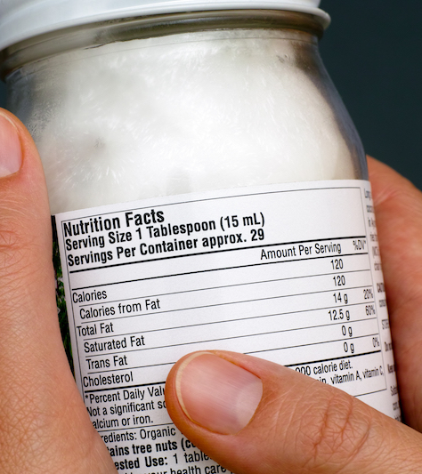
Part: 4 How to Read Food Labels

Slide 74
Food labels
FALCPA-regulated allergens can be identified in one the following ways:
In the ingredients list with the allergen's name.
After the word "Contains."
In the ingredients list in parentheses when an ingredient is a less common form of an allergen. An example is "albumin (egg)." Specific types of tree nuts, and fish and crustacean shellfish, are listed this way as well (example: almond, tuna, crab).

Slide 75
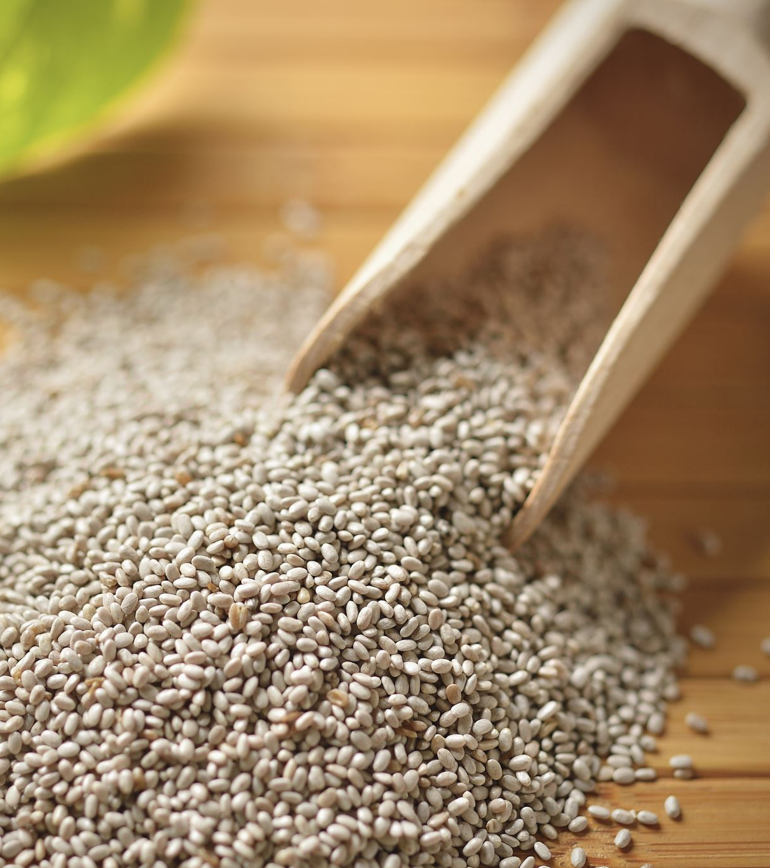
Non-FALCPA (Food Allergen Labeling and Consumer Protection Act of 2004) regulated allergens
Sesame, mustard, and other non-FALCPA -regulated allergens can be in food items, but they may not be listed separately if they're part of a spice or flavoring. In this case, they may be described as "natural flavorings." After Jan. 1, 2023, however, the Food Allergy Safety, Treatment, Education and Research (FASTER) Act of 2021 will require sesame products to have specific allergen labeling.^{[1]}
https://www.foodallergy.org/resources/how-read-food-label.

Slide 76
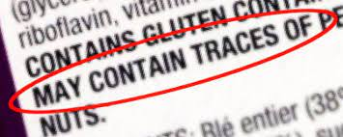
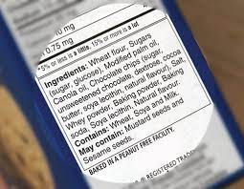
“May Contain” Statements
You may also notice other precautionary language on food labels. These include statements such as “may contain,” “processed in facility that also processes” or “made on equipment with.” These warnings often follow the ingredients list.
Such advisory labeling is voluntary for manufacturers. There are no laws governing or requiring these statements—neither when to include them nor what their wording should be. They may or may not indicate if a product unintentionally contains, or has come in contact with, a specific allergen. Likewise, the absence of an advisory label does not mean that a product is safe.
Per the U.S. Food and Drug Administration (FDA), advisory food labels “should not be used as a substitute for adhering to current good manufacturing practices and must be truthful and not misleading.”

Slide 77
More Tips for Reading Food Labels
Familiarize yourself with your allergen and the foods it often appears in. Food allergens can appear in surprising places and go by less-common names. Knowing your allergen inside and out will improve your sleuthing skills. Here are some tips for avoiding your allergen.
If you are unsure whether a product could have come in contact with your allergen(s), call the manufacturer. Ask them about their ingredients and manufacturing practices.
If you encounter a product that doesn’t have an ingredients list, don’t buy it.
Be extra careful with imported products. Food labeling regulations vary by country. Imported items are supposed to follow FALCPA and other domestic food labeling laws, but occasionally they do not.
A child with a food allergy can start checking food labels as soon as he or she learns to read. Practice at home and when you’re shopping—with help from an adult.

Slide 78

How to read food labels for food allergies:

Slide 79
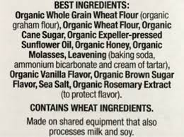
Other Allergen Statements
Phrases such as “peanut-free” and “egg-free” are not regulated. Product labels can bear these phrases but be made in facilities where the allergens are present. Always contact the manufacturer if you are unsure.

Slide 80
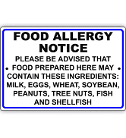
NM-AAA Food Allergy Policy
Section VII Number 714
Therapeutic Diet may be provided if:
The need has been determined, as evidenced by written diet order signed by a physician and placed in the consumer's file;
The necessary resources are available to the program; and
Supervision is provided by registered dietitian, or the meals are purchased from a qualified agency (hospital or similar facility) whose meal preparation is supervised by a registered dietitian.

Slide 81
Mom’s Meals
https://www.momsmeals.com/?gclid=Cj0KCQiAm5ycBhCXARIsAPldzoUmT3ylZH9vm9H4yo3TdApX1QCKyNx2hgKtYFKSaQSDYTh8TEf3kJIaAmnfEALw_wcB
Offers the following:
Diabetic Friendly
Vegetarian
Lower Sodium
Renal Friendly
Pureed
Heart-Friendly
Gluten free
Cancer Support

Slide 82
This presentation was adapted from the following:
North American Learning Institute Food Allergen Awareness class

Slide 83


Slide 84




